Slide 1
校園桌面雲基礎架構的自動化作業管理
林俊谷
Alan Lin,
VMware Taiwan

Slide 2
整合桌面與行動設備，即時存取相同的資料成為最重要的事
終端用戶運算
桌機與筆電
平板或手機
隨處可得的內容
整合的用戶工作區
與軟體定義資料中心整合的維運與管理
Notes:
Now, all of this comes together in an integrated solution.
Remember, best of breed and integrated. So, we spent a lot of time actually integrating many of the pieces.
There's integration between desktop and laptop, between mobile and content, not just with the workspace services, so you have things like single sign-on, but also for the Software-Defined Data Center.
Let me give you one example. If you think about VDI, one of the biggest costs is the way in which you effectively use storage.
When you use our Horizon View products on top of Virtual SAN, we believe we can take that cost down by 30-40 percent.
A unique advantage of bringing together the head and the body, or that big tall structure with the foundation, that's the type of advantage we bring to our customers.

Slide 3
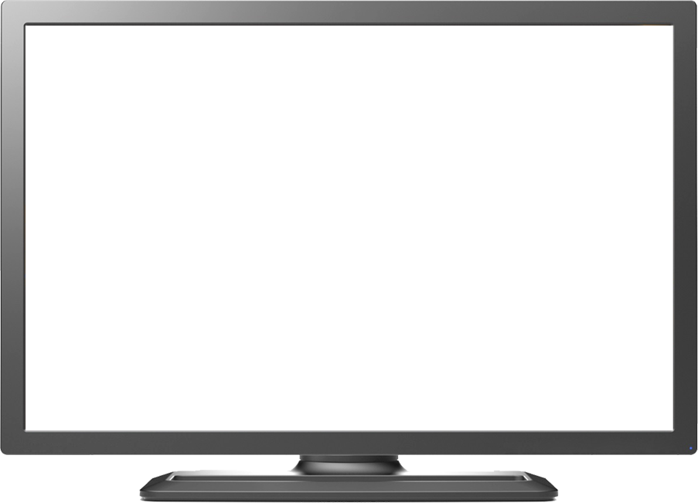
所有桌面與應用都可以由單一介面進行存取
HORIZON WORKSPACE
公有雲SaaS服務
虛擬 VDI 桌面
Citrix XenApp
遠端終端應用程式
Office 365
ThinApp封裝程式
Google Apps
單一登入 | 統合的用戶經驗 | 任意設備
Notes:
[SWITCH to Demo-1] - D2D-EUC1-Workspace-v2-final.exe
Applications that can be delivered and accessed through the
unified workspace across devices including Macs, Linux, Android, Windows, Thin Clients and Zero Clients include
RDS-hosted apps and desktops for Windows Server 2008 and
later
SaaS applications and web applications
ThinApp packaged applications ( 5.0 and later)
And
Citrix virtualized XenApp applictions ( 5.0 and later)
.

Slide 4
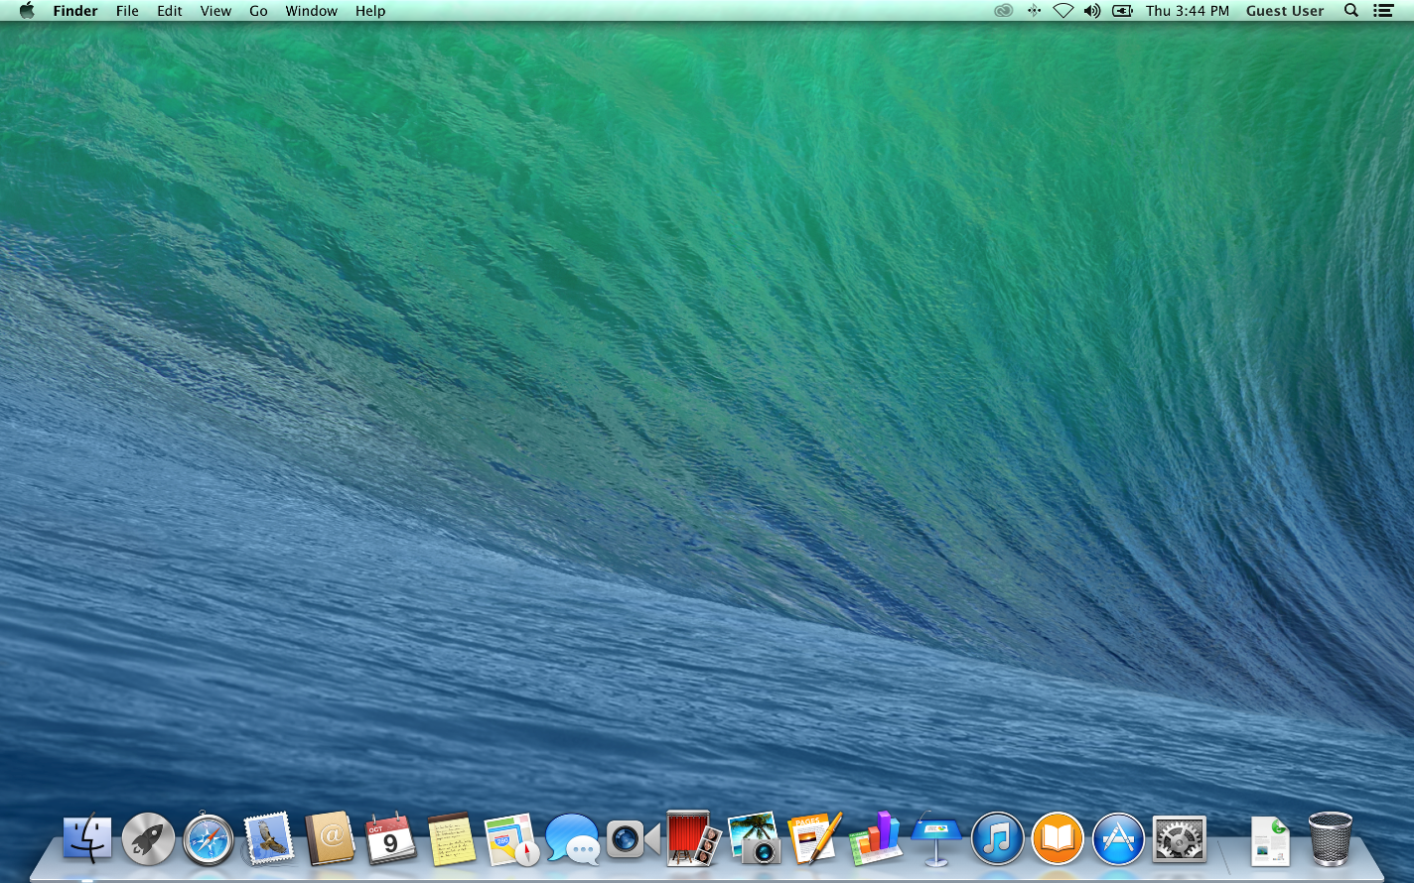
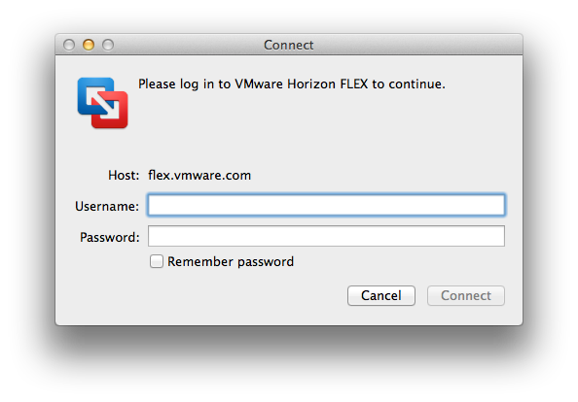
宣布推出Horizon Flex： 離線設備的集中管理與維護

Slide 5
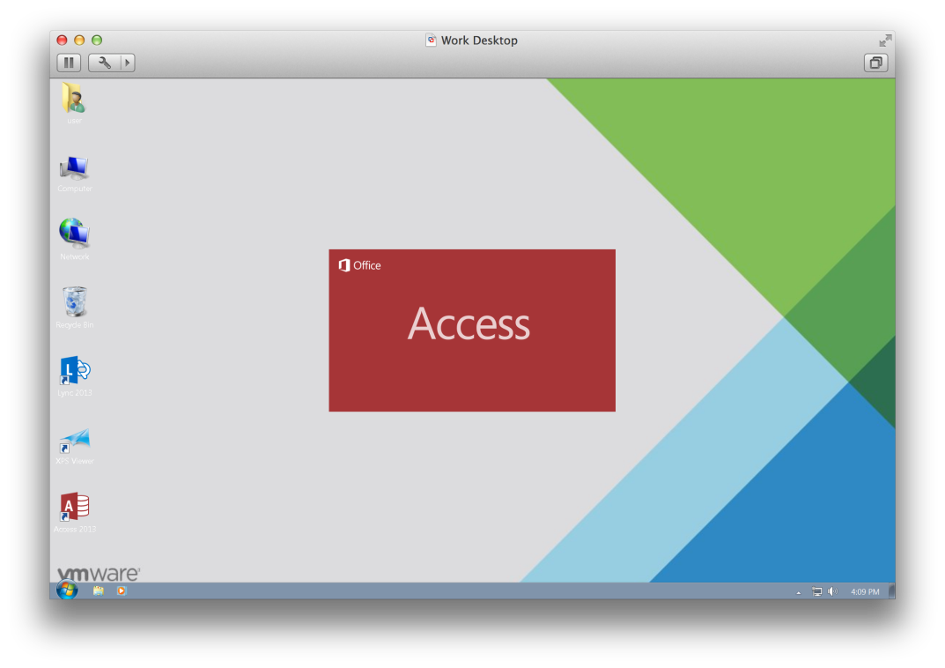
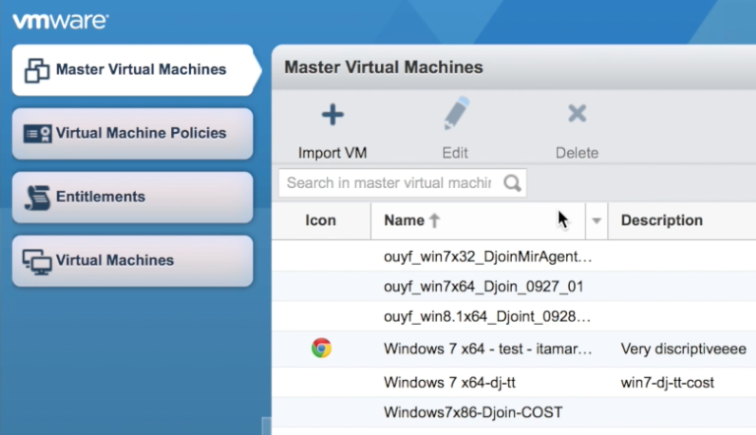
支援BYOD與離線使用的筆電工作站，提供集中管理、資料備份、與系統統一更新
Notes:
Competition: predictable landscape
Now: Competitors globally, new domains, new rules
Assets: Old mindset: “I have to control all the assets”
Now: Share or rent assets. Eg.Uber market cap ~ Renault
Innovation: Speed of prototype, Rapid Iteration. “Fail Fast”
App Deployment: Took months /years – now automated & instant
Customers: Used to target thousands – clear barriers to scaling
Now: With a great app, you can reach a billion customers
Org – Jim Collins famous book – Built to Last. Now – Built to Change!
T: Click to next slide – Status Quo

Slide 6
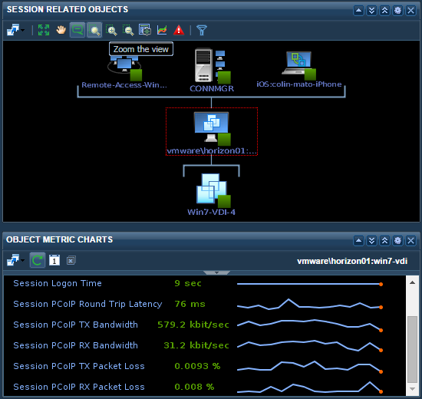
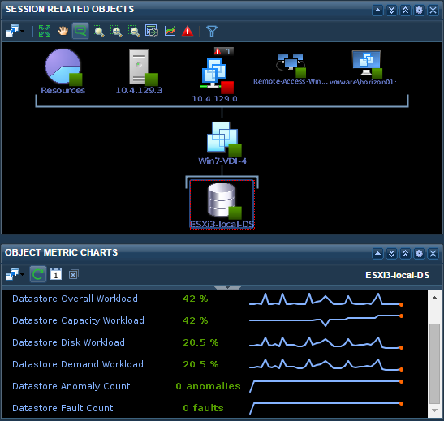
vRealize Operations for Horizon：提供與軟體定義資料中心一致的管理與監控介面
單一的監控介面
確保用戶使用者經驗
由連線到系統的整體監控
系統分析與報告
Notes:
Let’s first turn to vRealize Operations for Horizon- this solution provides IT with the ability to monitor, manage and troubleshoot infrastructure, desktops and apps. What you should know about vRealize Ops for Horizon…..
Single Pane of Glass
Manage and monitor performance through a single integrated console that provides end-to-end visibility from your datacenter to your devices.
Better User Experience
Quickly find and trorubleshoot problems across your end user computing environment with in-guest metrics that analyze log in times as well as user applications.
Performance-Optimized Infrastructure Automatically track the health of your virtual desktop infrastructure stack to optimize performance. Monitor all storage, compute and network resources—including PCoIP performance, Horizon (with View) Connection Servers and Horizon (with View) Security Servers—across physical and virtual boundaries.
Screenshot: need new one
Advanced Analytics & Reporting
Automatically learn normal operating parameters for Horizon (with View) infrastructure and user workloads. Get proactive warnings. Set alerts based on dynamic rather than “hard” thresholds that adapt to your environment. Receive advanced notifications before events impact end users to proactively manage your environment. Take advantage of out-of-the box usage and license-compliance reports and easily remediate your environment with common commands.
Improved Utilization Identify over-provisioned hardware, bottlenecks and resource constraints. Reconfigure resources and systems as needed for optimal utilization.

Slide 7
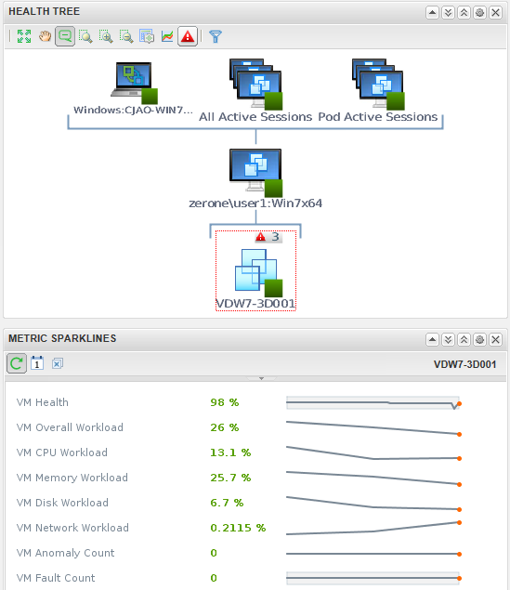
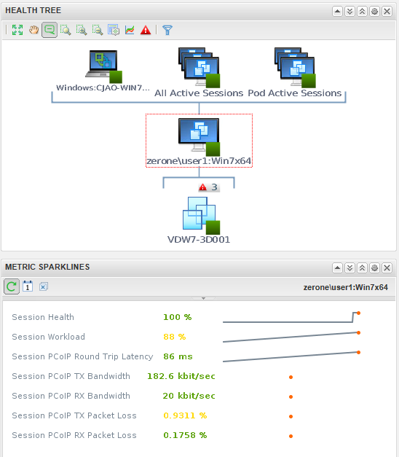
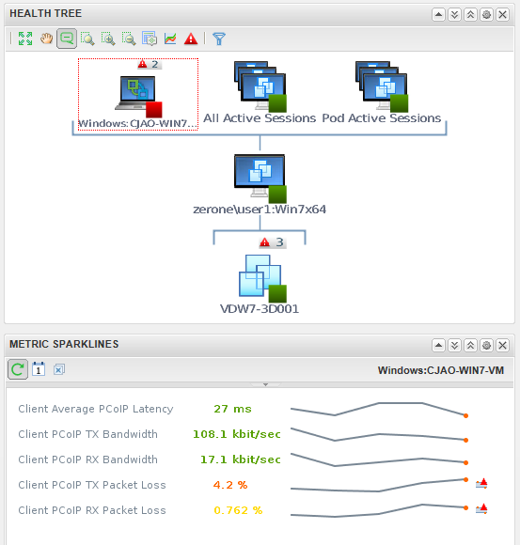
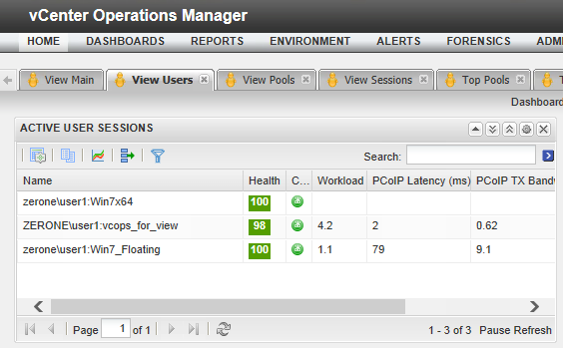
Dashboard: View Users檢視連線，並取得對應資源
Notes:
View adapter
Internal vC Ops adapter (java)
Can be installed into standalone or vApp
Can be used with remote vC Ops collector
vC Ops View Desktop Agent
Installed with View 5.5 agent
Extensible collection of perf counters, registry, and WMI data
Leverages existing PinPoint agent code
RMI interface with View Adapter
vC Ops View Server Agent
Separate install on View server (may be installed into multiple View Pods)
Collects View topology using PowerShell API and LDAP
Leverages v1.0 View adapter code
RMI interface with View Adapter
7

Slide 8
桌面整體管理與自動化達成與資料中心伺服器一致的管理經驗
集中式母版管理
監控儀表板
自動化部署
離線管理
容量規劃
用戶自助工作流程

Slide 9
Horizon View 自助服務與vRealize Automation 的整合方便用戶與IT管理者

Slide 10
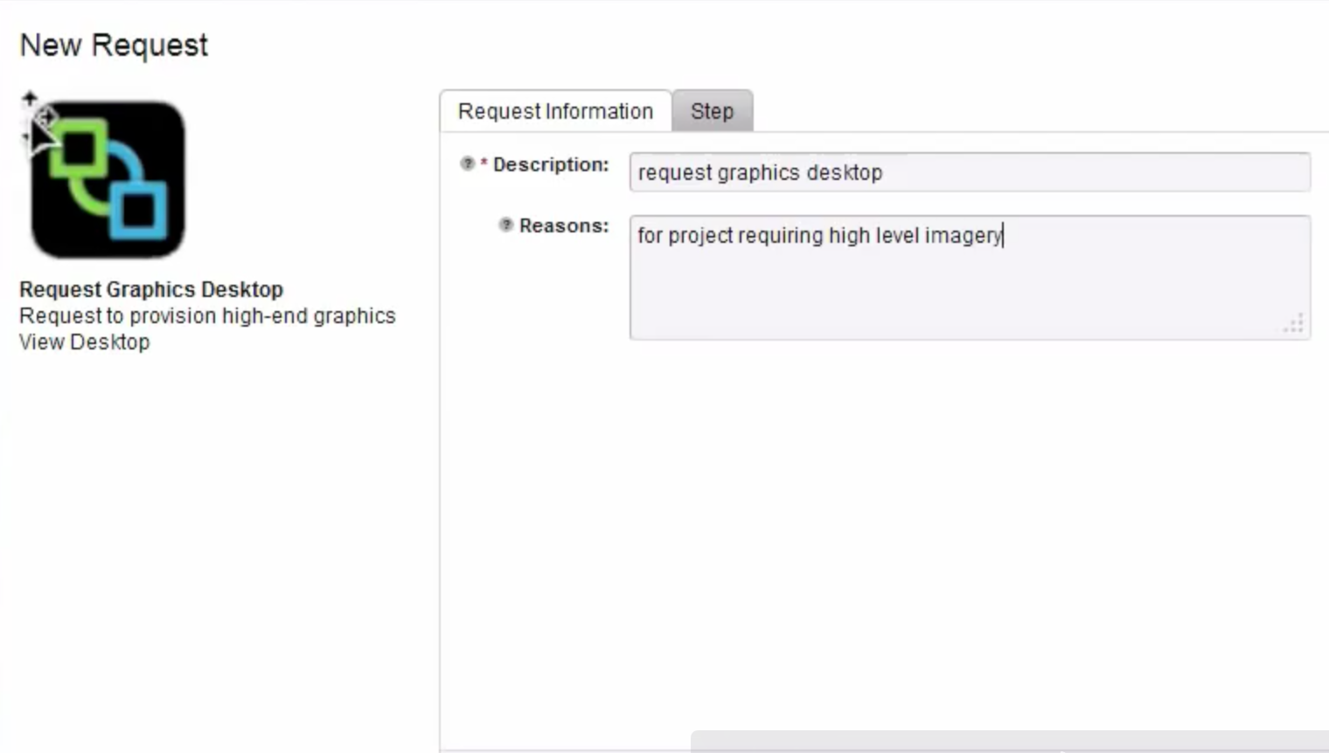
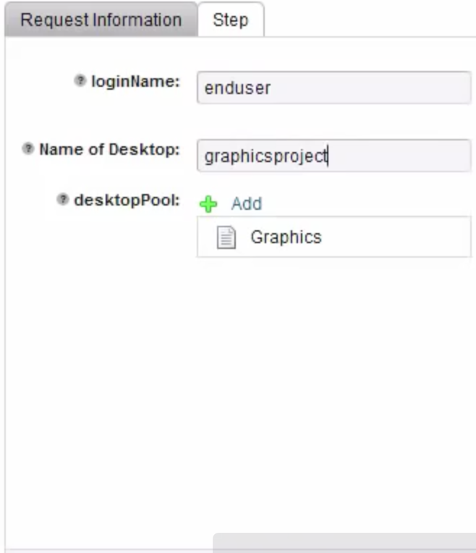
使用者可以透過自助服務申請桌面環境

Slide 11
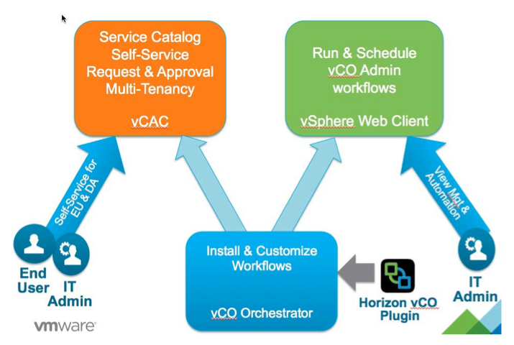
Horizon與自動化整合架構說明

Slide 12
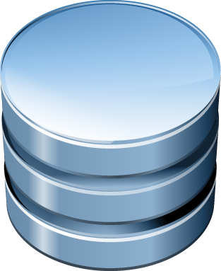
應用軟體資源模組化與容器式管理
傳統作業環境
即時性應用資源模組化
Data/Files
Applications
Settings
App Container
App Container
User changes
OS
App Volumes agent
OS

Slide 13
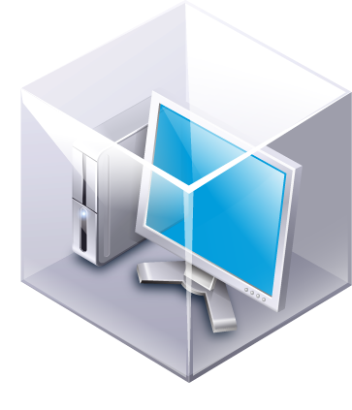
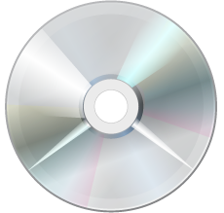
簡易且快速將應用軟體資源部署
1
建置一個 AppStack
2
掛載 AppStack 並且安裝應用軟體
3
將已安裝應用軟體的AppStack 指派給使用者或群組

Slide 14
應用程式資源生命週期管理
可選擇
線上即時更新
或
下次登入再進行更新
Core Apps 2
Engineering
虛擬桌面
Finance
Core Apps
將所有相關應用軟體放置於同一個 AppStack，達到簡易管理與部署優點
( e.g. 可依部門單位進行分類管理)
RDSH
主機

Slide 15
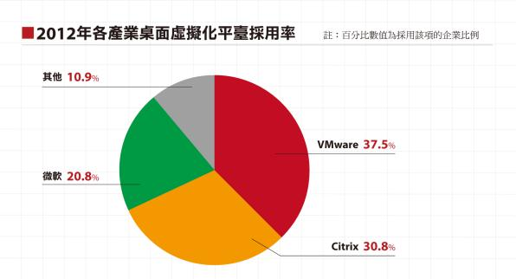
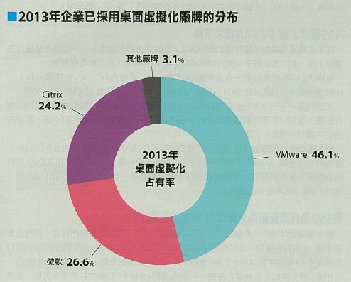
iThome 2014 CIO大調研 VMware桌面虛擬化市佔於2013年更大幅拉開領先
2012年市佔率
2013年市佔率
資料來源：iThome 2013年CIO大調查
「VMware在2013年的市佔領先幅度超過2成，Citrix直接跌到市佔第三」
資料來源：iThome 2014年CIO大調查, 2014/02

Slide 16
VMware Horizon View 協助您建立安全、行動化、管理簡易的用戶終端作業環境

