Slide 1
Enable for future Campus
Flip your future !
Flip your world !
Jackie Chang
Country manager
Taiwan
Edge-Core networks
December 2015

Slide 2











Accton group overview
Innovation
Design
IoT Solutions
Taiwan, Since 2010
Internet Portal
Taiwan, Since 2000
SDN/NFV
China, Since 2014
Ads Platform
Taiwan, Since 2009
Manufacture
Manufacturing
China, Since 2005
Branding
Carrier & Enterprise Networking
Worldwide, Since 2004
SMB & SOHO Networking
Worldwide, Since 1997
Cloud Wireless
Worldwide, Since 2013
Corporate Social Responsibility
Art Foundation
Taiwan, Since 2000
E- platform for charitable works
Taiwan, Since 2001

Slide 3



On the internet, everything is for hire
High Scalability-Flexibility-Mobility-Reliability network services
The rise of the sharing economy
-The economist , Mar , 2013
Notes:
行動共享經濟

Slide 4

We are in IoT-Enabled World
Internet of Things
Integration of Things
Intelligence over Things
IoT Enabled
World
5G
Wi-Fi
4G
WSN
3G
NFV
SDN
SDN
NFV
SDN
NFV
NFV
Community
Connectivity
Virtualization
Data driven
Notes:
3G/4G still rules as the main application
Deploying 5G drive the innovation for Taiwan
Service-Aware Networks with SDN/NFV technology behind
以智慧連接萬物
以技術整合萬物
以智慧&技術駕馭萬物

Slide 5

Tomorrow’s Connectivity : Available Today
We deliver high-performance connections today at astonishingly lower CAPEX/OPEX points.
Network requirements are driven by many different needs and demands by customers.
We drive the development of next generation applications and services through our cloud & network infrastructure.
IaaS
Ready
PaaS
Capable
User needs
Delivered
Enabling Services and Apps of the Future

Slide 6

What you real need for next campus network ?
Challenge
Choice
Change
Chance

Slide 7

What key requirement Campus needed for future network?
Immutable low-cost architecture
Easy Maintenance
Unlimited and adaptive scalability
Capable to employ any product that is most economical and suitable at each moment
Small , simple and transparent equipment
No fixed chassis
Flexible operation with “Any-vendor” product
Simplified furcation and unified spec. of hardware
Best cost for providing functions required for service provide network
Easy normal operation
Easy to detect the cause
Free from the suffering to complicate bugs routers own
Capable to provide any level of scale needed for any use case
Easy to introduce new network with a small start
Many vendors software , applicable
Flexible operation by any any equipment to be replaced freely with any vendors product
Wireless / SDN / NFV / Cloud / Application services
Non-Stopping Infrastructure Services
Mainly effective to CAPEX through automation
Service leading application
IoT / Community
Mainly effective to OPEX through virtualization
Notes:
Carrier – today’s
Large number of complex facilities
Evolved piecemeal over the past 40-50 years
>Source of huge CAPEX/OPEX costs
>Difficult to introduce new services
Especially when compared to OTT cloud providers

Slide 8









Accton Open Network Solution
Applications
OF-DPA compliant
OF-DPA compliant applications
Controller
Open DayLight
Open Software
Open switch software
Open Hardware
Edge-Core data center switch hardware
Bare Metal Switch – 100G/40G/10G
Openstack integration

Slide 9
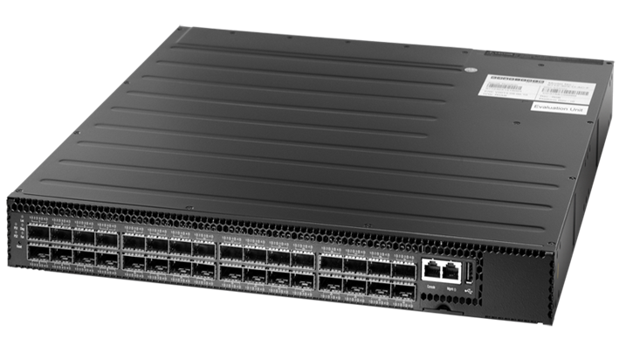
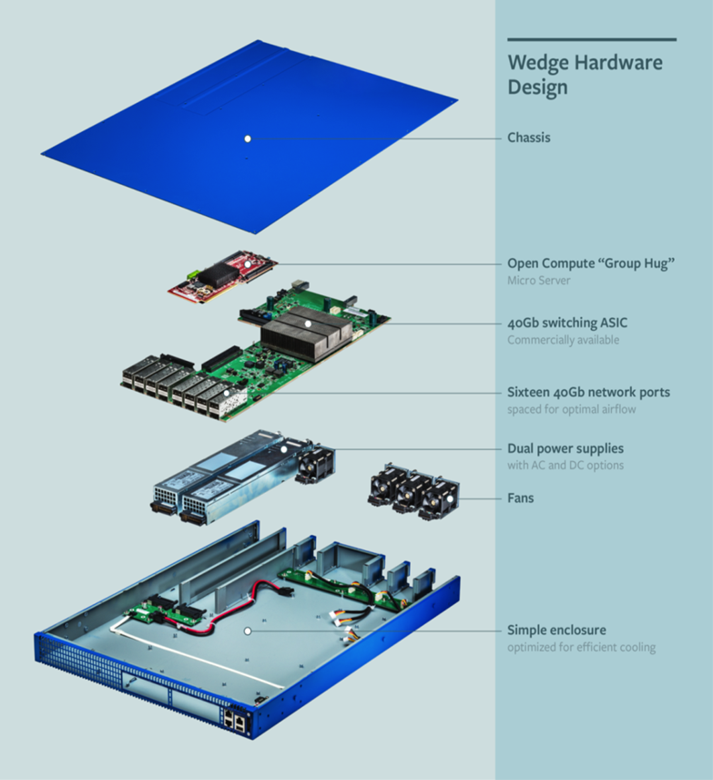
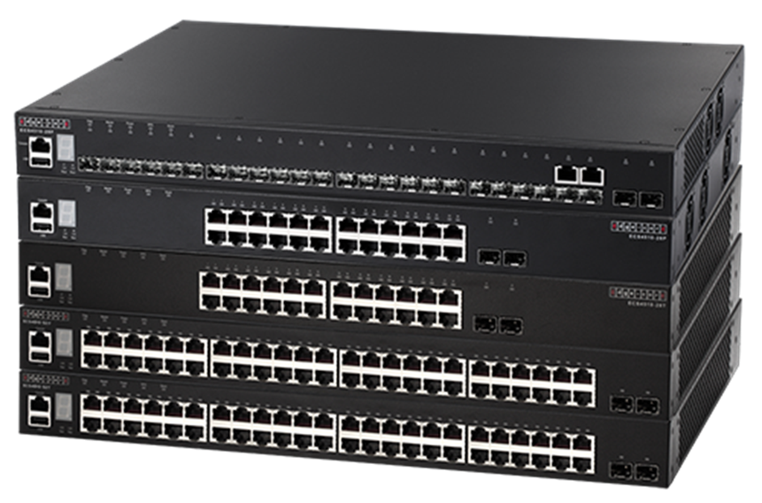
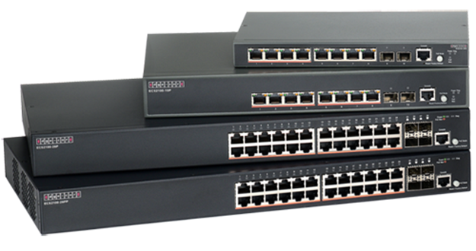

Accton Network Solution
Edge-Core AS7712-32 x 100G QSFP28
Data Center Open Hardware
Edge-Core Wedge-16X
16 x 40G / ONF
Edge-Core HEROSS Smart switch
Edge-Core L2/L3 switch

Slide 10


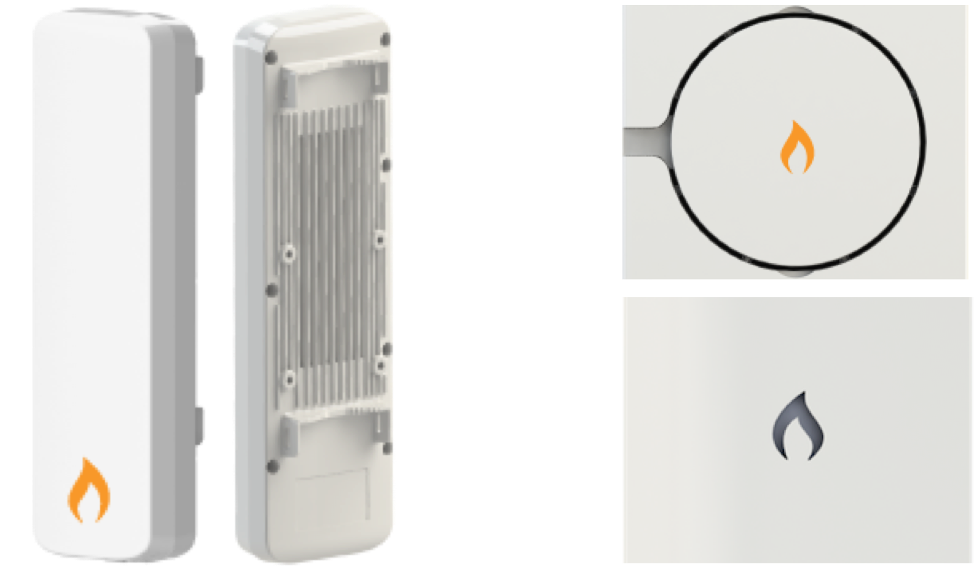

Accton Cloud Wireless Solution
Easy to use
Saves CAPEX/OPEX
Additional applications
Outdoor solution
Indoor solution
And do it all from the palm of your hand, anywhere in the world.
Notes:
IgniteNet is easy to use
Manage your devices - enterprise APs, fixed wireless infrastructure, CPEs, switches
Manage your Over the Top Services
Do it all from one place for all your networks
Plug and Play installation
IgniteNet saves cost
Enterprise-grade 11ac APs starting from $69
Unlimited cloud management for $99/year
IgniteNet adds additional revenue
MSPs, SIs, Operators can charge end-customers for management
MSPs, SIs, Operators can charge for OTT services like content filtering (and other MarketPlace Apps

Slide 11
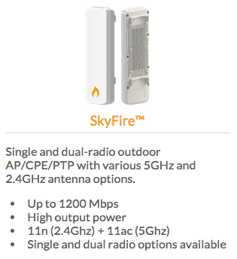
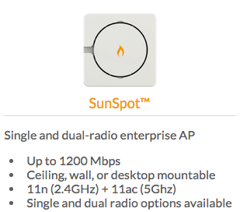
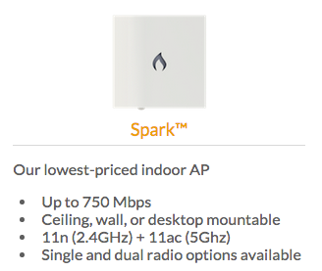
Accton Cloud Wireless Solution
Product overview
Indoor and outdoor enterprise APs for connecting laptops, tablets, smartphones - or any other WiFi-enabled device.

Slide 12
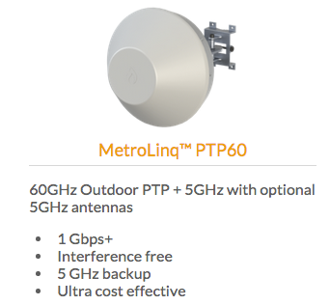
Accton Cloud Wireless Solution
Product overview
Connect buildings together quickly and easily with wireless

Slide 13

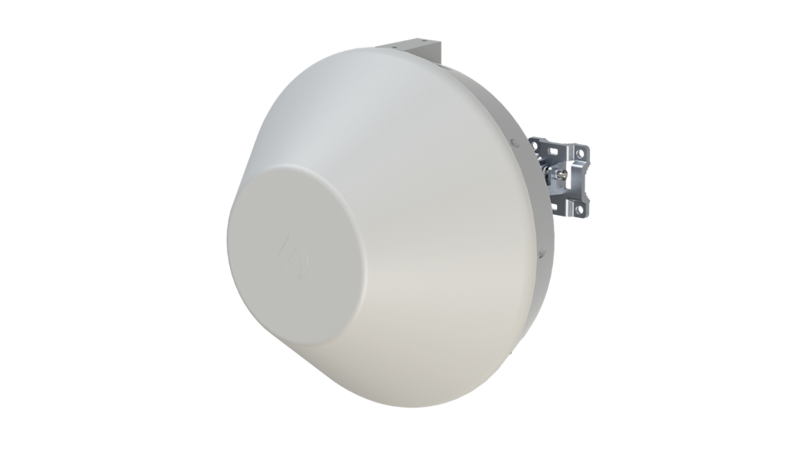
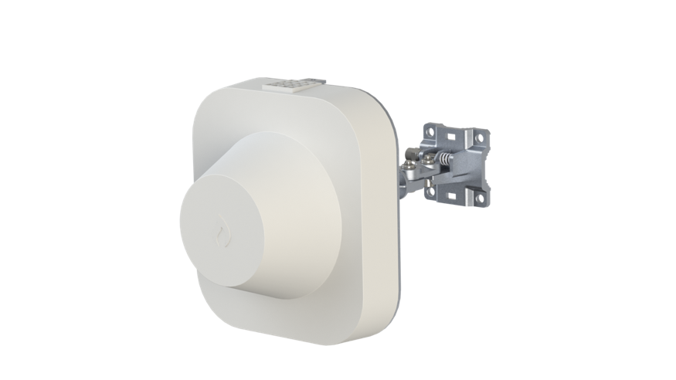

IgniteNet MetroLinq – Building Carrier Mobile Network
Outdoor 60GHz PTP + 5GHz
Cost to lay fiber are estimated at $25/ft for urban environments (or $82,000/km)
Cost for MetroLinq™ to cover the same 1km is estimated at less than $1,000/km - less than 2% of the cost!
The next billion internet users are expected to be mobile device users. Metrolinq™ already solves this problem with multi-tenant WIFI access.

Slide 14

IgniteNet Cloud controller
The IgniteNet Cloud controller features not only localized failover and backups, but also geographic failover and backups as well!
All data is encrypted to the cloud using TLS - a very high level of security.

Slide 15
Accton IgnteNet advantage for campus wireless network
Easy Installation & centralize Management with multiple languages
Cost effective vs. Highly performance
Intergrade current RADIUS with Captive Portal security management .
Made in Taiwan with Local service offer .
Cloud management by friendly UI with multiple language , Anytime ! Anywhere!

Slide 16
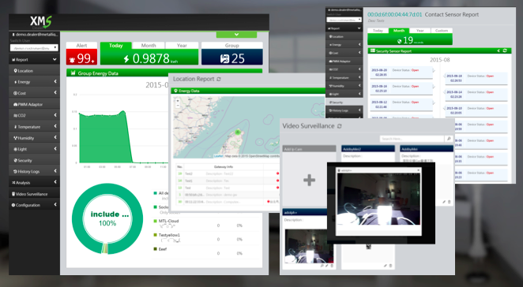
Metalligence deploys IoT platform services for MAKER!
User-friendly Data Visualization Platform
Created on a Simple & Practical Building Block
Partners in these industries have deployed our PAAS
Open API for easy development
Smart Home
Health
Care
Intelligent
Surveillance
Energy Management
Smart Agri
+
Accton XMS Cloud service
Data driven
Cloud
service
IoT technology
Connectivity
Notes:
Data Visualization
Easy-to-Use
Access Anywhere
Data Repository
Best of Both Worlds (Order vs Flexibility)
Active Data on MySql, Archive Data in MongoDb
Cloud Server
Scalable, Secure
No upfront cost
Sensors / Devices
Optimized Calibration
Mesh Network

Slide 17

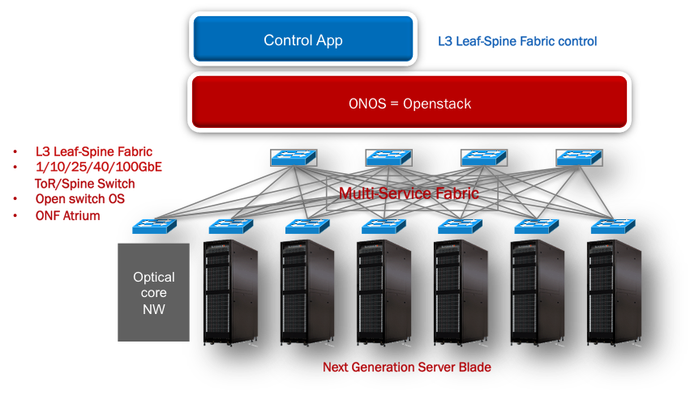
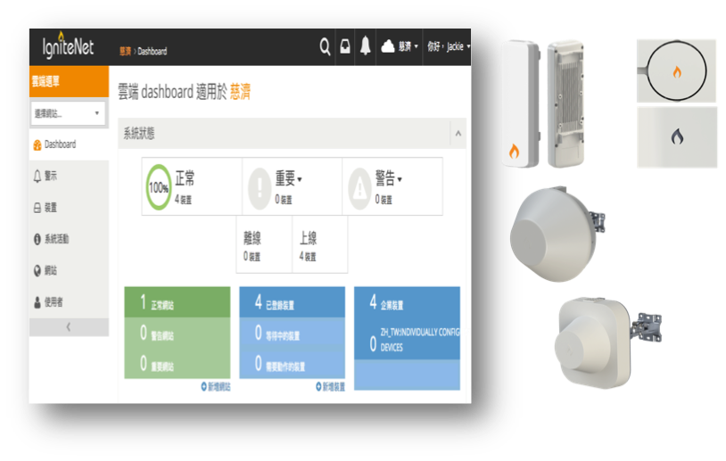
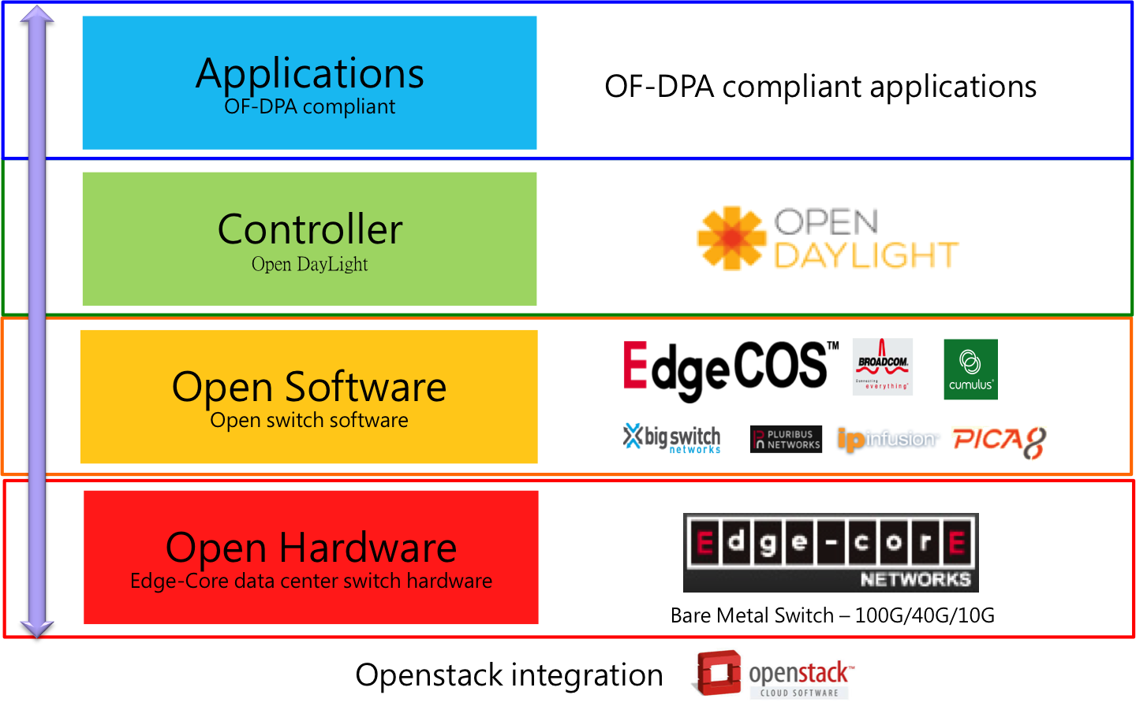
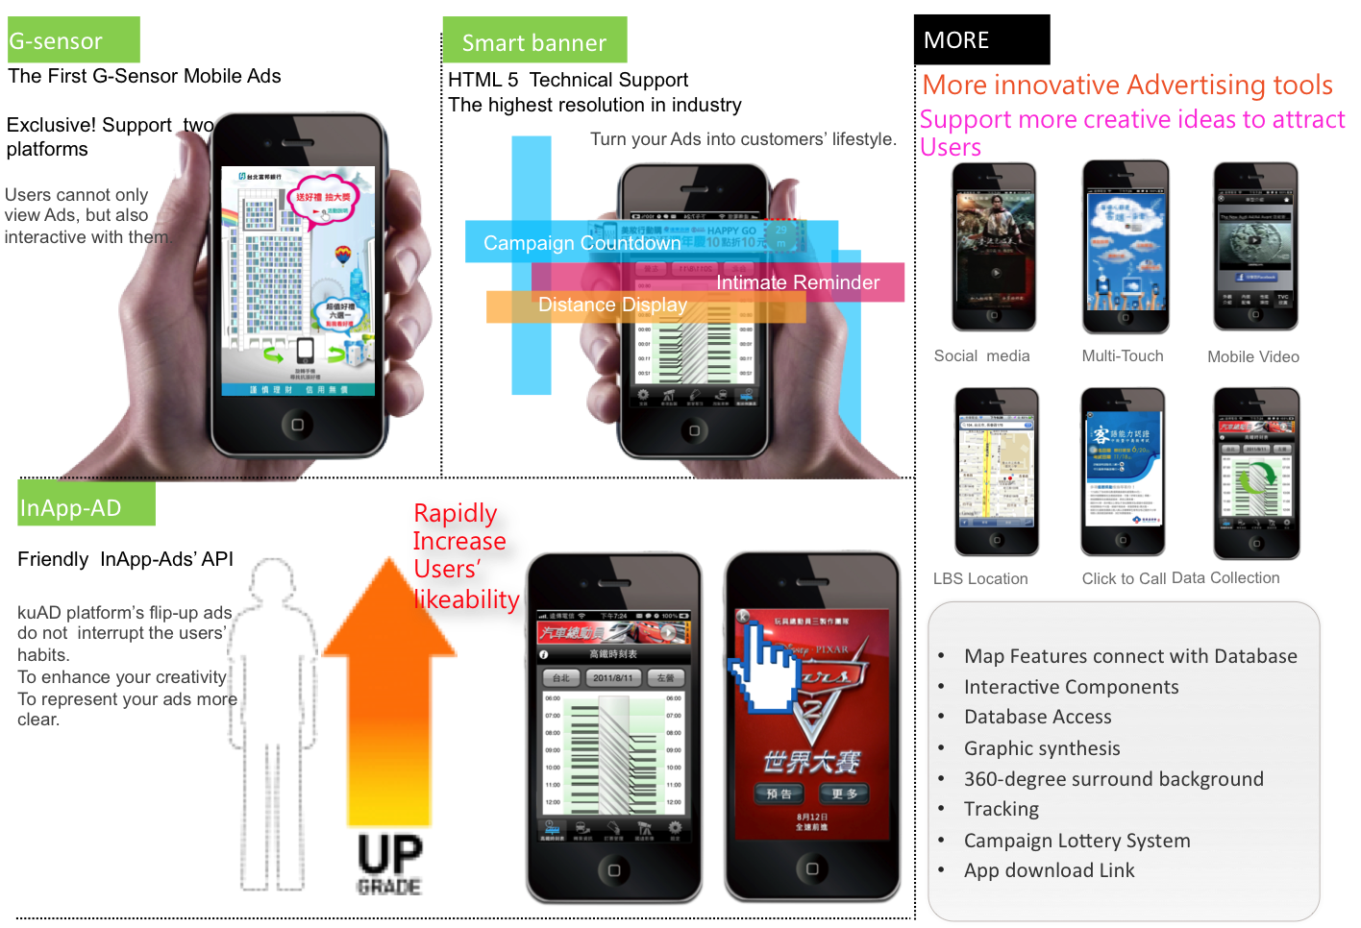
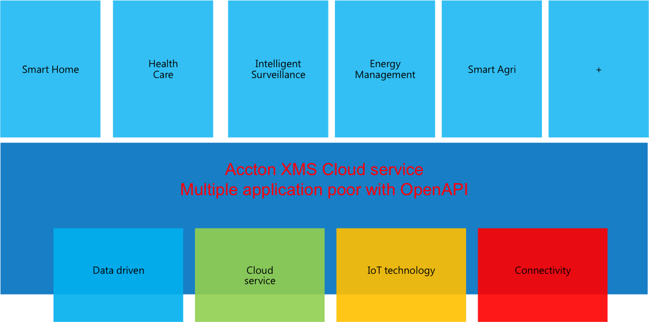
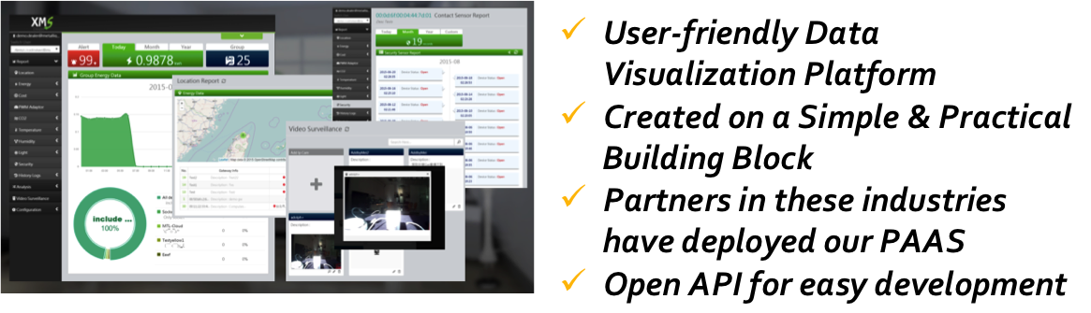
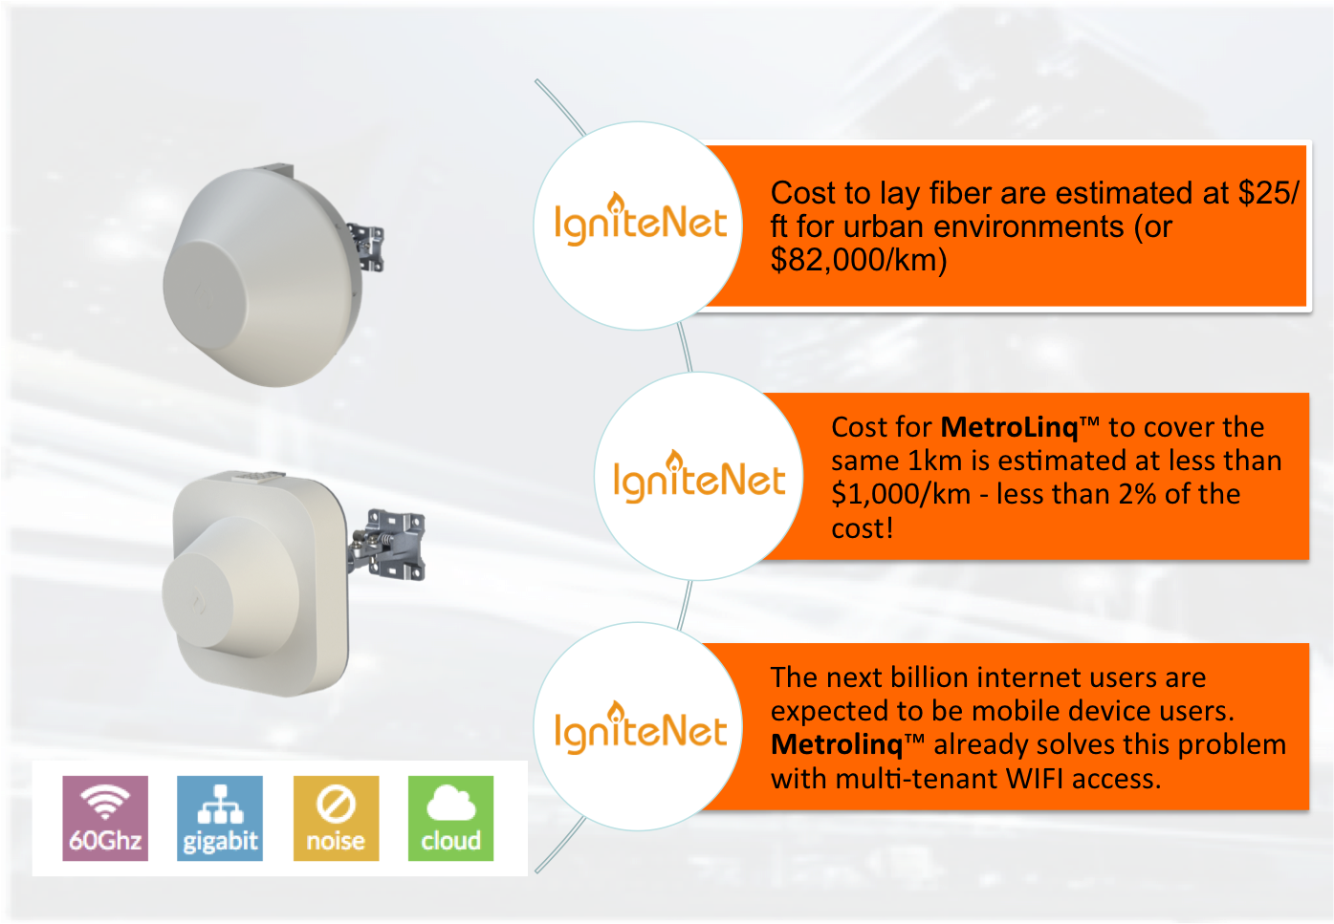
Accton solution for campus future services network
Edge-Core Open Network
IgniteNet Cloud Wi-Fi
Metalligence / SMC IoT
WayStrom Community

Slide 18







New Campus Network will enable….
New cloud applications for campus future network from co-existing Wi-Fi and/or future SDN / IoT applications
Security,
Monitoring, Control &
Recording
Energy, Management, Personal Notifications & 24hr Emergency
Services
Device
Automation, Diagnostics, Maintenance &
Metadata
E-Health,
Technicians, and
Expert help
Notes:
That will allows the use to be more pervasive and practical for all users whether in city or in rural areas. If we want to accelerate 3g/4g and even 5g investment, this group need to think about how to foster traffic growth by fostering use.

Slide 19

Our vision for IoT-Enabled world
To build up service leading applications over an intelligence network & management !
Virtualization
Connectivity
Community
Data driven
Connecting Taiwan , Connecting global , Connecting future !
Notes:
以「服務」為導向之聯網網路應用架構

Slide 20

以
智
築
城
thank you
智
慧
城
邦

