Slide 1
85
of the Fortune 100 choose Quantum
10
recent product of the year awards
WELCOME
Quantum is the LARGEST data backup, recovery, and archive specialist in the world.
34
years specialized expertise
100K
plus customer deployments
Notes:
THIS IS AN AUTOMATED SLIDE THAT YOU CAN USE AS FOLKS ARE GATHERING IN THE ROOM.
IT’S NOT MEANT TO BE PRESENTED; JUST LET IT TELL A BIT OF THE STORY BEFORE YOU GET STARTED.

Slide 2
Proven, Experienced Leader Scale-out Storage and Data Protection
34
100K
650+
85
years in storage
deployments
of Fortune 100
industry patents
Northampton, UK
EMEA Service HQ
Bellevue, WA
WW Sales, Mktg, & Finance
Mendota Hts., MN
Scale-out Storage R&D
Beijing, PRC
North Asia Service HQ
Kuala Lumpur, MY
APAC Service HQ
San Jose, CA
WW HQ
DXi and VM R&D
Denver, CO
Systems R&D / Test
WW Service
Paris, FR
EMEA HQ
Singapore
APAC HQ
Irvine, CA
Devices R&D
Sydney & Adelaide, AU
Dedupe R&D

Slide 3
Market Share Leader in Open Systems Tape Automation
CY13 Revenue Market Share
Source: IDC Open Systems Tape QView CY2013

Slide 4
Quantum Solutions
WORKFLOW STORAGE
DATA PROTECTION
CLOUD
Tiered Solutions and Object Storage
Solutions that help you maximize revenue and results by extracting full value from your data
Deduplication Systems and Tape Libraries
Systems that optimize backup and recovery, simplify management, and lower cost
Virtual Server Backup, Archive, and DR
Software that protects VM’s in native form, simplifying backup and recovery for virtual environments.
Cloud Services
Services that enable cloud backup and disaster recovery for physical & virtual servers
Central Management, Professional Services, & Global Support
Notes:
SUMMARIZE OUR SOLUTIONS PORTFOLIO, EMPHASIZING OUR OFFERINGS ACROSS BIG DATA, VIRTUALIZATION, AND THE CLOUD
Quantum has a family of unique offerings across Data Protection, Big Data, and the Cloud.
Big Data
Our Big Data suite solutions allow you to store, manage and protect massive files and petabytes of data. These solutions are typically deployed in very high-scale environments, where Quantum is a pioneer in high-performance streaming of large files, data lifecycle management, and archiving. Our StorNext software and appliances are used by some of the largest Media companies, leading-edge research firms, and federal governments. With Quantum Lattus Object Storage solutions, customers are able to store more data in a cost-effective archive using data dispersal technology that distributes content across sites and in the cloud. This provide continuous access even when disks fail, when entire sites have outages, or when customers want to upgrade to new technologies. Our Big Data solutions provide cost-effective and innovative alternatives to EMC Isilon, IBM GPFS, or cloud infrastructure in general.
Data Protection
We provide tiered storage solutions for data protection as well, including our innovative dedupe appliances and our virtualization data protection products.
Our DXi appliances incorporate patented variable-block deduplication to not only deliver best-in-class performance and efficiency but also enable optimized and affordable replication for disaster recovery. For reference, our midrange DXi series exceeds the performance of EMC Data Domain systems at much lower cost points.
Our vmPRO backup software is the industry's only native backup and archive for virtual environments. vmPRO simplifies how customers protect their virtual environments and unlocks new ways for customers to access native copies in the cloud, at a DR facility, or on NAS tape archives.
Our market-share-leading Scalar tape systems help you reduce costs of backup and long-term retention. Our enterprise libraries are perfect for large-scale archive and include dual robotics for high availability, industry-leading density, and policy-based media integrity checking.
For customers deploying multiple Quantum products, our Vision software provides common management across global locations, systems and tiers.
Cloud
Quantum provides best of breed, highly optimized, low-cost cloud-based data protection that is powerful yet simple to deploy. Our cloud solutions operate in public, private or hybrid environments. Q-Cloud is a Quantum branded BackUp-as-a-Service and DR-as-a-Service subscription model designed to provide enterprise class backup, recovery and disaster recovery model at a competitive subscription price. Small and mid-sized enterprise customers can leverage Q-Cloud’s simple, secure, and flexible approach to data backup and recovery for as little as 1 cent/GB/month. With Q-Cloud, customers can benefit from Quantum’s patented deduplication technology to back up both physical and virtual infrastructures.

Slide 5
Quantum StorageCare Global Services
World-Class Team & Infrastructure
Expert engineers and remote mgmt technology
Focused Expertise
Data protection and data management expertise
Global Coverage
100+ countries and call centers around the globe
Vast Pro Services & Support Plans
Consulting, install, support, customizable options
Learning & Education
Online and onsite training available
Enterprise Proven
Multi-petabyte installations
Notes:
Quantum’s service organization is a key differentiator and a reason why 85 of the Fortune100 select Quantum.
Our global service presence spans over 100 countries. Our comprehensive end to end service approach, know as StorageCare Services, provides world class service to our customers. Our service plans and education offerings are second to none.
When you work with our service organization, you get the services you need for your business and the knowledge to protect your data while maximizing your investment

Slide 6
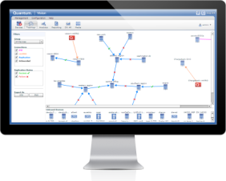
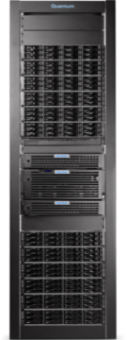
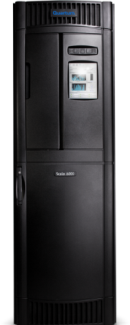
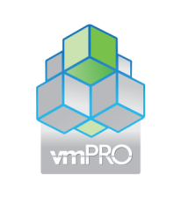
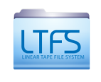
VISION MANAGEMENT
VISION MANAGEMENT
STORNEXT BIG-DATA STORAGE
DXi DISK BACKUP
CLOUD SERVICES
LATTUS OBJECT STORAGE
SCALAR TAPE AUTOMATION
VIRTUAL BACKUP

Slide 7
Workflow Challenges

Slide 8
Modern Workflows Have Changed
Video, Image, and Sensor data is 100% digital
Globally distributed teams require shared access
Files sizes are variable
Unstructured data growth
Topologies and interconnects have evolved
Acquire
Analyze
Deliver
Archive
Process

Slide 9
Demands of the Modern Workflow
Ingest
Work in Process
Delivery
Archive
Long Term Off-Site
Complex workflows present many challenges
Performance bottlenecks
Managing content location
Archiving with frequent reuse
Secure asset preservation
Open systems design – ensuring vendors work together

Slide 10
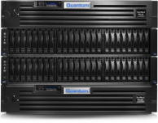
StorNext 5 Family
End-to-End Workflow
Ingest
Work in Process
Delivery
Archive
Long Term Offsite
StorNext
StorNext Q-Series High-Performance Disk Storage
LTFS
Lattus Object Storage
StorNext AEL Archives

Slide 11
Quantum StorNext Big Data Technology
Third Party Application Solutions
Disaster Recovery
Create/ Edit
Disk Tiers
Ingest
SHARE
PRESERVE
StorNext File System
Tape and Vault
StorNext Storage Manager
Distribute
Data Protection
High-performance shared file system
High performance sharing across platforms
Single namespace for multi-PB systems
Data access across SAN and LAN
Replication
Tiered storage management
Transparent data migration between tiers
Integrated data protection
Disaster recovery
Long term archiving

Slide 12
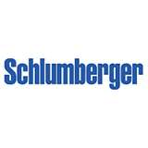
Quantum is Proven in These Environments
Highest PERFORMANCE
LOWEST COST Greatest FLEXIBILITY
Disaster Recovery
Create/ Edit
Disk Tiers
Ingest
SHARE
PRESERVE
Distribute
Tape and Vault
Data Protection

Slide 13
Quantum's Tiered Storage Approach
Complete
Lifecycle Management
Online
Storage
Tuned Performance
Shared Access
Extended
Online
Storage
Durability
Multi-PB Scalability
Cost Per Terabyte
Lowest Possible TCO
Ease of Use
Archive
Storage
Tape
Vault
Access and Restore Times

Slide 14
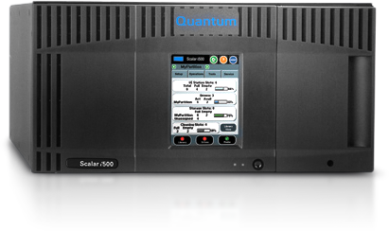
Recommended Architecture
Ethernet (public)
Ethernet (private)
Clients
MDC
Gateway
LAN switch
Fibre
Channel switch
Tier 1
QS Storage
Tier 2
3rd Party Storage
Tier 3
Scalar TLU

Slide 15
Next-Gen Data Protection & Retention
Notes:
NOW TRANSITION TO OUR PERSPECTIVE ON HOW THE DATA PROTECTION MARKET IS CHANGING.

Slide 16
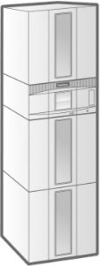
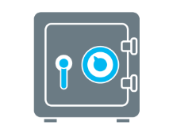
Generation 1 Data Protection
Exchange
Backup directly to tape
Export tapes to a vault
CRM
Database
Notes:
TAKE A STEP BACK AND QUICKLY DESCRIBE GEN1

Slide 17
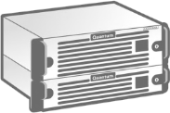
Generation 2 Data Protection
Backup and retain on dedupe disk
Store replicated copy for DR
Exchange
CRM
Database
Create tape for long-term retention
Notes:
HIGHLIGHT THE STEP THE INDUSTRY TOOK WITH DEDUPE AND THE IMPORTANT ADVANCEMENTS THAT PROVIDED.
Where most customers are today. Drives significant benefit in terms of multi-site backup and recovery. Deduplication plays a key role.

Slide 18
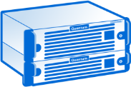
Generation 2 Data Protection Scaling
Backup and retain on dedupe disk
Store replicated copy for DR
Exchange
CRM
Database
Create tape for long-term retention
Notes:
HIGHLIGHT THE CHALLENGES WITH THIS APPROACH AS IT SCALES. DISCUSS HOW NOT ALL DATA PLAYS WELL WITH DEDUPE
The problem with Gen 2 is that as you grow primary storage, your backup data has to scale accordingly.
In addition, not all data types work well with deduplication, particularly rich unstructured data like video

Slide 19
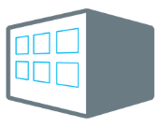
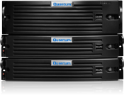
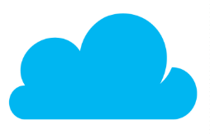
Gen3 Data Protection & Retention
On Premise
Off-Site
Structured Data
Dedupe & Replicate
Physical Environment
Exchange
Snap a native copy
CRM
Database
Virtualization Environment
Retain in native format on low-cost LTFS & LTO
Unstructured Data
Keep content active and available from anywhere with object storage and tiering
Notes:
INTRODUCE GEN3. a next generation approach is required.
We think a next-gen approach is required, one that builds on the benefits of Gen2 for structured data but that meets the needs of varying workflows, especially for unstructured data. Unstructured data is what is breaking traditional backup. Unstructured data requires a different approach, a workflow-based approach. This is particularly true for rich content like video, audio, and images.
Unstructured Data. {click} Managing unstructured data growth is becoming a vital part of any IT strategy, whether it’s archiving video content for future re-monetization, offloading static data from primary storage, or building a private cloud infrastructure. Due to the scale and access requirements of these use cases, traditional backup simply won’t work. Q’s tiered storage technology helps you align data value to storage costs by applying the right technology at the right point of time. We enable you to store more data and retain access to it for longer periods of time… while minimizing TCO. Our tiered solutions also include next-gen Object Storage, which allows you to create massively scalable self-protecting disk archives for near-line storage. Finally, for deep archive use cases, we developed tape libraries with dual robotics, the industry’s most compact datacenter footprint, and embedded software that indicates when data is aging and needs to be migrated to new media.
Virtualization and the Cloud. Virtualization and cloud-based DR are other areas where a next-generation approach is needed. With the advent of virtualization, the relationship between the server and data has changed. So why would you continue to protect the information using legacy approaches? Quantum has unique VM technology that allows you to take a snapshot of the VM at any point in time, in native format. Once you have a native copy, your data now becomes much more portable and useful to the business. You can store and access the copy of data in the cloud or DR facility, or archive it to tape. You no longer need a complex restore process to access, analyze, or leverage your content for business needs.
To enable portability, data must be stored and transported in a way that minimizes the requirements for storage and network resources. Q has developed patented dedupe technology and an innovative replication engine that reduces WAN costs and is extremely resilient to WAN latencies. And we have 256-bit encryption to ensure that data is protected in flight and at rest. In addition, we give you the flexibility to select how you will deploy deduplication, either in purpose-built hardware appliances with industry-leading performance or as virtual appliances so you can leverage your own server and storage resources. Finally, by leveraging LTFS technology, we can present a tape library as a large NAS store, allowing you to store your data for the long term.
Quantum can help you rethink your data protection and retention workflows today - by applying the right technology to the appropriate data and the right time. We have a track record of helping customers in the most demanding environments (Gov’t, M&E, etc), and we can apply these same technologies and approaches to the datacenter.

Slide 20
Results in Overall TCO Savings of 40%-70%
Move 60% of static data from primary storage to an archive tier
40%
Savings
DELIVERS ROI AND REDUCES TCO IN 3 WAYS
Reduces primary storage costs | Reduces backup and DR costs | Backups are smaller and faster, reducing network load
Notes:
ILLUSTRATE THE ROI OF A GEN3-TYPE APPROACH
This chart shows the cost to store 1 TB of data using that traditional approach, and how the cost is reduced by 40% or more by moving 60% of the data from primary storage to archive tiers like Lattus or tape.
We mentioned the key drivers of this TCO reduction – and the great thing is that if you want to learn more about what you might save, we can help.
We have software that can evaluate your unstructured data environment, characterize how much is static, then we can create a similar TCO analysis for your environment. Let’s talk afterword if you’re interested.

Slide 21
Case Study

Slide 22
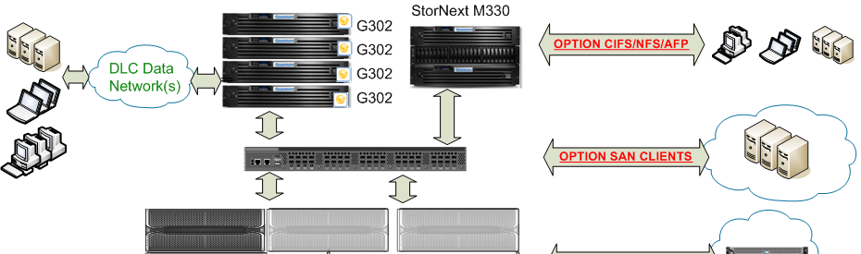
歐洲核子研究中心 更快速的研究分析與協同作業
現狀 / 問題 該研究機構的大型強子對撞機已投入運作，該加速器將產生大量的電腦資料並需要1.5GB/s的擷取效能來收集至少一個月持續產出的資料，總資料量會超過一個PB。另一個挑戰是這些資料需要被數量龐大的伺服器分享與協同運作。
客户解决方案
Quantum StorNext + Qlogic + Infortrend
效益
整合既有儲存資源，並橫向擴充資料存取效能以滿足作業需求
達成資料分享的目標，能協同運作各個工作流程
Notes:
USE THIS USE CASE FOR PROSPECTS IN THE EDUCATION VERTICAL, OR THOSE THAT MIGHT BE DEALING WITH ARCHIVING STATIC DATA
[ASK PROBING QUESTIONS AND UNCOVER IF THERE MIGHT BE A SIMILAR OPPORTUNITY]
Biola University is based in California, we actually have a great video on our website that talks about this use case. Biola is generating a lot of video content from online courses, distance learning, and lectures, and this content was using more disk storage than the IT budget could support. Biola’s IT department needed a solution that offloaded primary storage but still allowed staff “users” to access their content directly.
To solve their problem, we deployed a tape-based NAS archive using Scalar libraries and our Scalar LTFS appliance. Biola was able to free primary storage of static data and reduce the burden on day-to-day backup operations, while enabling users to access their data directly in native format.
[WALK THROUGH THE USE CASE DIAGRAM LEVERAGING THE CALL OUTS AS NEEDED]

Slide 23
楊百翰大學 更快的HD實況球賽剪輯與轉播
現狀 / 問題 該大學有數量龐大的影片包含實況運動賽事轉播、音樂會、線上教學及招生宣傳等視頻內容。為了提升影片品質，他們由SD轉換為HD，但這個升級也產生了儲存空間不夠與剪輯效能不足的問題。
客户解决方案
Quantum StorNext儲存管理設備 + 磁帶櫃
效益
實現全HD的實況賽事轉播
提升兩倍的剪輯效率
整合工作流程，在擷取時歸檔，而不是兩個流程
在Scalar磁帶櫃中長期保存以減少online storage的空間需求
AVID Pro Tools
即時自動拷貝及版本
實況球賽製作環境
Scalar 磁帶櫃
保險庫
Adobe Premier Pro
Apple Final Cut Pro

Slide 24
聖地牙哥大學 更好的虛擬與實體機備份
現狀 / 問題 該大學的IT工作人員很早就是虛擬化的支持者，目前接近90％的伺服器都導入虛擬化。他們的傳統備份和災難復原無法跟上發展的腳步，需要花費太長的時間。
客户解决方案
Quantum vmPRO軟體 + DXi重複資料刪除設備
效益
加快虛擬機備份性能以滿足目標備份時間
每次恢復的時間也縮短數個小時，提高用戶的工作效率
在1 TB 磁碟上儲存 22TB 的備份資料，從而降低成本
整合虛擬機備份和 vCenter，以降低管理費用
vmPRO
APP
OS
Commvault
DXi 備份設備
磁帶櫃
保險庫

Slide 25
拜歐拉大學 更符合成本效益的影像歸檔
現狀 / 問題 該大學致力於推廣教育，因此有大量的免費課程、遠距教學、即時教學等大量線上影片。為了提升影片品質，他們由SD轉換為HD，但這個升級也照成了儲存設備永無止境的擴充。
客户解决方案
Quantum LTFS Appliance + Scalar i500磁帶櫃
效益
整合工作流程，在擷取時歸檔，而不是兩個流程
在Scalar磁帶櫃中長期保存以減少online storage的空間需求
降低成本並同時滿足儲存空間需求
簡易的檔案歸檔，大幅降低IT人員的作業時間
At end of term, videos are moved to tape for long-term retention
NAS
Scalar LTFS
Scalar i500
Tape Library
LTFS shows archived data in a simple file structure
Notes:
USE THIS USE CASE FOR PROSPECTS IN THE EDUCATION VERTICAL, OR THOSE THAT MIGHT BE DEALING WITH ARCHIVING STATIC DATA
[ASK PROBING QUESTIONS AND UNCOVER IF THERE MIGHT BE A SIMILAR OPPORTUNITY]
Biola University is based in California, we actually have a great video on our website that talks about this use case. Biola is generating a lot of video content from online courses, distance learning, and lectures, and this content was using more disk storage than the IT budget could support. Biola’s IT department needed a solution that offloaded primary storage but still allowed staff “users” to access their content directly.
To solve their problem, we deployed a tape-based NAS archive using Scalar libraries and our Scalar LTFS appliance. Biola was able to free primary storage of static data and reduce the burden on day-to-day backup operations, while enabling users to access their data directly in native format.
[WALK THROUGH THE USE CASE DIAGRAM LEVERAGING THE CALL OUTS AS NEEDED]

Slide 26
85
of the Fortune 100 choose Quantum
10
recent product of the year awards
THANK YOU
For meeting with Quantum, the LARGEST data backup, recovery, and archive specialist in the world.
34
years specialized expertise
100K
plus customer deployments
© 2013 Quantum Corporation. Company Confidential. Forward-looking information is based upon multiple assumptions and uncertainties, does not necessarily represent the company’s outlook and is for planning purposes only.
Notes:
[AUTOMATED ANIMATION]

