Slide 1

教育單位虛擬主機暨網路快速佈署解決方案

Slide 2
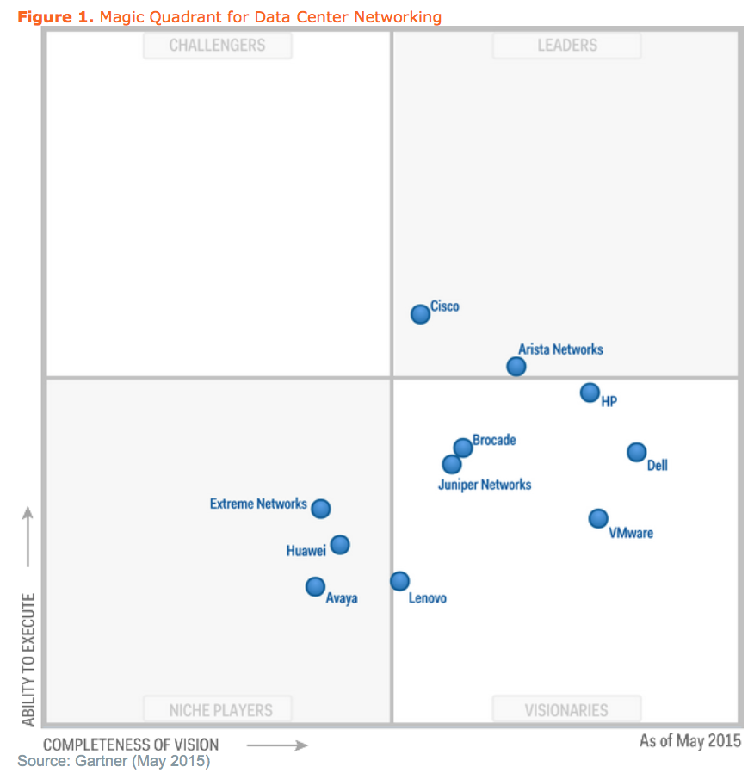
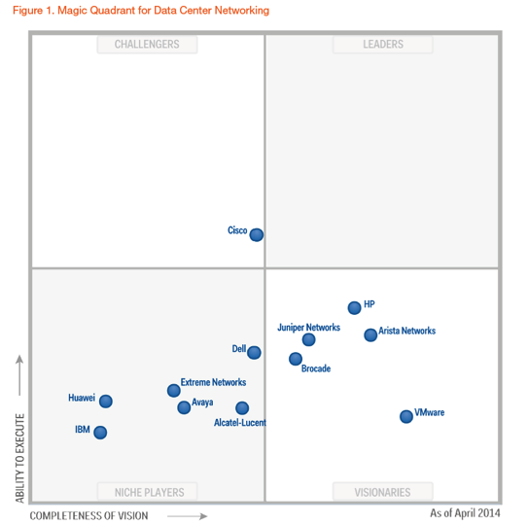
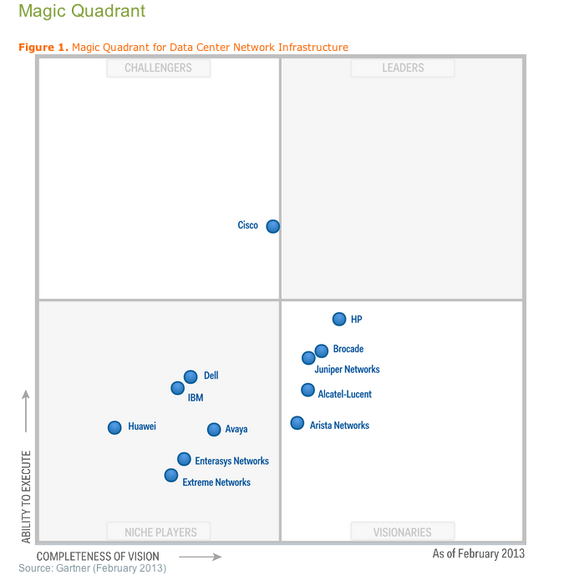
2015 Gartner MQ Data Center Networking
Arista placed in the leadership quadrant
1. Arista is by far the fastest-growing vendor in this MQ.
2. Arista provides high-performance solutions with
deep buffers and low latency to deal with the
complexities of modern DC applications.
Gartner Data Center Networking Magic Quadrant
May 11, 2015
Arista 2015
Arista 2014

Slide 3
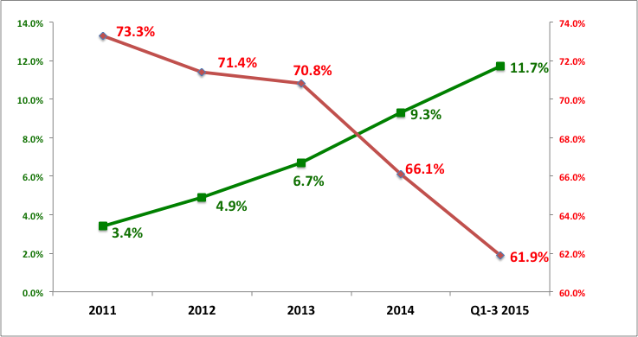
Arista Market Share vs Cisco
High Speed Data Center Switching Market Share in Ports (10/40/100GbE)

Slide 4
Customer use case
VMTracer
VMTracer

Slide 5


Arista and VMware Innovating together
A History of Innovation
✚
2008-2009 2015+
Arista Launches Cloud Networking Vision
Jointly Developed VXLAN
VMware builds public clouds with Arista
Arista & NSX
Network Integration
(L2GW with OVSDB)
Gateway P/V integration with NSXv
VM Tracer for vCenter
VMware delivers NSX
Arista vRealize
Log Insight
content pack
Joint vRealize Operations
(advanced services)

Slide 6




快速佈建虛擬主機及網路路徑 (VMTracer)
VMTracer
Arista
Arista
Arista
Arista
Arista
Arista
解決方案:
使用Arista switch 可與VMware vCenter 整合, 當vCenter 佈建虛擬主機時, 也同時佈建以Arista switch 之網路路徑, 解決原本需設定多品牌網路設備問題, 更使得 MIS 人力資源可以更有效率利用.

Slide 7
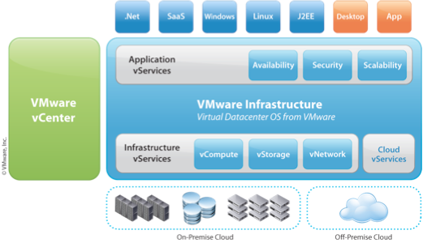




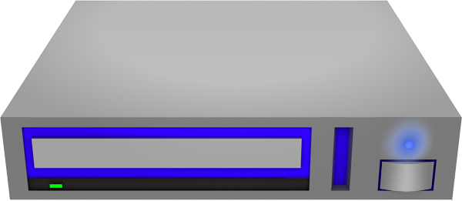
VM Tracer – 3 commands to enable SDN
Licensed Software Feature on Arista EOS 4.5 and higher on all Arista switches
Works with VMware vSphere v4.0 or higher. Works with all vSphere editions. VM Tracer is an independent re-startable and patchable process in the EOS SW Architecture
vmtracer session demo
url https://192.168.24.90/sdk
username administrator
password 7 bE5JvPGrbEpVHd9AejIfrw==
allowed-vlan 1-4094
vCenter API

Slide 8
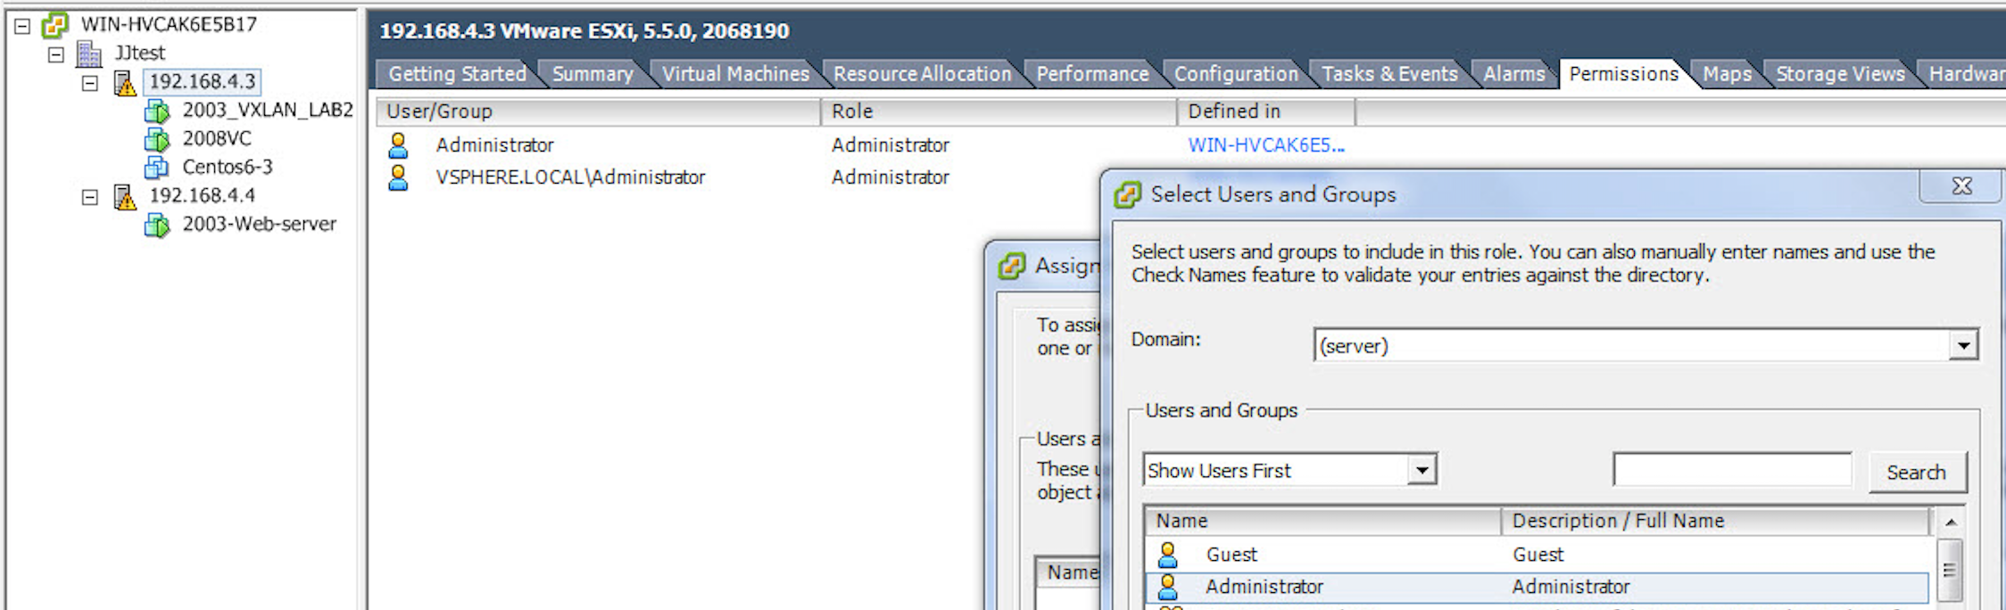
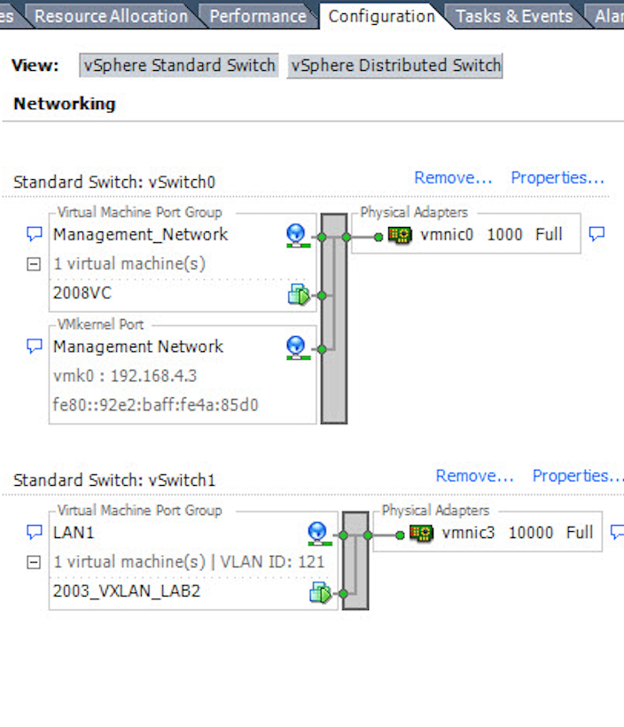
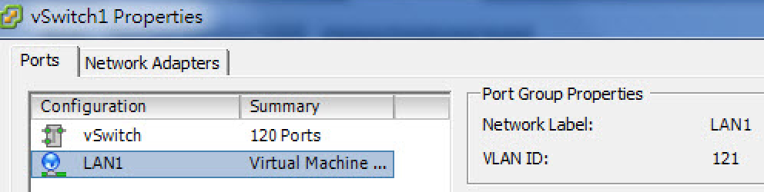
Vmware vCenter setup

Slide 9
VM Tracer - Host Discovery
VM Tracer reads the IPMI data from vCenter for each host. EOS then displays the following information:
Ethernet46 : esx-1.aristanetworks.com
Manufacturer: Dell Inc.
Model: PowerEdge 2950
CPU type: Intel(R) Xeon(R) CPU 5110 @ 1.60GHz
CPUs : 1
CPU Cores: 2
NIC Manufacturer: NetXen
NIC Model: NetXen NX3031 Dual Port SFP+ 10GbE
Service Tag: ABCDEF1234
Host discovery provides the network admin more information than ever about connected interfaces.
Result: smarter bandwidth provisioning, and easier troubleshooting.
Eth46
Eth48
Eth47
esx1
esx2
esx3

Slide 10



VM Tracer - VM Discovery
VM Tracer subscribes to the vCenter API and learns which Virtual Machines are connected to which vSwitch and which uplinks. EOS can now display the VM bindings as well--
show vmtracer interface Ethernet46
Ethernet46: esx1.aristanetworks.com/ndsTest/dvuplink1
VM Name Network Adapter VLAN Status State
-------------------------------------------------------
Exchange Network adapter 4 7 up/up --
Apache Network adapter 3 6 up/up vMotion
MySQL Network adapter 1 5 up/up FT-A
Eth46
Eth48
VM Name
Adapter Name
VLAN/Status/State
dvuplink0
dvuplink1
vSwitch
Status:
Up/Up - VM Booted/Connected to Arista Switch
Up/Down - VM Booted/NIC Disconnected
Down/Down - VM Down
State:
vMotion - VM actively being vMotioned
FT-A - Active member of a VM-FT pair
FT-S - Standby member of a VM-FT pair
Exchange
Apache
MySQL
VLAN 5
VLAN 6
VLAN 7
esx1

Slide 11
Log for VM add and delete on Arista switch
Jul 7 08:37:11 7150S VmTracer: %VMTRACERSESS-6-ADD_VMENTRY: VM Server1 nic 網絡介面卡 1 mac 00:50:56:97:00:3e portgroup dvPG_IN_V101 vlan 101 switch dvSwitch_IN_ACC host 192.168.180.1 datacenter ABC-DC intf Ethernet4
Jul 7 08:56:29 7150S VmTracer: %VMTRACERSESS-6-DEL_VMENTRY: VM Server1 nic 網絡介面卡 1 mac 00:50:56:97:00:3e portgroup dvPG_IN_V101 vlan 101 switch host datacenter intf Ethernet4

Slide 12
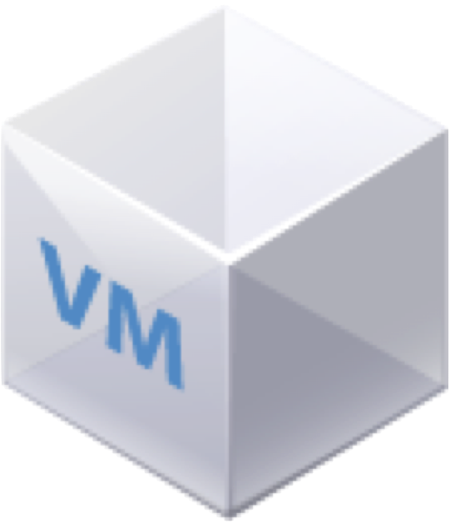
VMTracer Demo
vCenter
Demo
ARISTA-1
Et48
Trunk port
Et32
Trunk port
ARISTA-2
Et47
VLAN11
Et31
VLAN200
VLAN200
VLAN11
VM1
VM3
VM2
VM4
ESX Host
ESX Host

Slide 13
VM2 vmotion to Arista-1
Vmotion
Arista-2#show vm int e31
Ethernet31 : 192.168.4.4/vSwitch1/vmnic3
VM Name VM Adapter VLAN Status State
2012IOmeter-2 Network adapter 1 30 Down/Down --
VM4-Win7_2.2 Network adapter 1 11 Up/Up --
VM2-2012R2 Network adapter 1 200 Up/Up VMotion
Arista-2#show vm int e31
Ethernet31 : 192.168.4.4/vSwitch1/vmnic3
VM Name VM Adapter VLAN Status State
2012IOmeter-2 Network adapter 1 30 Down/Down --
VM4-Win7_2.2 Network adapter 1 11 Up/Up --

Slide 14
VM2 vmotion to Arista-1
vmotion
Arista-1#show vm vm
VM Name Esx Host Interface VLAN Status
VM3-2003_2.1 192.168.4.3 Et47 11 up/Up
VM1-Centos6-3 192.168.4.3 Et47 200 up/Up
2012IOmeter 192.168.4.3 Et47 30 down/Down
VM2-2012R2 192.168.4.3 Et47 200 up/Up
Arista-1#

Slide 15
Customer use case
100G + Extensibility Tap Aggregation

Slide 16
The Requirement
Minimum of 8x100G interfaces to tap Internet 2 circuits
Symmetric Hashing to BroIDS Cluster
Traffic steering for forensic capture
API integration for “Dumbno” application to minimize elephant flow
The Solution
Arista 7508E
Arista 7150S-64 for more granular filtering
Bulk traffic comes in and out of the 7500. A copy is sent to the 7150 for more specific analysis and/or packet capture to external device
htts://twitter.com/Bro_IDS

Slide 17
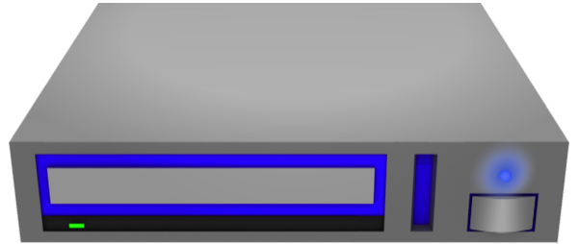
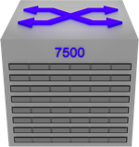
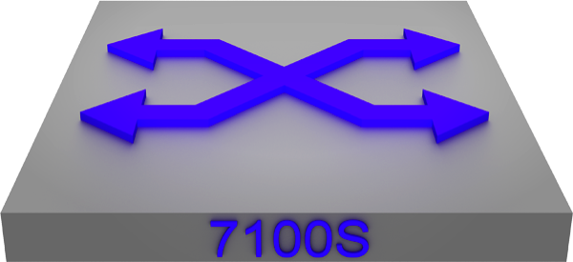
Customer use case
100G IDS
Symmetric Hashing
Bro-IDS
Existing Tap
Internet 2
Internet
Forensic Capture
htts://twitter.com/Bro_IDS

Slide 18
Don’t take our word for it…
http://commons.lbl.gov/download/attachments/120063098/100GIntrusionDetection.pdf

Slide 19
L2 Firewall / DPI load balance and
Firewall Offload

Slide 20
Transparent DPI/FW Load Balancing
Firewall / DPI
Firewall / DPI
Link Aggregation
Firewall / DPI
Link Aggregation
po1
po1
Arista
7050X-1
Layer2
Arista
7050X-2
Layer2
Firewall /DPI
Firewall / DPI
po2
po2
Link Aggregation
Firewall / DPI
Link Aggregation
Firewall / DPI
Firewall /DPI

Slide 21
Transparent DPI/FW Load Balancing
Link Aggregation
Link Aggregation
po1
po1
Arista
7050X-1
Layer2
Firewall / DPI
Arista
7050X-2
Layer2
po2
po2
untag
Link Aggregation
Link Aggregation

Slide 22

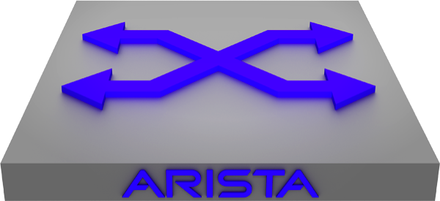
Software Defined Networking with Context
The visibility and context provided by Palo Alto Networks is leveraged to make optimized and secure SDN forwarding decisions on the Arista switches
Palo Alto Networks
Firewall
Untrusted/Unknown Flow
Trusted Flow
Attack Flow
Arista Switch

Slide 23
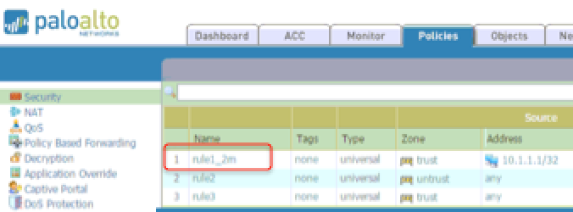
Configuration and Triggers
SDN flow configuration is integrated into the firewall policy and configured through the firewall GUI
Palo Alto Networks
Next Generation Firewall
The firewall triggers flow changes on the switch using syslog messages
syslog
Arista Switch
An EOS extension called Direct Flow Assist on the switch receives the syslogs modifies the flow table

Slide 24


Enterprise Customer: DFA with QoS marking
Palo Alto firewall monitors traffic and identifies the specific application such as “youtube”, sends syslog message to Arista Switch.
syslog
DFA running on the Arista switch parses the syslog message then does a lookup based on the application name to determine if any CoS and/or ToS flow markings should be written into the frames of the bypass flows.

Slide 25
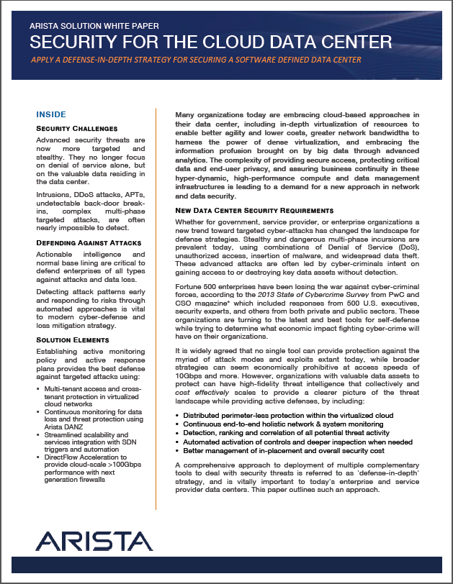
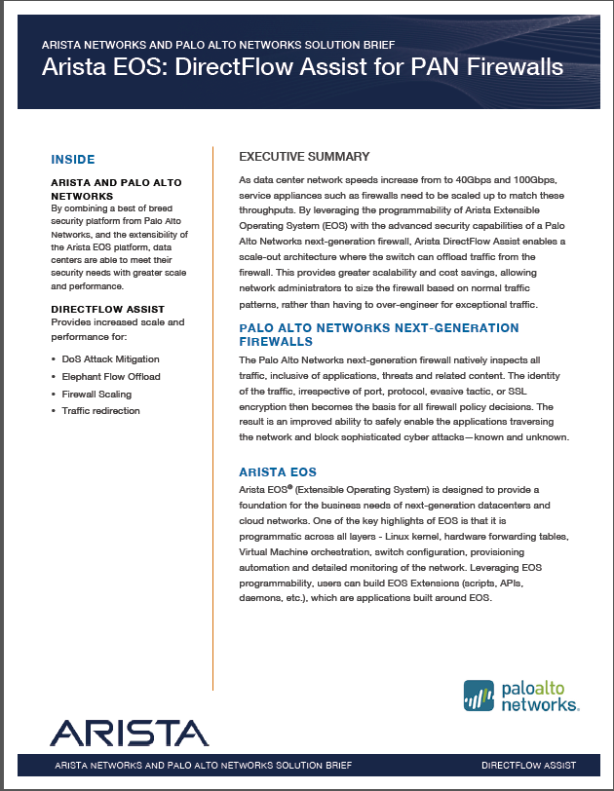
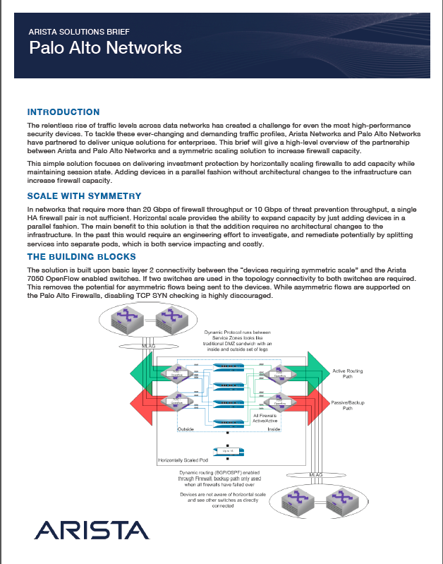
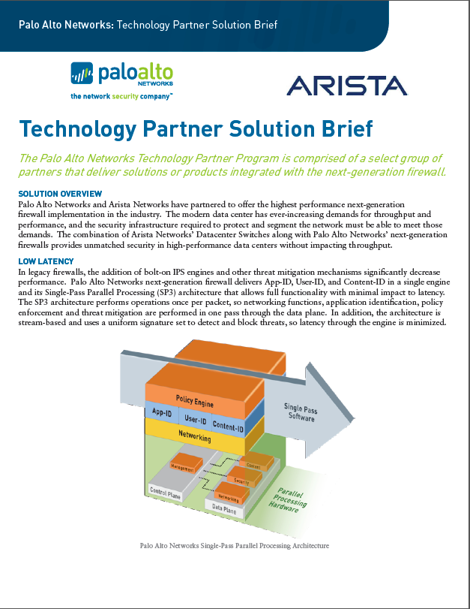
White Papers on www.arista.com

Slide 26
Takeaways
Vmware and Arista better together
Virtual to Physical Network:
- Vmtracer for vCenter - Arista 實現VLAN自動部署及虛擬主機/網路在實體交換器的可視性.
- NSX VXLAN L2 Gateway
- Arista 實現硬體效能VXLAN L2 Gateway自動部署, 並連結虛擬主機與實體主機, 實體防火牆,
實體負載平衡器, 無縫接軌NSX虛擬化網路及既有的傳統網路.
- Vmtracer for NSX VXLAN - Arista 實現虛擬主機與NSX VXLAN虛擬網路在實體交換器的可視性.
NSX Trace Flow - 整合Arista switch, 實現end-to-end 追蹤虛擬與實體網路連線路徑, 以利障礙排除.
Mirror traffic based on NSX Logical segment - 提供監控某個Logical switch 的流量, 以利監控分析.
Central point of Management for entire physical network – Arista 提供單一管理平台, 使Vmware 掌控Arista 實體交換器, 有如其系統的一部份, 達到虛擬與實體網路的無縫整合.

Slide 27
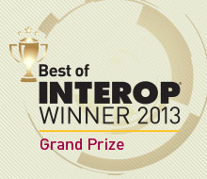
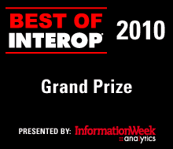
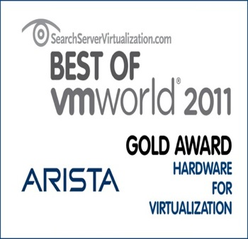
About Arista Networks
10/40/100GbE Networks for the Virtualized Cloud & Data Center
Founded in 2004
Shipping Since Mid-2008
NYSE: ANET in 2014/6
3000+ Customers
1000+ Employees
Profitable, self-funded network infrastructure provider
Founded to build the best Network Operating System for Next Generation Data Centers
Notes:
A new virtualized, cloud-architected data center is emerging with new traffic patterns and new performance, scalability, availability and cost requirements. Arista was founded in 2004 to build a new class of products based on a next generation network operating system to enable these new data centers to be successfully designed, built and deployed. We started with a clean slate. The results speak for themselves: award winning products since we began shipping – most recently two best of Interop awards and a best of VMworld, as well. We have over 2100 customers and over 600 employees around the world – more than half of them engineers who continue to innovate with new features for our best of breed switches.
What is unique in what we do? We provide best of breed hardware purpose built for the data center, which runs our next generation network operating system, EOS. Our software and hardware are built with one goal in mind: to reduce the operational and logistical challenges of running and maintaining modern data center infrastructures in a way and on a scale that has never been previously possible. Are these challenges that you face today or anticipate facing in the future? What would you like to change about your data center network?

Slide 28


Universal Cloud Network Design for
Any Application
Big Data
IP Storage
Cloud
Web 2.0
Legacy Applications
VM Farms
HFT
VDI
Network Applications

Slide 29
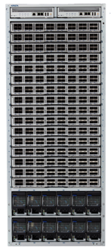
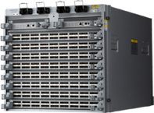
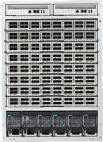

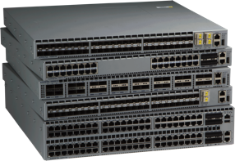

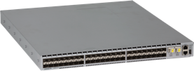
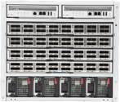

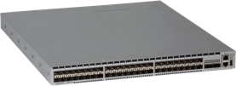
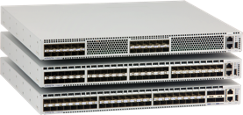
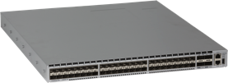
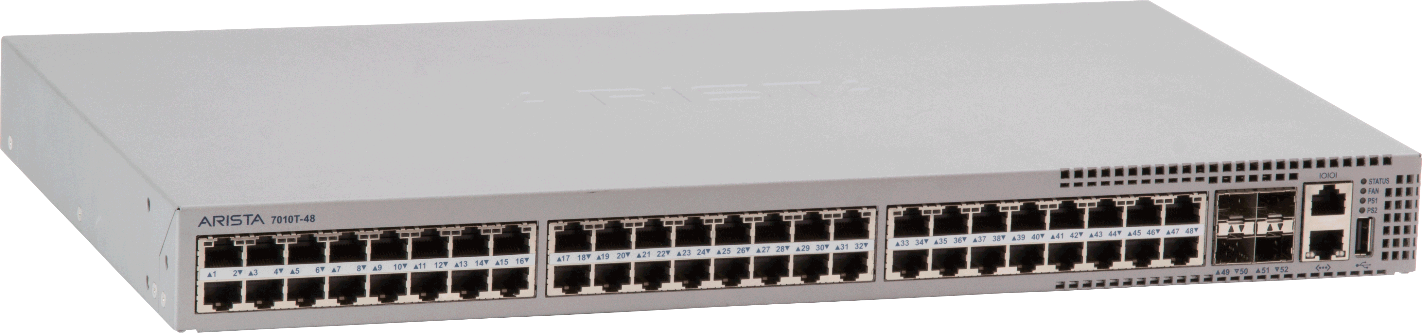

Arista : The Best Data Center Portfolio
Extensible Operating System
100G
VXLAN support
100G
100G
7300X
High Density, Modular System supporting up to 512 40GbE
Cloud Scale
Leaf and Spine
10/40G
7500E
Lossless, High Density, Modular Switching System supporting up to 1152 Wire speed 10GbE Ports
LANZ / DANZ
Spine
10/40/100G
7280SE
10/40/100G
Ultra Deep Buffers
VOQ and Lossless
Enhanced Visibility
LANZ/DANZ
NEBS
7150S
Ultra Low Latency 24,52,64-port SFP+ 1G-40GbE Switches
LANZ and DANZ
7050X & 7250X
Dense Low Latency
32 & 64-port QSFP
96xSFP+/8xQSFP
Advanced Virtualization
Scale-out
Visibility
7060X
Dense Low Latency
32 & 64-port 100G QSFP
2xSFP+/64xQSFP
Advanced Virtualization
Scale-out
Visibility
7010T & 7048T
48-port Data Center Class Gigabit Ethernet Switch

Slide 30
Thank-You

