Slide 1
打造智慧教學雲
以 VMware Workspace ONE 搭配NVIDIA GPU技術打造智慧學習平台
蔡均璋 Diamond Tsai
VMware 資深技術顧問
2019/3/22

Slide 2
Agenda
1 | 方案分享 | 貼近產業及科技發展，加速智慧教學及創新 | VMware
2 | 經驗分享 | 打造智慧軟硬體教學平台，以虛擬教室打破學習疆界 | 龍華科大

Slide 3
Intelligent Enterprise
Edge Computing
Quantum Computing
科技加速各種應用創新，智慧教學需要跟進腳步
Artificial Intelligence
Immersive Experiences
Blockchain
Notes:
People’s experiences of technology as consumers changed their expectations for technology at work, helping to create the first wave of digital transformation.
New technologies are propelling the next wave, technologies like big data and analytics, industrial and consumer IoT, and, of course, the increasingly powerful networking and hybrid cloud infrastructure that supports it all.
For example, IDC predicts that up to 43% of compute will happen at the edge in just the next couple of years, as organizations reimagine their models for communication, collaboration, training, and education.[1]
---- SOURCE ----
1. IDC. “The Future Is 5G: Five Ways the Combination of IoT and Mobility Drives Digital Transformation.” May 2017. https://www.idc.com/promo/thirdplatform/RESOURCES/ATTACHMENTS/IDC-DX-IoT-Mobility-eBook.pdf
According to IDC’s Global IoT Decision Maker Survey, enterprises expect that 43% of data generated on their IoT endpoints will be processed in whole or in part at the enterprise edge.

Slide 4
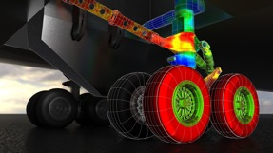
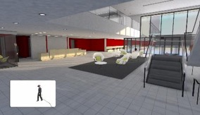
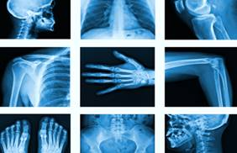
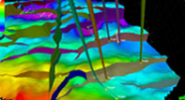

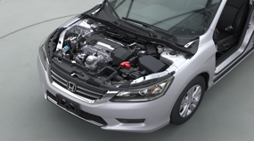
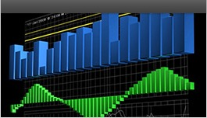
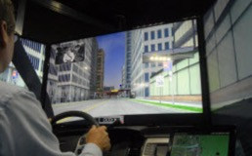
讓教學場景可以適用未來多元的產業應用
Manufacturing
Architecture
Medical Imaging
Energy
Media & Entertainment
Automotive
Finance
Defense
Notes:
The requirement to support mixed workloads is getting increasingly widespread with professional workflows getting more demanding so it improves the quality of their output and their productivity.
The need for compute intensive applications not defined by any one industry. It exists in fields of visual computing, life sciences, healthcare, financial services, big data analytics, and Engineering. It is the future of almost every industry and market because every engineer, designer, scientist and professional wants to improve their productivity and workflows by incorporating the benefits that these compute applications bring.
Lets pick the Computer Aided Engineering in the Manufacturing industry as an example to build on through this session.
Quadro vDWS is the most powerful virtual workstation and has the power to support the most demanding workflows. A few examples are here (pick a few to talk to that are most relevant to your audience)
In the manufacturing space, CAE workflows, for example, require both accelerated graphics for visualization and compute for running simulations (CUDA and OpenCL).
Similar to manufacturing, architects rely on graphic and compute intensive applications such as Autodesk Revit.
Applications like Cerner for cardiologists enable doctors to consult remotely, providing the ability to read high quality images from anywhere.
Schlumberger’s Petrel software platform is being used by some of the largest oil & gas companies in virtualized environments so engineers can work remotely.
We’re enabling an even more powerful user experience for video editing -- we have demonstrated 8K video editing using a virtual workstation on a Tesla P40 GPU.
Photorealism is enabling product designers to reduce design time and develop insights faster. As you can imagine it’s a very graphics intensive workflow, which you can also run from a virtual workstation.
Mapping and analytics applications like Esri ArcGIS Pro are used by transportation and government sector companies. These applications rely on very large data sets which are best secured and managed from the data center.
With the ability to support four 4K monitors, we can create very immersive training experiences with Quadro vDWS. A number of government agencies are delivering simulated design experiences using Quadro vDWS.

Slide 5
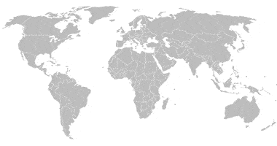



讓校園基礎架構可以適應未來的創新應用及多雲環境變化
Business
Critical Apps
Desktop
Virtualization
Graphic Intensive
Mobile
Cloud-Native
Apps
Analytics/
AI/ML
SaaS
Edge/IOT
Custom/Other
各種應用場景
混合雲
Public Cloud
雲端 及 邊緣運算
X86
GPU
NVM
SGX
QAT
FPGA
IPU
專用的加速 硬體
安全

Slide 6
VMware的混合雲平台方案支援各種智慧教學需求
雲原生應用教學
虛擬教室
應用
平台現代化
教學雲服務
資料中心現代化
混合雲基礎架構

Slide 7
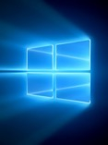
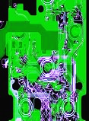

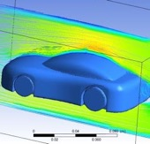
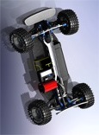

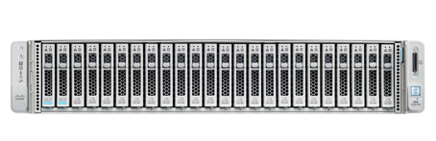

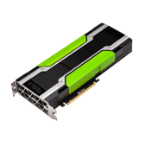
讓多種教學場景可以共享高價的硬體資源
虛擬教室
透過 Workspace One/vSphere 搭配 nVidia 顯卡
視覺化應用
智能及高速運算
vSphere vMotion with vGPU
Windows 10
2D EDA
3D Apps
Deep Learning
HPC
End-to-end GPU insights with vROPS
Notes:
Before we dive into that NVIDIA and VMWare platforms enable you to do, it is important to understand that not all workloads are equal. Even within the broad segments of Visualization (or Graphics) and Compute there are numerous subsegments and each of these have their own unique requirements. This is something you should factor in when you plan your deployments.

Slide 8
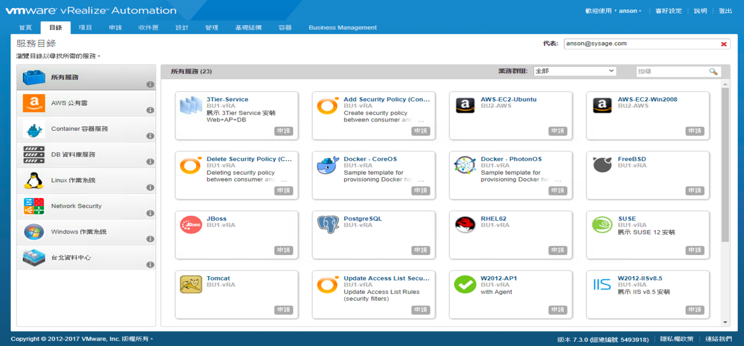
集中校園資源，讓建立像公有雲一樣好用的私有教學雲
教學雲服務
自助服務目錄
審核流程
自動部署
多租戶
服務計價
公有雲整合
應用程式商店體驗
服務類別
相關 IT 服務 x
自訂服務類別
基礎架構即服務和
一切即服務

Slide 9
VMware Cloud on AWS 讓公有雲可以成為教學雲的延伸
混合雲基礎架構
半天內完成雲端資料中心的部署，資源可以快速擴充、直接存取原生的公有雲服務
vRealize Suite
豐富多樣的 VMware 軟體定義的資料中心以雲端服務形式提供到 AWS 上
內部部署環境之間有一致性和
工作負載可移轉性
直接存取原生 AWS 服務的強大功能
Operational Management
VMware CloudTM on AWS
Powered by VMware Cloud Foundation
Native AWS Services
vCenter
vCenter
AWS
vSphere
incl. VIC
vSAN
NSX
Customer Data Center
AWS Global Infrastructure
AWS Global Infrastructure
Notes:
A look at VMware Cloud on AWS
KEY TAKEAWAYS
This slide shows a deeper view into the landscape of products that power VMware Cloud on AWS and provides a high-level view of how they interact.
TALKING POINTS
VMware Cloud on AWS is powered by VMware Cloud Foundation™, a unified SDDC platform that integrates VMware vSphere, VMware Virtual SAN™ and NSX™ virtualization technologies, and will provide access to the broad range of AWS services, together with the functionality, elasticity, and security customers have come to expect from the AWS Cloud.
Integrates VMware’s flagship compute, storage, and network virtualization products (vSphere, VSAN and NSX) along with vCenter management, and optimizes it to run on next-generation, elastic, bare-metal AWS infrastructure.
The result is a complete, no compromise, turn-key solution, that works seamlessly with both on-premises private clouds and advanced AWS services.
This service will be sold, delivered, operated and supported service. The service will be delivered over multiple releases with increasing use-cases, capabilities, and regions
Additional features include:
VMware VMware SDDC stack running on AWS
Compute (vSphere), storage (VSAN), networking (NSX)
Direct access to vCenter, including full API/CLI support
Delivered as-a-service (VMware lifecycle fully managed)
Access to AWS services
Consistent operational model enables Hybrid Cloud
Full support for existing and new applications
Existing management tooling layers on top
Hybrid and Cloud-only deployment options
Leverage cloud economics, aligning capacity & demand
Single bill for VMware software + AWS infrastructure
Consume elastically scalable SDDC clusters
On-demand or subscription
Leverage global AWS footprint
1. Initial animation: VMware Cloud on AWS is powered by VMware Cloud Foundation, a unified SDDC platform that integrates vSphere, vSAN and NSX, and provides access to the broad range of AWS services, together with the functionality, elasticity, and security customers have come to expect from the AWS Cloud.
VMC leverages the bare metal cloud services from AWS. These dedicated bare metal servers provided the basis of the vSphere Software Defined Datacenter.
2. vSphere 6.5 allows customers to operate their Virtual Machines and Containers, similar to how they do it on-prem. It provides the platform for vSAN and NSX. All-Flash vSAN acts as the storage platform and consumes host-local NVMe flash devices. NSX is used for all network functionality. It connects the ESXi host to the AWS network and exposes logical networks for virtual machine networking.
vCenter is used to manage the SDDC. Allowing customers to operate this cloud platform with the current tool and skill set.
An in-cloud SDDC can be used on its own, but most customers have a hybrid cloud strategy.
3. With vCenter Hybrid Linked Mode (a new feature for VMC), you connect the two vCenters to create a single pane of glass for Hybrid Cloud Management.
Most customers run a vRealize product on-premises such as vRealize Operations, or vRealize Automation. The in-cloud vCenter is just another end-point.
4. You can continue using your existing on-premises vRealize products,. This way, you get to manage both your on-premises SDDC and the VMC SDDC on a single pane of glass for operations and provisioning.
5. VMC provides access to the broad range of AWS services. It helps with data gravity. You are now able to place the application closer to the AWS services acting as data source.
6. Instead of network traffic egressing the DC firewalls to get to AWS, they are now connected to the same network as the underlying AWS services. This enables you to build and operate new application architectures

Slide 10
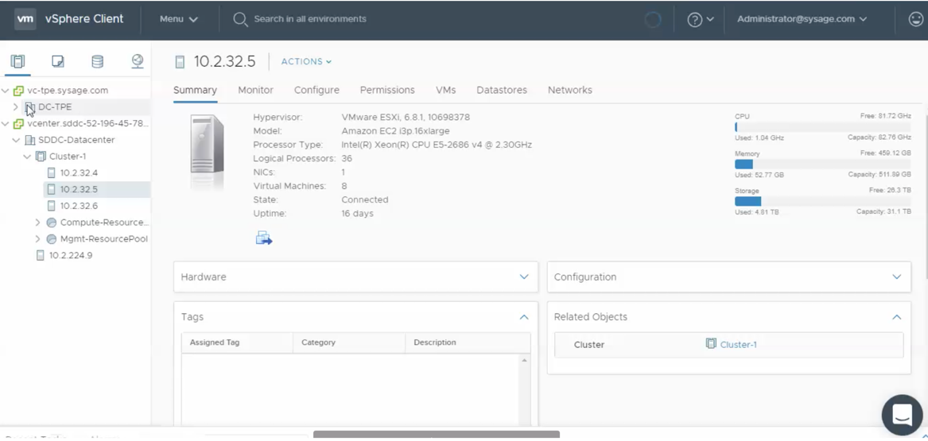
Hybrid Link Mode 提供一致性的基礎架構與管理介面
混合雲基礎架構
Notes:
A look at VMware Cloud on AWS
KEY TAKEAWAYS
This slide shows a deeper view into the landscape of products that power VMware Cloud on AWS and provides a high-level view of how they interact.
TALKING POINTS
VMware Cloud on AWS is powered by VMware Cloud Foundation™, a unified SDDC platform that integrates VMware vSphere, VMware Virtual SAN™ and NSX™ virtualization technologies, and will provide access to the broad range of AWS services, together with the functionality, elasticity, and security customers have come to expect from the AWS Cloud.
Integrates VMware’s flagship compute, storage, and network virtualization products (vSphere, VSAN and NSX) along with vCenter management, and optimizes it to run on next-generation, elastic, bare-metal AWS infrastructure.
The result is a complete, no compromise, turn-key solution, that works seamlessly with both on-premises private clouds and advanced AWS services.
This service will be sold, delivered, operated and supported service. The service will be delivered over multiple releases with increasing use-cases, capabilities, and regions
Additional features include:
VMware VMware SDDC stack running on AWS
Compute (vSphere), storage (VSAN), networking (NSX)
Direct access to vCenter, including full API/CLI support
Delivered as-a-service (VMware lifecycle fully managed)
Access to AWS services
Consistent operational model enables Hybrid Cloud
Full support for existing and new applications
Existing management tooling layers on top
Hybrid and Cloud-only deployment options
Leverage cloud economics, aligning capacity & demand
Single bill for VMware software + AWS infrastructure
Consume elastically scalable SDDC clusters
On-demand or subscription
Leverage global AWS footprint
1. Initial animation: VMware Cloud on AWS is powered by VMware Cloud Foundation, a unified SDDC platform that integrates vSphere, vSAN and NSX, and provides access to the broad range of AWS services, together with the functionality, elasticity, and security customers have come to expect from the AWS Cloud.
VMC leverages the bare metal cloud services from AWS. These dedicated bare metal servers provided the basis of the vSphere Software Defined Datacenter.
2. vSphere 6.5 allows customers to operate their Virtual Machines and Containers, similar to how they do it on-prem. It provides the platform for vSAN and NSX. All-Flash vSAN acts as the storage platform and consumes host-local NVMe flash devices. NSX is used for all network functionality. It connects the ESXi host to the AWS network and exposes logical networks for virtual machine networking.
vCenter is used to manage the SDDC. Allowing customers to operate this cloud platform with the current tool and skill set.
An in-cloud SDDC can be used on its own, but most customers have a hybrid cloud strategy.
3. With vCenter Hybrid Linked Mode (a new feature for VMC), you connect the two vCenters to create a single pane of glass for Hybrid Cloud Management.
Most customers run a vRealize product on-premises such as vRealize Operations, or vRealize Automation. The in-cloud vCenter is just another end-point.
4. You can continue using your existing on-premises vRealize products,. This way, you get to manage both your on-premises SDDC and the VMC SDDC on a single pane of glass for operations and provisioning.
5. VMC provides access to the broad range of AWS services. It helps with data gravity. You are now able to place the application closer to the AWS services acting as data source.
6. Instead of network traffic egressing the DC firewalls to get to AWS, they are now connected to the same network as the underlying AWS services. This enables you to build and operate new application architectures

Slide 11


HCX 即時移轉數千個虛擬機
混合雲基礎架構
Hybrid Cloud Extension 利用即時及排程式切換功能，加快移轉整個資料中心
HCX
  安全、廣域網路已最佳化、配合流量的
  雲端至雲端互連
  大規模、複寫輔助的雲端間 vMotion
  即時移轉
  提供從內部部署切換至雲端的可排定時程與立即切換功能
  雙向遷移
  10 倍於傳統遷移速度
VM
VM
VM
應用程式行動化
基礎架構混合
vSphere
vSphere
基礎架構抽象化
vSphere 5.0+ 內部部署
網際網路/Direct Connect/廣域網路
11

Slide 12
雲端發展讓未來的應用逐步轉為輕量化，容器化是基礎
雲原生應用教學
Containers are abstracting the application from the OS as VMs did to hardware
VM 1
VM 2
VM 3
VM 1
App 1
App 2
App 3
C 1
C 2
C 3
Bins/Libs
Bins/Libs
Bins/Libs
App 1
App 2
App 3
OS
OS
OS
Bins/Libs
Bins/Libs
Bins/Libs
OS/Container Engine
Hypervisor
Hypervisor
Infrastructure
Infrastructure
Virtual Machines
Containers + VMs
Notes:
Narrative: Containers are abstracting the OS like what VMs did to hardware

Slide 13
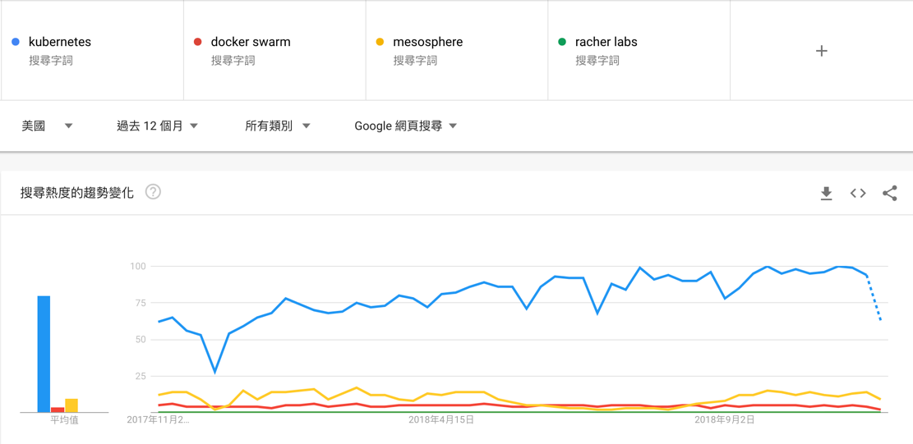
Container Orchestrator 戰爭已經結束， Kubernetes 是贏家
雲原生應用教學
Kubernetes 是下一代 Java

Slide 14
K8S 是容器編排平台贏家，但如何適用教學環境的多租戶特性?
雲原生應用教學
Kubernetes 可用於管理容器，誰來管理Kubernetes本身？
1
異構環境中的網路連接拓墣和流量管理？
2
Kubernetes 是容器編排平台的赢家。
單靠Kubernetes 是不足的。
3
異構環境中的存儲可用性和管理？
4
安全的容器鏡像存儲和部署？
5
運維基礎架構和流程？
（日誌紀錄、監控）
6
為開發人員提供的自助服務功能？

Slide 15

PKS 提供一個容易維運的雲原生應用學習環境
雲原生應用教學
快速部署 K8S 環境、K8S 生命週期管理, 多租戶安全性、容器網路配置及安全性提供
PKS Control Plane
Kubernetes on BOSH (Kubo/CFCR)
Container Registry
GCP
Service
Broker
etcd
master
worker
etcd
master
worker
BOSH
VMware
GCP
Azure
Openstack
AWS
NSX-T
Notes:
Market-ecture Slide

