Slide 1



Health Information Database Application
巨量醫療健康生活資料分析與應用
Big Data for Biomedical Applications
Chien-Yeh Hsu 徐建業 PhD
臺北護理健康大學資訊管理系所
National Taipei University of Nursing and Health Sciences
臺北醫學大學醫學資訊研究所
Taipei Medical University
台灣醫學資訊學會
Taiwan Association for Medical Informatics TAMI
2015-教育部「104年校務行政e化交流服務計畫」巨量醫療健康資料分析與應用
Notes:
修改自 yoyo_國合會-健康資料庫加值運用_徐建業_2014-new.ppt

Slide 2
Roadmap for ICT Development in Taiwan
行政院
2

Slide 3
Application Trend
Development Trend of Taiwan Health Systems
NHIP & U-Taiwan （2008~）
Ubiquitous e-Service
Tele Medicare
International Trend
Electronic
Medical
Record
Promote development of Value-added health applications
Personal
Healthcare
Record
Mobile Services
m-Taiwan（2005~）
Web Government
Services
Promote development of health informatics applications
Web Healthcare
Services
Government
e-Service
& e-indus-trialization
e-Taiwan（2002~）
HIS
Health
Insurance
IC Card
Construct Healthcare Informatics Infrastructure
HIN
NII
2002
2005
2008
2011
Notes:
鴻基、重品、祐民、蕾淇(2006/12/07)

Slide 4

The NHI VPN國家衛生基礎設施
DOH
CDC
HIN
BOH
Admin
SC
NHI head-quarter
HCA
IDC
600
Hospitals
NHI local offices
Other 100
HIS
NHI VPN
5,000
Pharmacy
17,000
Clinics
IDC – Internet Data Center
SC – Service Center
HIN – Health Information Network
NHI VPN – Virtual Private Network
4

Slide 5
衛生署「健康雲」規劃
◎ 【1-1】個人健康照護資訊整合雲端服務
[執行單位] 醫學資訊學會
◎ 【2-1】診所病歷雲端備份服務
[執行單位] 衛生署醫事處、工研院
1. 預防保健服務
亞健康
管理
慢行病
醫療
2. 醫療服務
◎ 【2-2】署立醫院醫療照護雲端服務計畫
[執行單位] 衛生署醫管會、署立醫院、資策會
保健
預防
亞急性
醫療
4. 健康資料
分析回饋
健康
衛教
急性
醫療
【4-1】健康資料加值中心網路化服務
[執行單位] 衛生署統計室、資策會
長期
照護
居家
照護
機構
照護
社區
照護
1-1 個人健康照護資訊整合雲端服務
2-1 診所病歷雲端代管及備份服務
2-2 署立醫院醫療照護雲端服務
3-1 遠距健康照護服務計畫
4-1 健康資料加值中心網路化服務
3. 復健及後續性服務
◎ 【3-1】遠距健康照護服務計畫
[執行單位] 衛生署照護處、工研院
資料來源：資策會-創研所整理, 2010

Slide 6
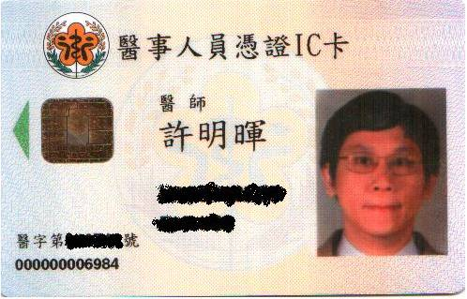
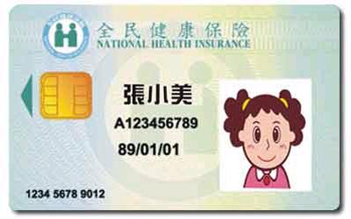
HCA Card
RSA Card issues from HCA
to health professionals
non-RSA
Health insurance IC Card for all citizens
6

Slide 7
Establishing EMR in Taiwan
Vision: At any hospital, a patient can get his/her integrated medical records using the health insurance IC card under the agreement and authorization of the patient.
Goal: By 2012, 80% hospitals(400, no clinics) DICOM and report, Test reports, and medications, 60% hospitals can exchange EMRs。
By 2014-(2016) complete EMR and exchange for all hospitals
7

Slide 8
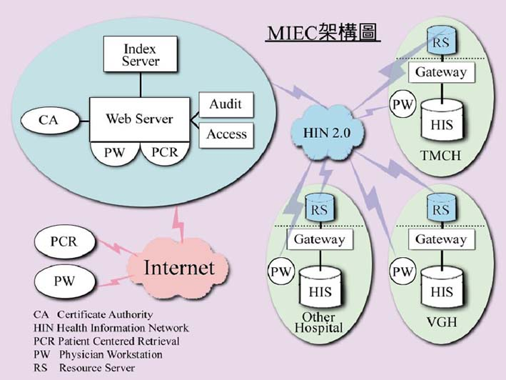
Medical Information Exchange Center – MIEC 2000
8
Notes:
8

Slide 9





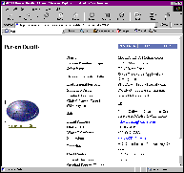
個人化健康資訊整合架構
TMT File Exchange Pathway
Hospital Information System
Hospital Information System
1
Laboratory
Information Systems
TMT viewer
Laboratory
Information Systems
Data Mapping
Gateway
Data Mapping
Gateway
2
3
Pre-Authorized
TMT File
TMT File
TMT File
TMT PHS
File
TMT PHS
File
TMT PHS
File
Personal Health
Records
Personal Health
Records
Personal Health
Records
4
TMT mini-server
TMT mini-server
Paperless server
9
Internet Health and Life Supporting Data Bank
Notes:
9

Slide 10
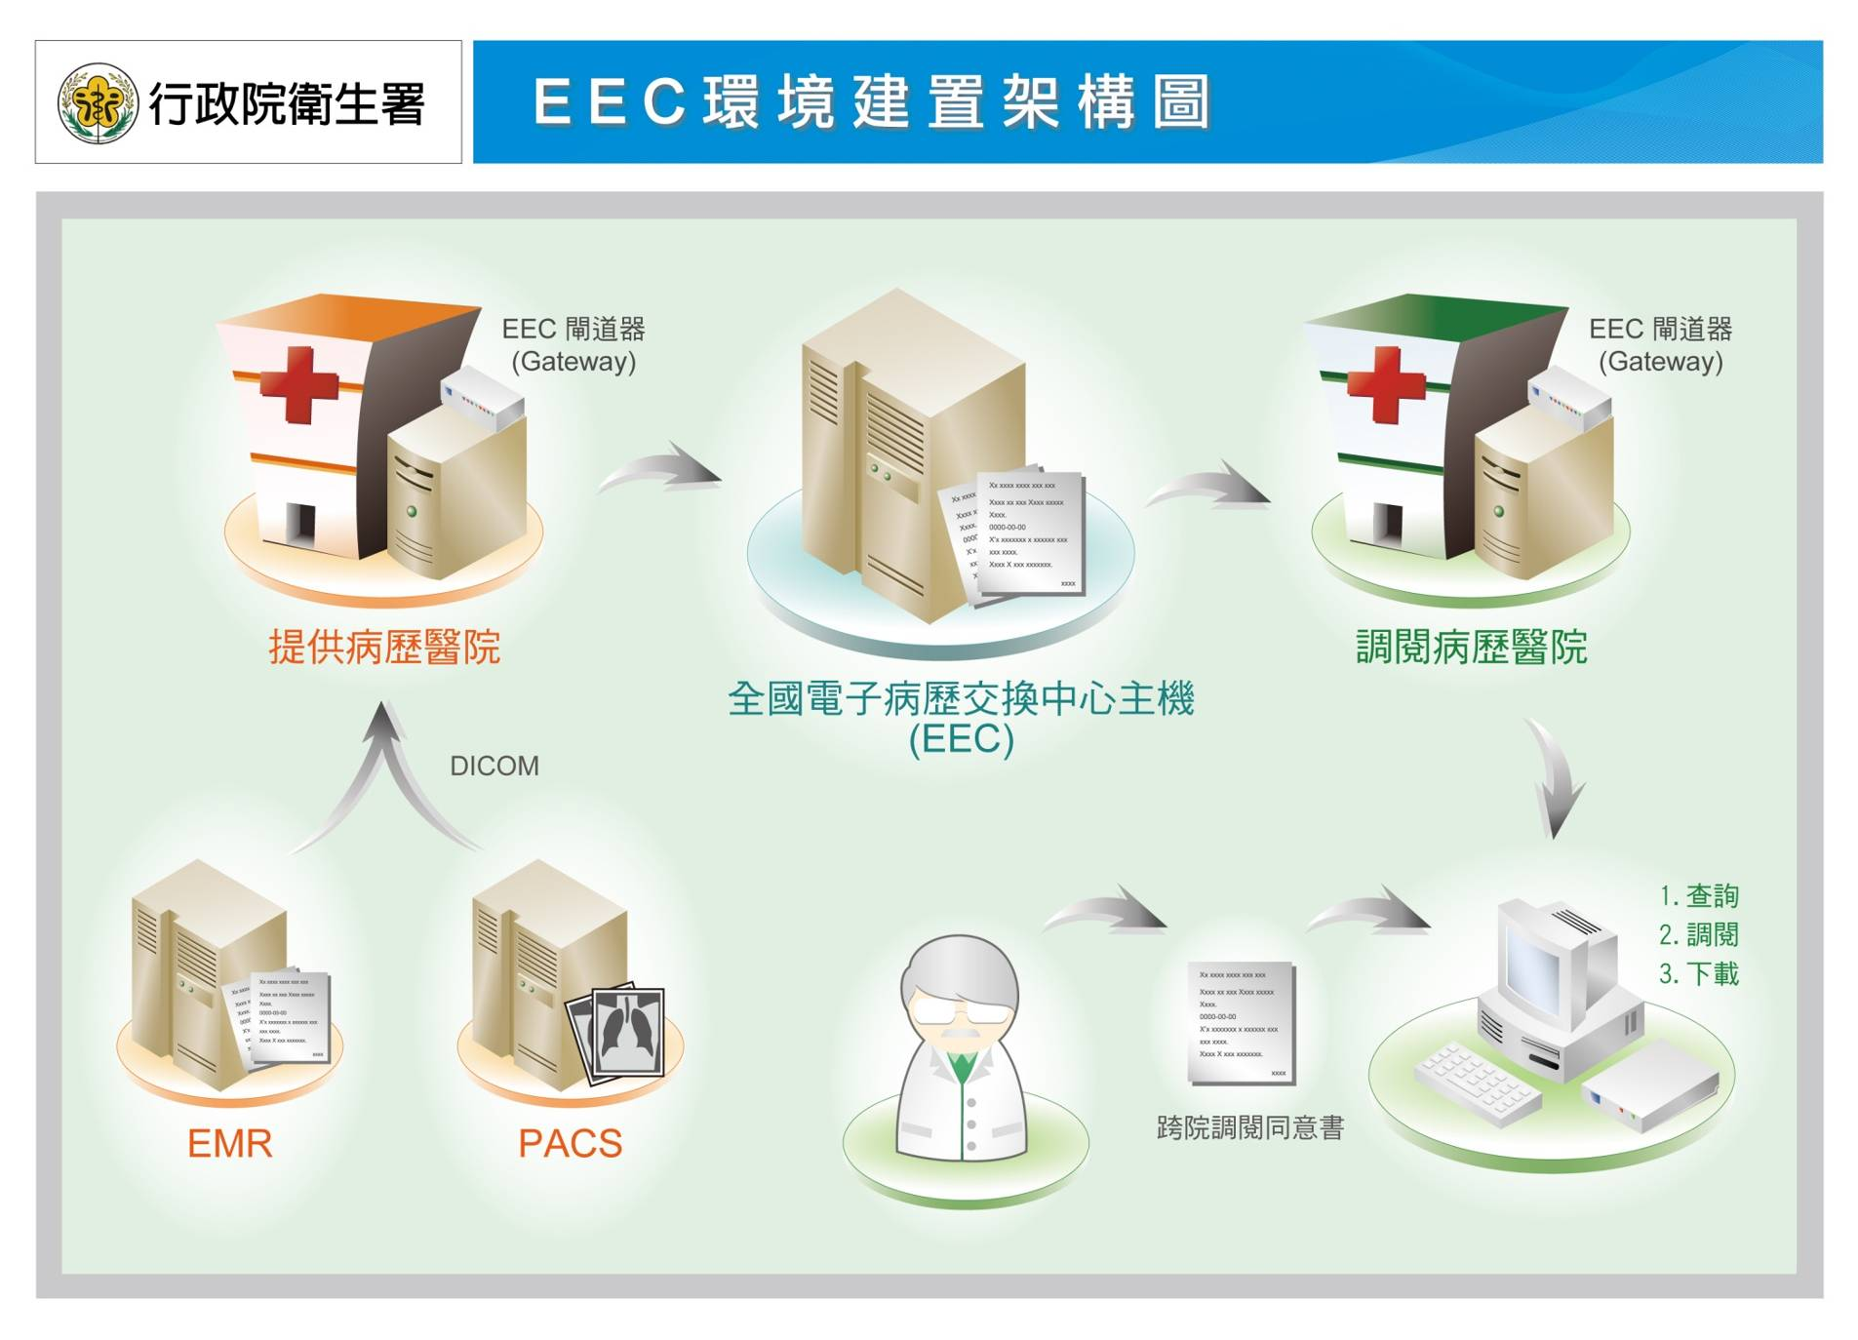
EMR Exchange Center
EMR providing Hospitals
EMR Reading Hospitals
National EEC Center
Download, Querying, and Reading

Slide 11
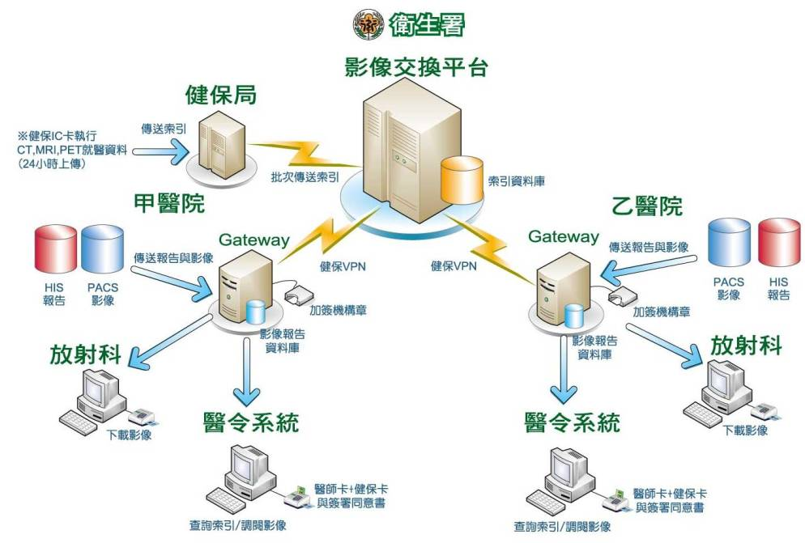
Ministry of Health
Image Exchange Center
134 hospitals,
2010-2011
upload index 2,168,063 request: 6,592 download: 81,108
Health Insurance Center
Index Server
Hospital B
Hospital A
eSignature
Image Report Database
Radiology
Radiology
Image Report Database
CPOE
CPOE
Download image
Download image
Dual Card system and inform consent
Dual Card system and inform consent
11
Request for image
Request for image

Slide 12

Personally controlled EHR
Value-added application
Private
sector
PHR
Public sector
EMR
Health Insurance Data
Immunization Record
Health Check-up
Self-collected
Min-Huei (Marc) Hsu, Director of Medical Informatics Center, Ministry of Health and Welfare, TAIWAN

Slide 13
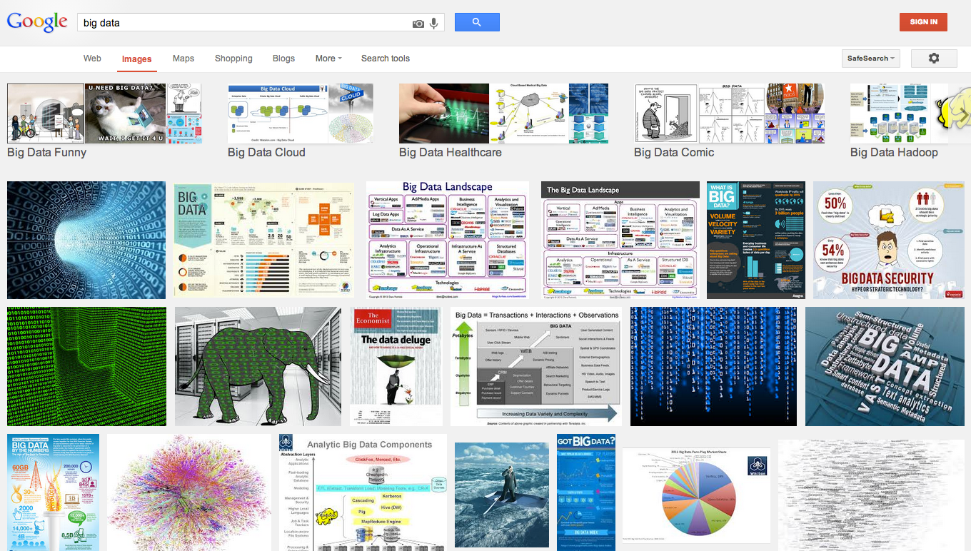
Let’s ask google about “big data”

Slide 14
What is BIG DATA?
Wikipedia: a collection of data sets so large and complex that it becomes difficult to process using on-hand database management tools. The challenges include capture, curation, storage, search, sharing, analysis, and visualization. The trend to larger data sets is due to the additional information derivable from analysis of a single large set of related data, as compared to separate smaller sets with the same total amount of data, allowing correlations to be found to "spot business trends, determine quality of research, prevent diseases, link legal citations, combat crime, and determine real-time roadway traffic conditions”.

Slide 15
What Is Big Data?
High-volume (大量)
High-variety (多種類)
High-velocity (快速)
  sources such as online personal activity, commercial transactions, and sensor networks
Relating to health is a component of a growing field.
  e.g., e-health, m-health, digital health, health information technology, health 2.0, e-medicine, etc.
  Nilsen W, et al. J Health Commun, 2012.
  Laney D. META Group, 2001.
  Kumar S, et al. Computer, 2012

Slide 16
5 Vs of Big Data
Volume, Veracity(準確), Velocity,
Variety, and Value(價值)
Banking/Marketing/IT:
Volume, Velocity, and Value
Healthcare/Life Sciences:
Veracity(準確性), Variety, and Value

Slide 17




How Big is BIG DATA?
What about human brain? The Human brain’s memory storage capacity compares to something closer to around 2.5 petabytes (or a thousand Terabytes); which hold three million hours of TV shows. You would have to leave the TV running continuously for more than 300 years to use up all that storage.
http://www.scientificamerican.com/article.cfm?id=what-is-the-memory-capacity

Slide 18
Variety of BIG DATA Sizes
Google Map
~ 80 Tb
Human brain
capacity ~ 2. 5 Pb
WikiPedia
> 10 million articles <50 Gb
Facebook
~ 100 Pb
NCBI Genbank
Download
~ 600 Gb
Amazon.com
~ 42 Tb
Human Genome (compressed)
< 1Gb
NIH BTRIS DW 42K patients with 4 billion rows; ~ 1 Tb
NSA?
Google?
Mb
Gb
Tb
Pb
Eb
Database Size

Slide 19
The BIG DATA Challenges in Biomedical Science
Technology:
  Storage
  Query (Search)
  Sharing
  Transmission
  Computation & Analysis
  Visualization
Policy:
  Data sharing and access
  Workforce Education and Training
  Sustainable funding support

Slide 20
BIG DATA Sharing Challenges in Biomedical Science
Lack of incentive, motivation and means
Culture change from DIY (Do It Yourself) to DIT (Do It Together)
Technical infrastructure to address unique requirements of clinical research IT, e.g. confidentiality and security issues!
Lack of metadata in biomedical datasets (not being effective with universal frameworks or standards, but rather successful with research focused and project driven)

Slide 21
Opportunities to BIG DATA Science
Infrastructures, policies and incentives to promote data sharing
  Fosters the development, dissemination, and effective use of computational tools for the analysis of datasets whose size and complexity have grown by orders of magnitude in recent years
Integration of molecular and clinical datasets for analysis
  Collaboration & interoperability
  Logistical and analytical challenges and needs
  How to contextualize and comprehend?
Data should not be integrated for the sake of integration, but rather as a means to address specific biomedical questions and needs

Slide 22
Leveraging Big Data to Prevent Disease
Disease prevention requires two steps.
Identify modifiable risk factors for disease
  e.g., diet, exercise, smoking, alcohol consumption, and environmental pollution.
Interventions to improve disease risk factors
  To help that person achieve these goals.

Slide 23
雲端運算的醫療資訊運用
醫療資訊雲端服務託管Cloud services of hosting healthcare information
基礎設施和服務 National level infrastructure and services
  電子病歷的資料資源分享平臺EHR Data Platform for resource sharing
  電子病歷資訊整合與交換 EHR Information Integration and Exchange
  醫療政策控制 Healthcare Policy Control
  建立資料中心以進行各種資料管理及分析，提供各項服務，例如醫療機構KPI，多元化個人電子健康紀錄與健康管理

Slide 24
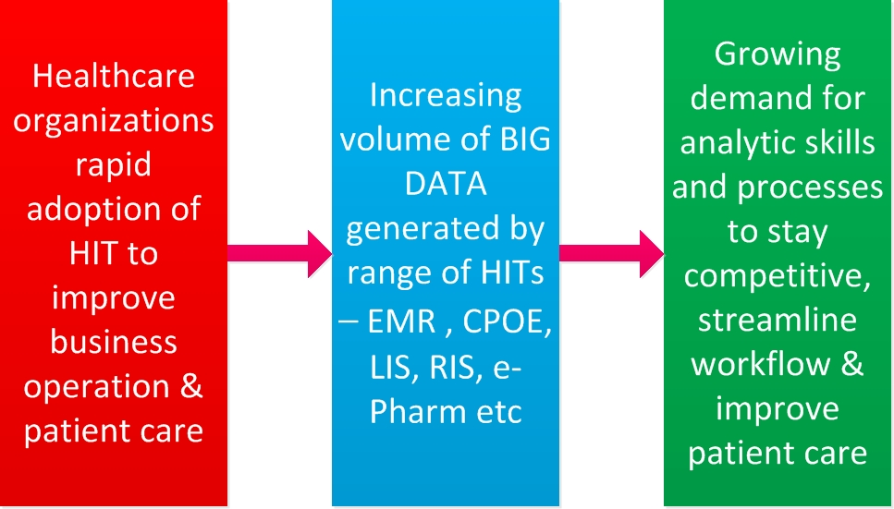
Bio-Medical and Health Informatics needs Analytics
醫院資訊系統快速的發展
需要分析資料來改善健康照護
各類數具快速大量的累積

Slide 25
The Value of use of health related data
Secondary Use(加值應用或二次運用)去識別化之健康資料為世界趨勢
  美國早已在20年前開放全國住院資料供研究者使用, USA started from 20 years ago
新的治療方式、疾病的診斷、藥物之副作用、疾病之關聯性…等, for discovery of New treatment, diagnosis methods, side effects of drugs, relationship between diseases
若沒有完整開放健康加值資料將嚴重損害廣大病人之權益, open data will fit the benefits of majority of people
From Prof. Jack Li

Slide 26
International Cooperation Example
Global Alliance
Just announced: 7 June 2013
70 organisations joining to promote sharing and standardisation of genomic data
A Global Alliance for sharing genomic and clinical data
A White Paper circulated in early 2013 has the support of nearly 70 organisations in Asia, Australia, Africa, Europe, North America and South America who are committed to creating a common framework that supports data analysis and protects the autonomy and privacy of participating individuals.
http://www.ebi.ac.uk/about/news/press-releases/Global-Alliance

Slide 27
Integrated Biomedical Informatics for Clinical Research
醫學研究之道，就是整合研究數據
2003年9月30日，美國國家衛生研究院（NIH）院長塞烏尼（Elias Zerhouni）宣佈：對美國政府資助的醫學研究進行重整。
「研究路線圖」的計畫 NIH Roadmap
National Electronics Clinical Trials and Research (NECTAR) network
建立完整的路線圖以及徹底更新醫學數據的收集、儲存及共用 methods for collecting, storage, and sharing
把龐大且分散的資料庫結合成一個巨大的資料庫 integrating data bases
發展軟體，使實驗計畫的撰寫能夠簡化並標準化 developing software for helping experiment design and common data element
減少紙張的使用 reducing paper use

Slide 28
Roadmap Standard Models
Laboratory
Research
Translational
Research
Clinical
Research
Population Research
Public
Health
Bench
Bedside
Practice
Accelerate basic research discoveries and speed translation of those discoveries into clinical practice
Explicitly address roadblocks that slow the pace of medical research in improving the health of the American people

Slide 29
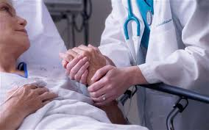
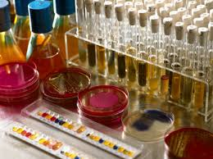
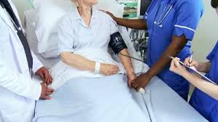
Translational Research in Biomedicine
Bedside
Bench
Bedside
From curative
to predictive, preventive and preemptive
to personalized medicine
Yang C. Fann, Ph.D. 2014 NIH/USA

Slide 30
Databanks related to health 我們有哪些資料?

Slide 31
Health-related Databanks
Process and Outcome
Mortality | Morbidity | Disability |  | Others
Death reporting | 1.Health insurance utilization databank 2.Cancer registration | 1.Catastrophic disease certificate databank 2.Disability certificate databank |  | 1.Birth reporting 2.Health care organization/service databank 3.Special survey for care providers
Health determinant
Health behavior | Economic status |  | Family status | Ethnicity
Health and nutritional survey | Household income and expenditure survey |  | Household & health insurance records | Indigenous people databank
31
Notes:
31

Slide 32
Use of cloud technology to provide health information value-added services加值應用
Bio-medical and Healthcare Data are
BIG Data = EMR data + genomic data
BUILDING A CLOUD-BASED CLINICAL DATA REPOSITORY (CDR)

Slide 33
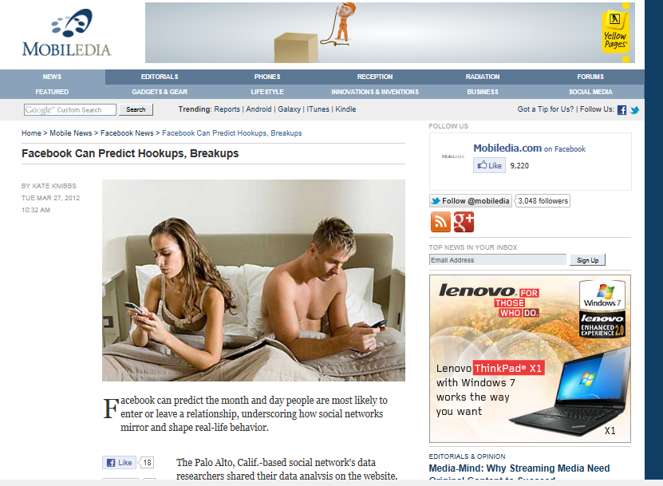
Facebook can predict your breakups
10/27/2015
©2011 Healthcare Information and Management Systems Society
33

Slide 34
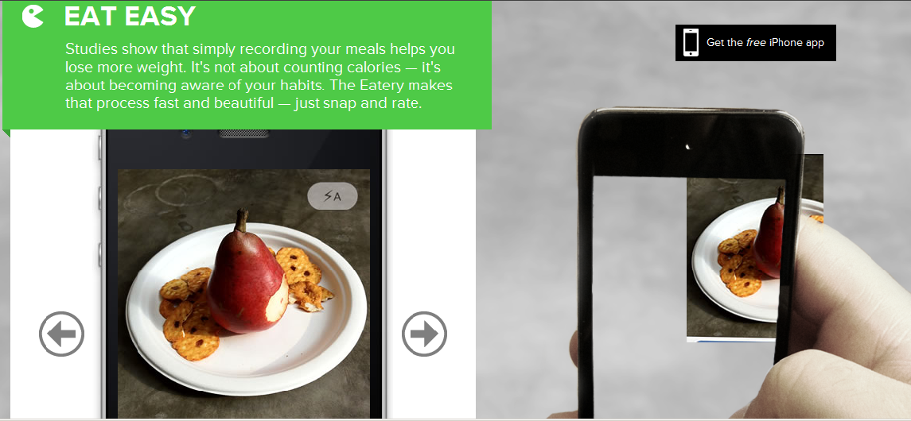
Eating Habits
Stop counting calories start eating better
https://eatery.massivehealth.com/

Slide 35
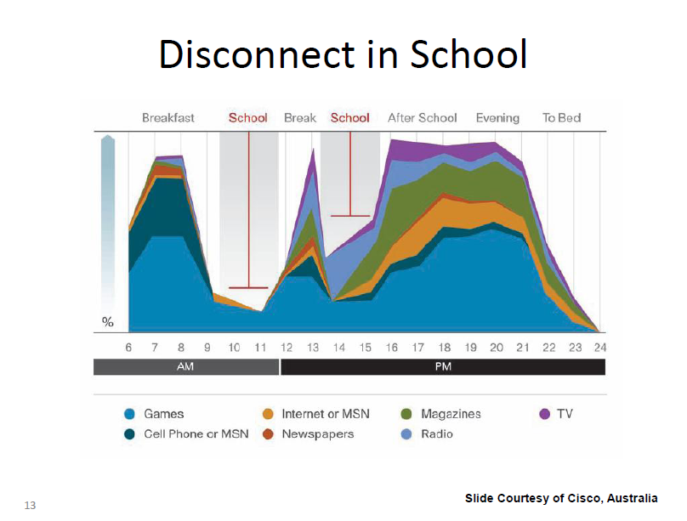

Slide 36

National Health Data Center
Bureau of Health Promotion
NHI
DOH
CDC
National Data
Data Center
Local Health Bureau
NHRI
Providers
MOI
TJCHA
FDA
Notes:
36
整合健保IC卡VPN網路、 HIN網路及HCA認證機制
建立各層級醫療院所醫療資料交換之標準
建立資訊與通信安全規範
建構衛生醫療大型資料庫與共通之資訊作業平臺
健保IC卡加值利用
研究發展HL7,DICOM醫療資訊標準化整合技術(IHE)及進行試辦

Slide 37
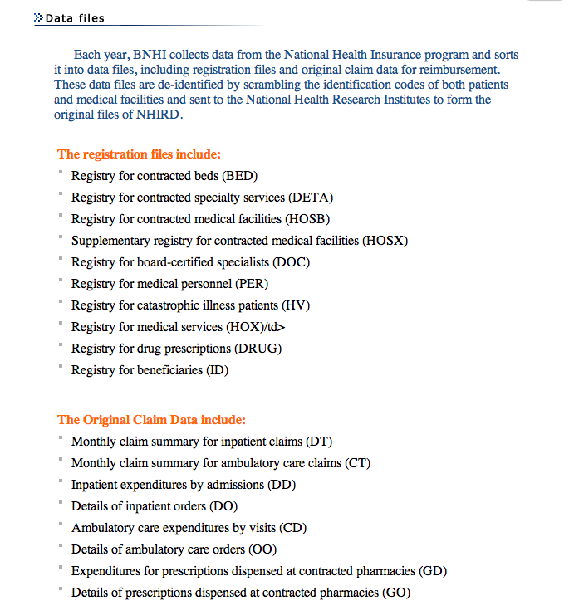

NHIRDB in Taiwan
NHIRDB (National Health Insurance Research Database)
  12 years of de-identified claim database for 23 million people
  Cohort DB (Five 1-million people groups for 13 years)
  Disease-specific DB (16 disease groups)
  Random sample DB (outpatient 1/500, inpatient 1/20)
  generates >100 research papers a year

Slide 38
健康資料加值應用思維
健康與社會關聯
38
社會結構
(Social structure)
物質環境
(Material factors)
勞動環境
(Work)
社會環境
(Social environment)
心理環境
(Psychological)
腦
(Brain)
神經內分泌
與免疫系統
的反應
(Neuroendocrine
and immune
response)
健康行為
(Health behaviors)
幼兒期環境
(Early life)
生理病態的變化
(Pathophysiological changes)
器官損害 (Organ impairment)
遺傳因素
(Genes)
健康 (Well-being)
罹病 (Morbidity)
死亡 (Mortality)
文化因素
(Culture)
資料來源(Source)：Social determinants of health,2006
Notes:
38

Slide 39
Cross-databank analysis
Algorithm of Cross-databank Analysis With Physical Isolation
Databank A downloading
Encryption of individual data
Databank B downloading
Encryption of individual data
Generating processed collective results
Abolish the downloaded database, only collective results can be taken out from isolated area

Slide 40
Integrated Data Analysis
Social Determinants of Health
Socioeconomic status
Work environment
Childhood environment
Health behavior
Indicators of Health Service
Accessibility
Availability
Efficiency
Effectiveness
Appropriateness
Safety
健康與社會的關聯
衛生政策的評估
Of Medical, healthcare, epidemic prevention or control, Healthcare policy
Source: Translated from Huang SM
40
From 衛福部統計處

Slide 41
Value-added application
世代追蹤應用
醫療服務及病預防
就診率存活率
追蹤
防治(疫)
效益追蹤
族群健康
追蹤
41
From 衛福部統計處

Slide 42
Examples of value-added application

Slide 43
Big Data 醫療應用
Drug for reducing mortality
  Statin(降膽固醇用藥，可減少全身的發炎反應) Use and Reduced Cancer-Related Mortality, Sune F. Nielsen, N Engl J Med 2012; 367:1792-1802
Predict disease outcomes
  Diabetes Care. 2015 May;38(5):746-51. Epub 2015 Feb 9. Long-term Mortality Risk After Hyperglycemic Crisis Episodes in Geriatric Patients With Diabetes: A National Population-Based Cohort Study.
Better anesthesiology
  Anesthesiology. 2010 Aug;113(2):279-84. Anesthetic management and surgical site infections in total hip or knee replacement: a population-based study.
New drug
Capturing disease risk factors
  L. Li,, Disease Risk Factors Identified Through Shared Genetic Architecture and Electronic Medical Records. Sci. Transl. Med. 6, 234ra57 (2014).

Slide 44
Cohort Study for Hemodialysis
1999
new cases
7,461人 ( 100% )
Death 919( 12% )
continue dialysis
5,366 ( 72% )
drop-off or death
1,176 ( 16% )
2000
Death 1,021( 14% )
2001
continue dialysis
4,567 ( 61% )
drop-off or death
799 ( 11% )
Death 622 ( 8% )
continue dialysis
3,955 ( 53% )
drop-off or death
612 ( 8% )
2002
Death 517 ( 7% )
continue dialysis
3,464 ( 46% )
drop-off or death
491 ( 7% )
2003
Death 432 ( 6% )
continue dialysis
3,052 ( 41% )
drop-off or death
412 ( 6% )
2004
Death 369 ( 5% )
2005
continue dialysis
2,710 ( 36% )
drop-off or death
342 ( 4% )
Death 311 ( 4% )
Source: Translated from Huang SM
44
Notes:
44

Slide 45
Disease Prevalence by Medical Visits
Malignancy
Brain Stroke
C-V disease
Diabetes
Pneumonia
Chronic liver disease
CKD
Hypertension
AMI Acute Myocardial Infarction
Source: Translated from Huang SM
45

Slide 46
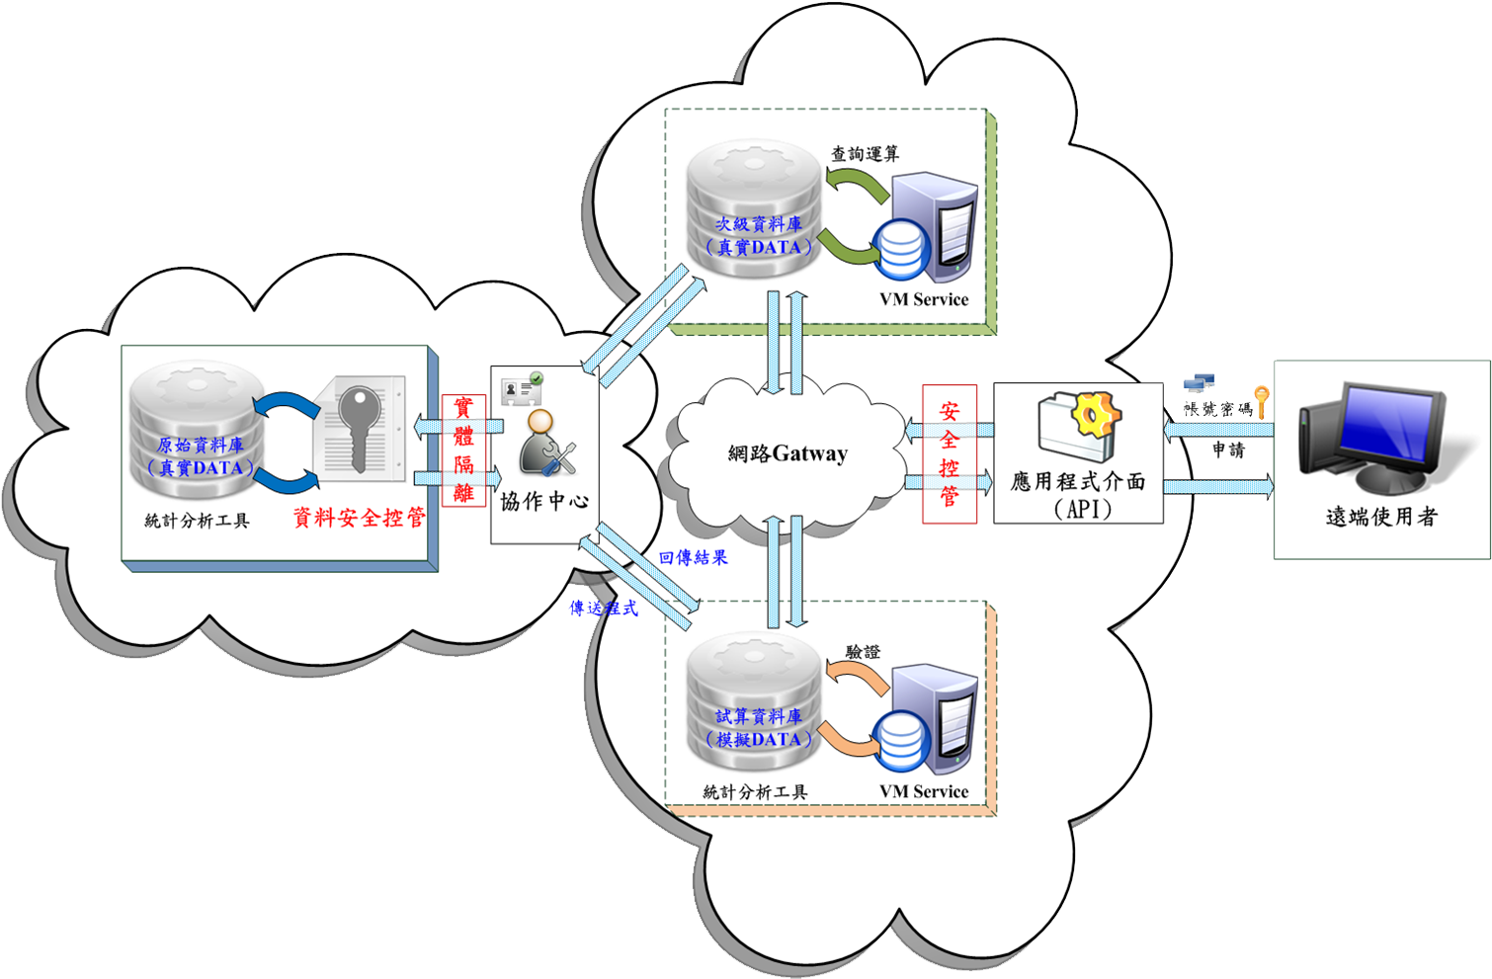
Collaboration Center for Value-added Application of Health Databanks – a Pilot (2)
Distant User
Phase 1
Phase 2
46
Notes:
46
46

Slide 47
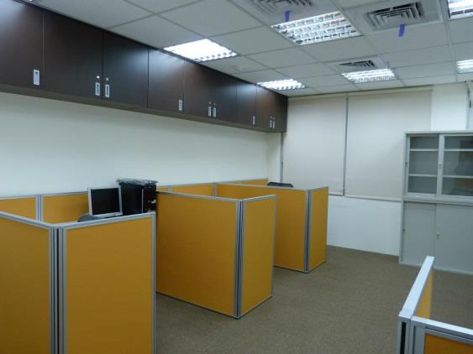
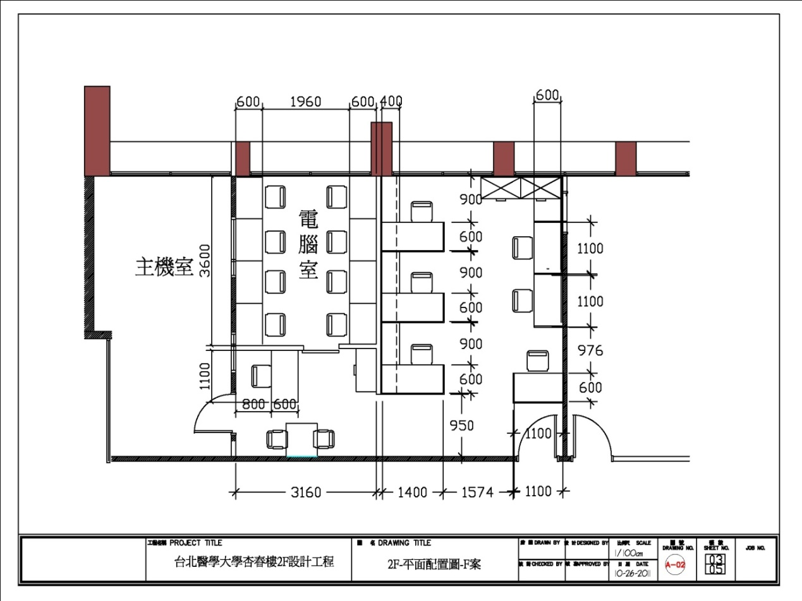

臺北醫學大學健康暨臨床研究資料加值中心平面圖與現況圖Taipei Medical University
左側隔間使用者坐位8個，2名管理人員坐位(左邊隔間左下角以及右邊隔間左下角)
47

Slide 48
主動式具有分析評估能力的主題式資料架構 2010
Data Architecture by Subjects with Active Analysis and Assessment
Public Health Administration
Integrated Data Center for Bio-medical Informatics
Health Insurance
DB
Provide Data
Regular Data Released
Epidemiology
Health Care
Management
De-identification
Cause of Death
DB
▪  
Redundant /
Feedback
Others
未通過專法，本中心不直接釋出資料
Cancer Register
DB
Data Released after IRB approval
Limited Data Set
Continuity Research
Tool Kits
Household (census)
Register
DB
User

Slide 49



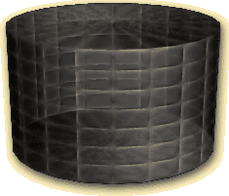


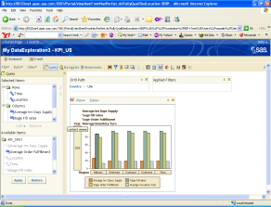


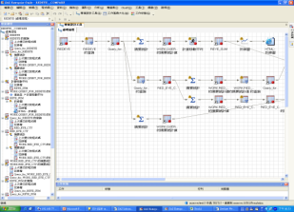

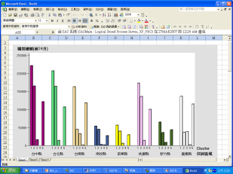

次級資料/
資料超市
臨床研究資料集:
線上即時分析報表
資料庫
健保資料
臨床/生統指標 (BI)
連結
資料庫
生統報表資料集:
報表資料/
彙整資料集
癌症資料
ETL
工具
生統報表(Web)
死亡資料
SAS 介面
其它
資料查詢與維護
(Office )介面
行政院衛生署統計室

Slide 50
現有資料庫種類(33種) different databases
代號 | 統計項目 | 資料提供單位
1 | 全民健保處方及治療明細檔-中醫門診、西醫門診、牙醫門診、住院、藥局 prescription details | 健保局
2 | 全民健保處方及治療醫令明細檔-中醫門診、西醫門診、牙醫門診、住院、藥局 | 健保局
3 | 全民健保承保檔 | 健保局
4 | 全民健保重大傷病檔 | 健保局
5 | 戶籍資料檔 census file | 內政部
6 | 死因檔 cause of death | 統計室
7 | 醫事機構現況檔 | 統計室
8 | 醫事機構服務量檔 | 統計室
9 | 醫療院所評鑑等級 | 醫事處
10 | 出生通報檔 | 國民健康局
11 | 癌症登記檔(含癌症登記檔、癌症診療資料庫、短表、長表) | 國民健康局
12 | 家庭醫療保健消費調查資料檔 | 統計室
13 | 醫事機構基本檔 medical institutes | 健保局
14 | 原住民檔(區分出生、死亡、戶籍) | 原住民委員會
Notes:
NHI prescription and treatment detail file - TCM clinics, physician visits, dental clinic, hospital, pharmacy
NHI prescription and treatment of medical orders detail file - TCM clinics, physician visits, dental clinic, hospital, pharmacy
NHI coverage file
NHI Catastrophic file
Census data files
Death file
Medical institutions the status file
Medical service volume file organization
Hospitals accreditation level
Birth notification file
Cancer Registry files (including cancer registry file, a database of cancer treatment, short form, long form)
Home health care consumption survey data file
Basic medical institutions file
Native file (distinguishing birth, death, residence)

Slide 51
糖尿病確診後罹患為肝癌之預測模型-
預測表現
 | Sensitivity | Specificity | AUC | SE | 95% CI | Significance level
ANN | 0.802 | 0.773 | 0.873 | 0.0123 | 0.747 – 0.798 | P < 0.001
LG | 0.751 | 0.736 | 0.793 | 0.0148 | 0.708 – 0.762

Slide 52
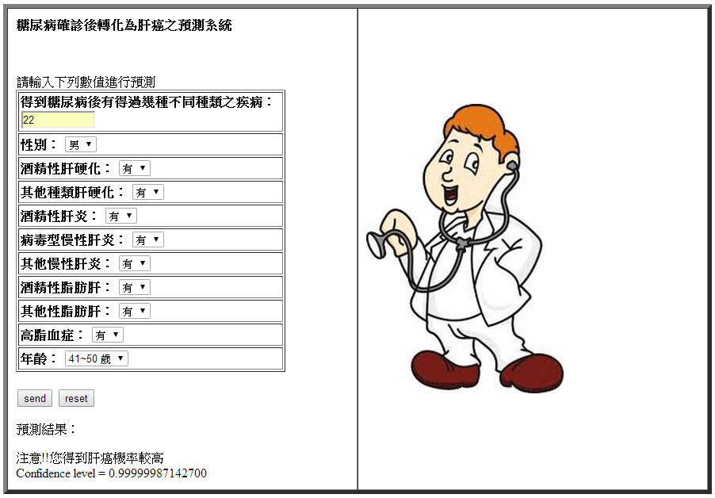
糖尿病確診後罹患為肝癌之預測模型
應用系統

Slide 53
CLOUD COMPUTING FOR PERSONALIZED HEALTH CARE
Achieving Meaningful Use of EMR/PHR

Slide 54
Meaningful Use of Health/Medical Information -- 4P Medicine
Personalization
Participation
Prediction
Prevention
More Ps
  Healthcare Promotion
  Precision medicine
  Payment system
Dr. Leroy E. Hood

Slide 55
A Definition of Personalized Medicine
Personalized medicine is the use of information from a patient's Phenotype/genotype to: initiate a preventative measure against the development of a disease or condition, or select the most appropriate therapy for a disease or condition that is particularly suited to that patient.
Definition paraphrased from www.wikipedia.org
Other sources: Jones, D. Nature Reviews Drug Discovery 2007; 6:770-771; Katsanis et al. Science 2008; 320(5872):53-54; Feero et al. JAMA 2008; 299(11):1351-1352

Slide 56
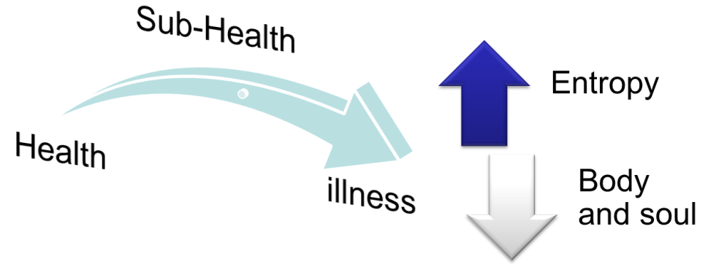
Meaningful Use of EMR
The importance of this project
  Build infrastructure so that citizens own their health record and receive basic health care services at the right time and right place
  Fee for illness → Fee for health
Benefit
  Reduce the waste in medical resources
  Improve healthcare quality
  Promote the health for all citizens
Business Model
Focus on healthcare industry
56
Notes:
56

Slide 57
Cloud computing will quickly change the use of medical information
The fact that Google and Microsoft are heavily invested “in the cloud” extends to their new offerings for medical records services, such as Microsoft’s HealthVault and Google Health.
Google 23andMe, 3.9 million USD and more, The integration of biological information, the use of new technology to establish a standardized DNA database, work with pharmaceutical and biotech industry to develop new drugs and personal medicine, Alzheimer’s foundation, Direct-to-Consumer research: recruit 10,000 patients with Parkinson’s disease to enroll. Brin’s Search for a Parkinson’s Cure, Brin proposes a different approach, one driven by computational muscle and staggeringly large data sets.
For example, a mutation to the GBA gene is 5 times more likely to have Parkinson’s
23and Me: Parkinson’s Genetics initiative
1. Tool Construction: Survey 2. Recruitment: 10,000 subjects with Parkinson’s. 3. Data aggregation: Community members DNA analyzed and surveys. 4. Analysis: database query based on 3,200 subjects. The results are returned in 20 minutes. 5. Presentation: People with GBA are 5 times more likely to have Parkinson’s. Total time elapsed: 8 months
Traditional Model
1. Hypothesis: 2. Studies: 3. Data aggregation: 5,500 subjects 4. Analysis: 5. Writing: 6. Submission: 7. Acceptance: NEJM 8. Publication: The paper notes that people with Parkinson’s are 5.4 times more likely to carry the GBA mutation. Total time elapsed: 6 years
Notes:
Not everyone with Parkinson’s has an LRRK2 mutation; nor will everyone with the mutation get the disease. But it does increase the chance that Parkinson’s will emerge sometime in the carrier’s life to between 30 and 75 percent. (By comparison, the risk for an average American is about 1 percent.) Brin himself splits the difference and figures his DNA gives him about 50-50 odds.

Slide 58
Big Data Network
“Manage data in Place” based on a “Data Networks”
Standards like Ethernet connector for Big Data
  Any data repository (structured or unstructured) can link it into the big data network (and access it remotely) in a consistent, open, and secure way.
  SharePoint (Microsoft), Network File System (NFS, Sun Microsystems)
Infrastructure links the individual data sources together
  Leaf Data Network Element (LDNE).
  Indexed data sources
  Authentication and access control, privacy and security
Enforcing interoperability
  Data Standards and metadata index about all the data elements
  trade-offs between scale – how big a data network can one build – and richness – how much information can I know in one place
SaaS: Software as a Service (data network application layer, DNAL)
  external, higher-level Tools and Applications logically live anywhere to perform operations on the data (move, copy, delete, analyze, etc).

Slide 59
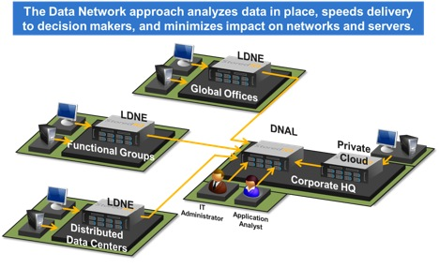
Leaf Data Network Element (LDNE).
The Rise of the Data Network
http://www.bigdatabytes.com/the-rise-of-the-data-network/

Slide 60
Huge data needs to be integrated個人化大量的資料必須整合
All kinds of Clinical Data 各種臨床資料
Patients can measure every feature, as the technology becomes cheaper: genome sequence, gene expression in every accessible tissue, chromatin state, small molecules and metabolites, indigenous microbes, pathogens, etc. 基因組測序，基因表達，染色體狀態，小分子和代謝物，微生物，病原體
These data pools can be created by anyone who has the consent of the patients: universities, hospitals, or companies.
This will be a huge amount of data to use statistical learning for medicine. The next engine of economic growth and improve peoples’ lives.
Use cloud computing to integrate all this data. better platform and network with computational power, data quality control, model building, and interpretation.

Slide 61
數據之”天龍八不”
不准用
找不到
拿不到
打不開
不會用
看不懂
不合用
不夠用
2014 中研院open data seminar
ODTW Meetup 2014 #3
從生態資料整合經驗看 LOD 建置

Slide 62
Public View
正確的方式
開發各式各樣的數據處理及分析工具
連結數據資料庫與分析工具
開放數據資料庫，使數據可以被搜尋到
方便的雲端化數據分享與處理
錯誤的方式
填寫各式各樣的統計表格
使用困難，不方便
需要花錢買
Internet
Data Sets
許多都是政府支持的研究或是公家收集並擁有的資料庫

Slide 63
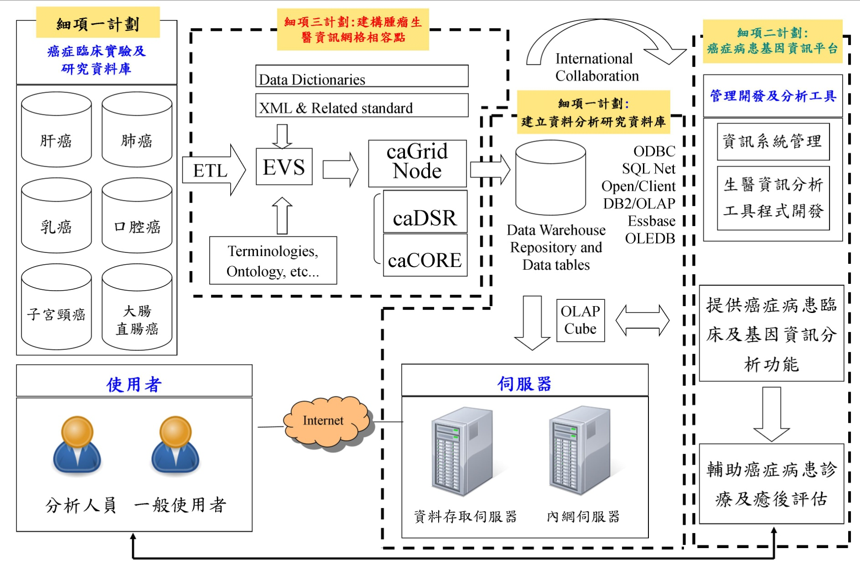
健康醫療BIG DATA 應用範例
癌症資訊標準化資料整合分析平臺
63
輔助癌症病患診療及預後評估

Slide 64
Privacy and data management
Who owns your genome/EMR data?
Who controls access to your data?
Who will store the genome, images, medical records?
How do you control access?
Why protect patient data?
  Right to privacy
  Could affect insurance costs
Can we share data to improve:
  Drug research?
  Treatment research?
How to manage the information
  Privacy: patient records, including genomes should stay within each medical system (country)
  Standards: personal genomes and other genetic data need standards
  Language: genomes are just data, but metadata (name, address, medical history) will be in local languages

Slide 65
Want can Data Governance Accomplish?資料治理的重要
The Data Governance Institute
www.DataGovernance.com
Enable better decision-making
Reduce operational friction
Protect the needs of data stakeholders
Train management and staff to adopt common approaches to data issues
Build standard, repeatable processes
Reduce costs and increase effectiveness through coordination of efforts
Ensure transparency of processes
The most common objective of Data Governance programs is to standardize data definitions across an enterprise or initiative. (for example: 電子病歷標準)

Slide 66
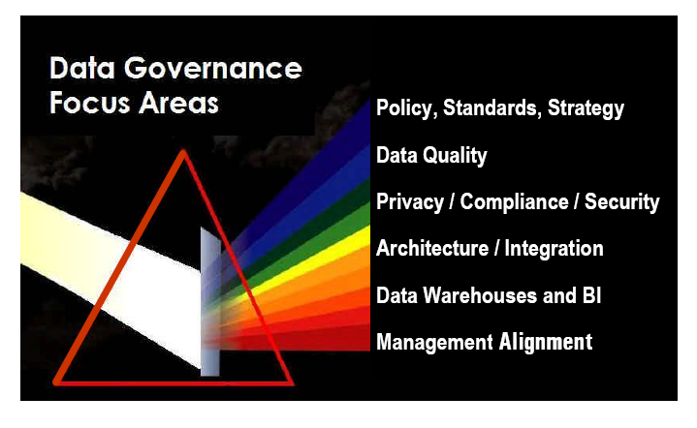

Typical Data Governance Focus Areas
Seven phases of Data Governance Life Cycle Methodology
第10頁
The Data Governance Institute
www.DataGovernance.com

Slide 67
What Do We Need To Get There?
New-Style Leadership
New Skills 人才需求
Next Generation of ICT-engaged Clinical Leaders
Executive Level-performing CIOs
Medical/Clinical Informatics
Patient Informatics
Enterprise data warehouse architects/data modelers, master data managers
Data Scientists (epidemiologists are the “new cool”)
Analysts - both business & clinical systems and clinical data analysts
Project managers
Source: Gartner, 2013
Notes:
Placeholder for text (substitute your own text; delete when not used)

Slide 68
Data Analyst
  Learn how to manipulate and analyze data
Data Scientist
  Learn how to make inferences and predictions from data.
Data Engineer
  Learn how to build data pipelines to work with large datasets.

Slide 69
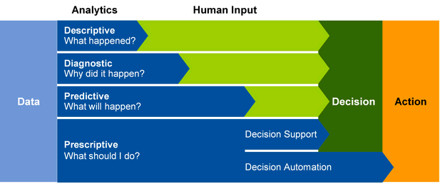
Four Types of Analytics Capability
資訊價值不同由低到高
知識深度不同由淺到深
Gartner Says Advanced Analytics Is a Top Business Priority
Analysts to Explore Analytics Capabilities at the Gartner Business Intelligence & Analytics Summit 2014, October 21-22 in Munich, Germany (http://www.gartner.com/newsroom/id/2881218)

Slide 70
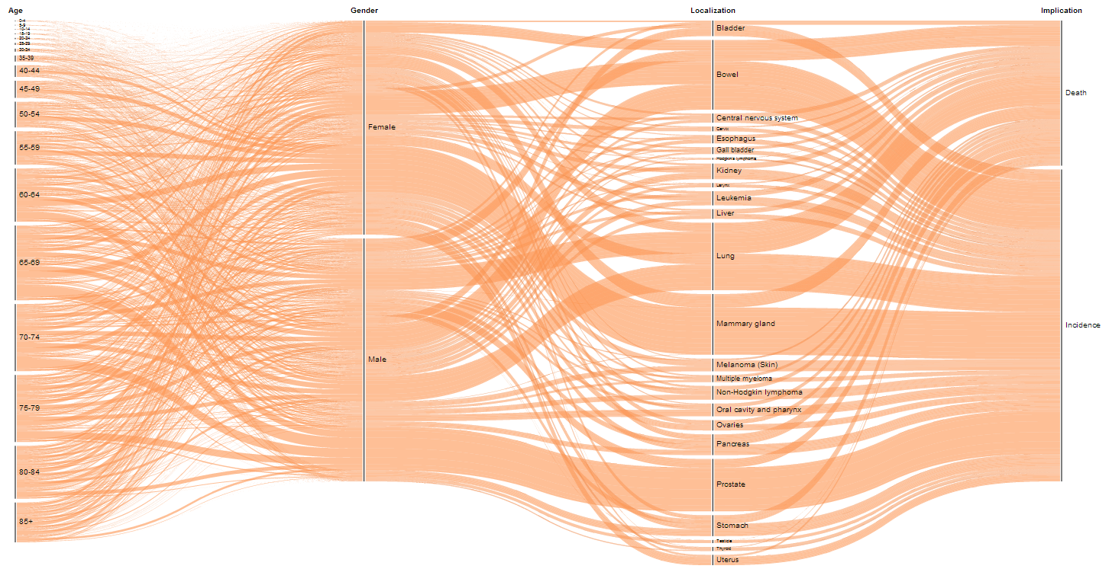
Visual Telling of Flow of Cancer Statistics
http://www.visual-telling.com/?p=343

Slide 71
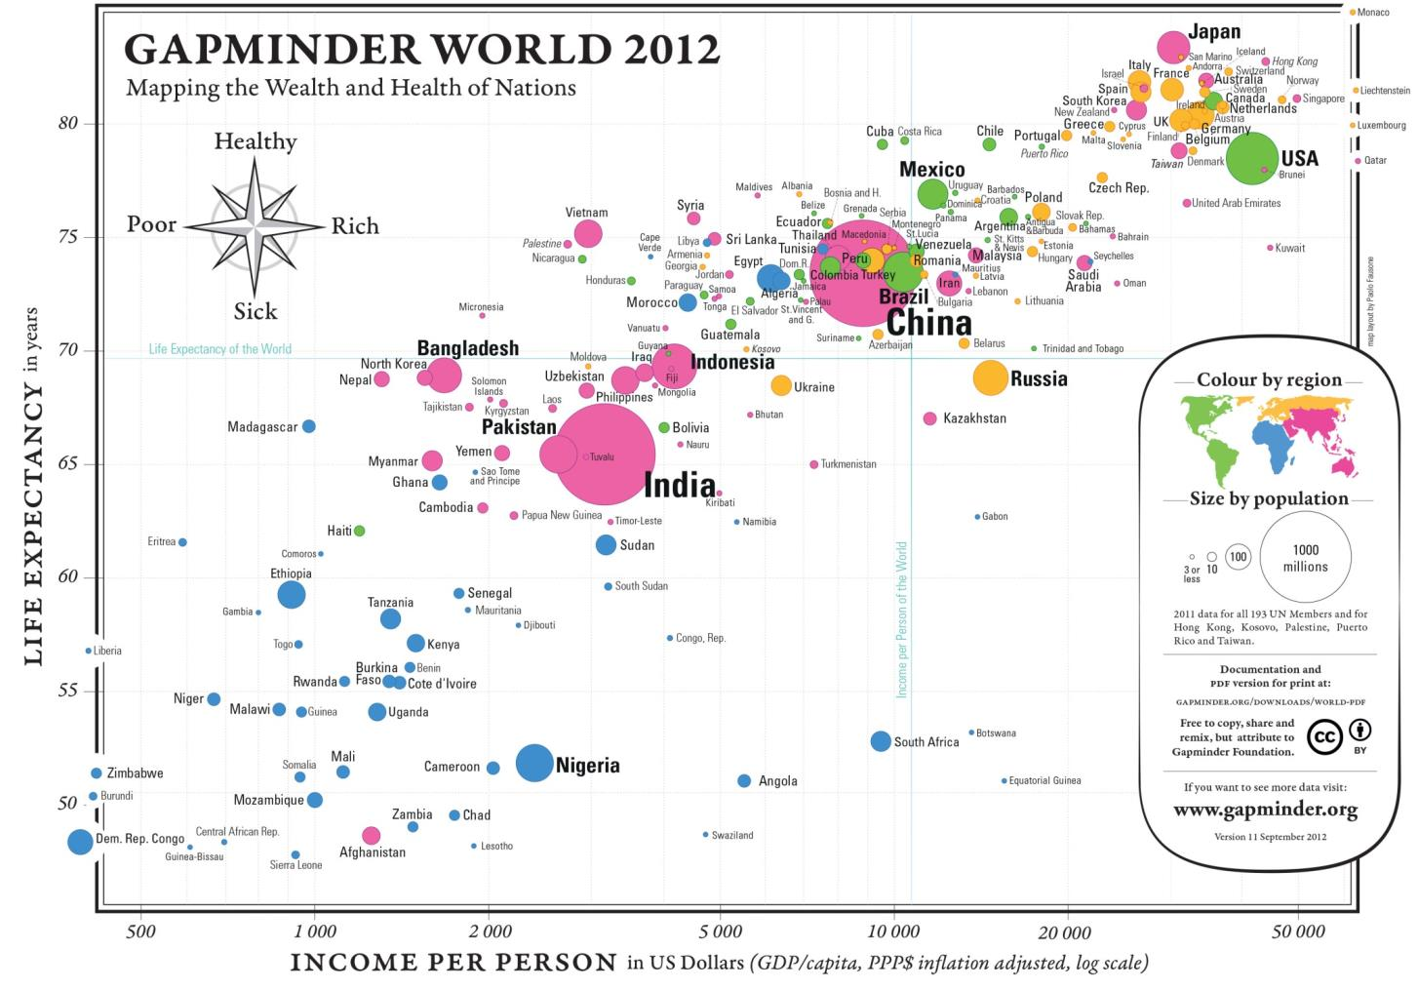
This graph from Hans Rosling's Gapminder.org shows by country how long people live and how much money they earn.(https://www.youtube.com/watch?v=Y4hKgqu_J_M)

Slide 72
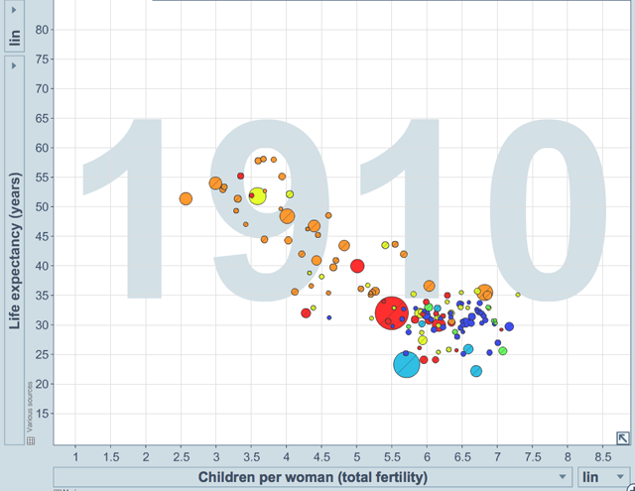
WORLDHEALTHRANKINGSLIVE LONGER LIVE BETTER
http://www.worldlifeexpectancy.com/country-health-profile/bangladesh

Slide 73
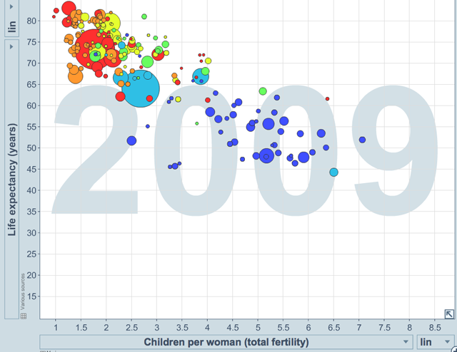
WORLDHEALTHRANKINGSLIVE LONGER LIVE BETTER
http://www.worldlifeexpectancy.com/country-health-profile/bangladesh
(https://www.youtube.com/watch?v=Y4hKgqu_J_M)
Show at 4:50, 5:49, 7:58, 12;04, 19:06

Slide 74
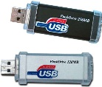
Personal Health Information Application Scenario NHIP
Diet Record
Exercise Record
BP, BS Record
Others
Public Health Knowledge Portal
Health Examination Center
Health Examination Center
People
Hospital
Hospital
Health Information Exchange Platform
Health Management Institution
Health Management Institution
Health Information Exchange Platform
Health Information Exchange Platform
Nursing Care Institution
Personal Health
Data Bank
Nursing Care Institution
Notes:
以民眾為中心
左邊是說民眾拿著存有ePHR之媒體載具(隨身碟或光碟片)到健檢中心檢查或者到醫院就醫,結束後再把資料存回
右邊是說資料存回後可進行個人之健康管理(可透過健檢中心、健康管理機構之健康管理諮詢服務，醫院之健康管理門診或由養護機構協助健康管理)
除了媒體之外可透過網路個人健康資訊儲存空間如個人健康Data Bank來存取個人之ePHR
ePHR除了病歷資料以外還包括了個人之飲食紀錄、運動紀錄等資料（此部分由個人自行提供）
由於用光碟儲存資料無法整合,所以有透過網路個人健康資訊儲存空間如個人健康Data Bank或ISP

Slide 75
Q&A
Prof. Chien-Yeh Hsu 徐建業教授 0939193212
e-mail:
cyhsu@ntunhs.edu.tw
cyhsu@tmu.edu.tw,
臺北護理健康大學
臺北醫學大學
臺灣醫學資訊學會
台灣電子健康學會
National Taipei University of Nursing and Health Sciences
Taipei Medical University
Taiwan Association for Medical Informatics, TAMI

Slide 76
Thanks you!

