Slide 1
如何翻轉行動教學 -桌面虛擬化教學應用
Fion Su
24. Feb 2017

Slide 2
Legal Disclaimer
INFORMATION IN THIS DOCUMENT IS PROVIDED IN CONNECTION WITH QUANTA PRODUCTS. NO LICENSE, EXPRESS OR IMPLIED, BY ESTOPPEL OR OTHERWISE, TO ANY INTELLECTUAL PROPERTY RIGHTS IS GRANTED BY THIS DOCUMENT. EXCEPT AS PROVIDED IN QUANTA'S TERMS AND CONDITIONS OF SALE FOR SUCH PRODUCTS, QUANTA ASSUMES NO LIABILITY WHATSOEVER AND QUANTA DISCLAIMS ANY EXPRESS OR IMPLIED WARRANTY, RELATING TO SALE AND/OR USE OF QUANTA PRODUCTS INCLUDING LIABILITY OR WARRANTIES RELATING TO FITNESS FOR A PARTICULAR PURPOSE, MERCHANTABILITY, OR INFRINGEMENT OF ANY PATENT, COPYRIGHT OR OTHER INTELLECTUAL PROPERTY RIGHT.
UNLESS OTHERWISE AGREED IN WRITING BY QUANTA, THE QUANTA PRODUCTS ARE NOT DESIGNED NOR INTENDED FOR ANY APPLICATION IN WHICH THE FAILURE OF THE QUANTA PRODUCT COULD CREATE A SITUATION WHERE PERSONAL INJURY OR DEATH MAY OCCUR.
Quanta may make changes to specifications and product descriptions at any time, without notice. Designers must not rely on the absence or characteristics of any features or instructions marked "reserved" or "undefined." Quanta reserves these for future definition and shall have no responsibility whatsoever for conflicts or incompatibilities arising from future changes to them. The information here is subject to change without notice. Do not finalize a design with this information.
The products described in this document may contain design defects or errors known as errata which may cause the product to deviate from published specifications. Current characterized errata are available on request.
All products, computer systems, dates, and figures specified are preliminary based on current expectations, and are subject to change without notice. Contact your local Quanta sales office or your distributor to obtain the latest specifications and before placing your product order.
Copyright © 2012-2014 Quanta Computer Inc. All rights reserved.
Other names and brands may be claimed as the property of others.

Slide 3
簡報內容
公司簡介
教學的演進
QCT 桌面虛擬化解決方案
QxVDI-OA
QXVDI-HC
QxVDI-3D
QxVDI VMware 系列產品效益與特色

Slide 4
廣達
台灣上榜企業第三大
Rank: 326 Employees: 90,167
Source: Fortune Magazine, issued on 2016
http://beta.fortune.com/global500/quanta-computer-326
Notes:
Many of you may already know about Quanta Computer.
1 out of 4 laptops sold worldwide are manufactured by Quanta.
In 2013, we were ranked number 409 on the Fortune Global 500 list.
Quanta has an established track record of building reliable, quality IT hardware for many global brand names for the last 2 decades.

Slide 5
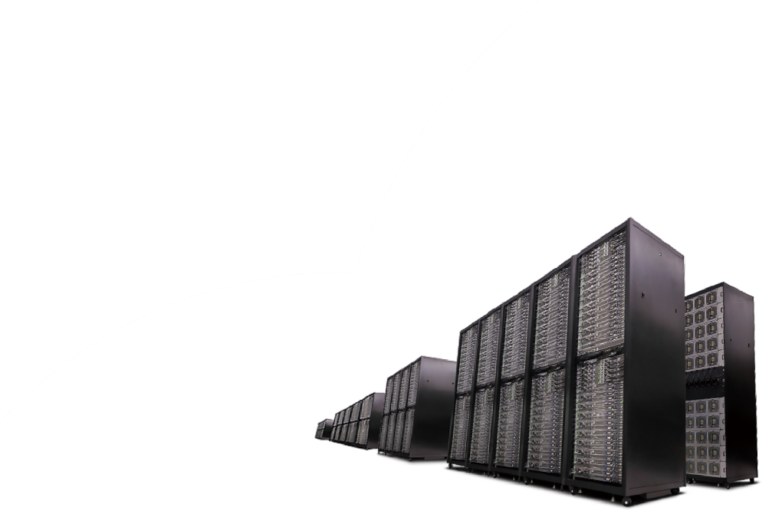
廣達 2015 營收
Datacenter
Servers
Storage
Switches
Rack Systems
台幣 1兆72億元
5
Notes:
But we do more than building great laptops. We started building datacenter products in 2000, and our datacenter products, including servers, storage, network switches, and integrated rack systems, already account for a large portion of Quanta’s business, and this portion is continuously getting bigger.

Slide 6
QCT 已是全球知名雲端資通服務及大型企業的伺服器供應商

Slide 7
A leading cloud datacenter
solution provider that delivers
Server, Storage, Networking,
Rack System and Cloud Solution
under a single, proven roof
Notes:
Our product lineup includes Servers, Storage, network Switches (3S), integrated rack systems and cloud solutions for datacenter customers. Traditionally, datacenter customers have had to buy each of these components from different venders, then integrate them to build the precise solution they need for their application workloads. We design, manufacture, integrate and optimize our solutions all under a single roof, making sure all devices are working together properly without compatibility issues.

Slide 8
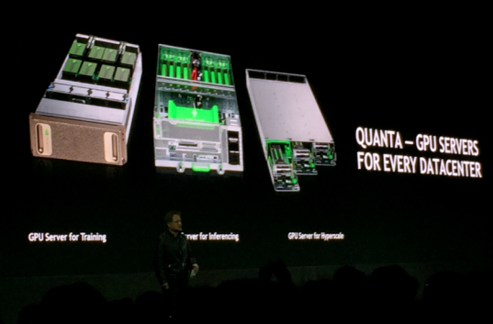
GTC 2016 - 廣達是 nVIDIA GTX-1 唯一製造商

Slide 9
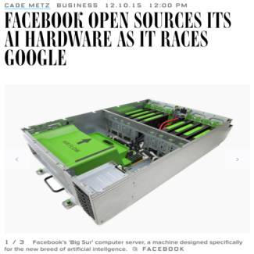
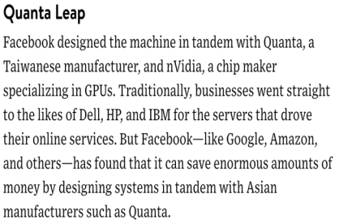
廣達是 Facebook Big Sur 唯一的供應商

Slide 10
廣達 Quanta vs. 雲達 QCT
雲達科技是廣達電腦獨資子公司
專注於為客戶提供資料中心產品及服務
VS.
Quanta – Quanta Computer Inc. 廣達電腦
QCT 母公司
專注於 ODM 業務
為雲達科技提供全方位後勤支援, 包括研發, 製造, 系統整合以及廣達全球供應鏈支援
總公司及研發總部設於桃園華亞園區, 在台員工超過 5000人
QCT – Quanta Cloud Technology 雲達科技
透過經銷體系為雲端服務業者提供品牌產品銷售, 包括伺服器, 儲存設備, 網路設備, 整合式系統機櫃以及雲端平台等解決方案
提供完整資料中心產品服務, 包括工程研發, 架構設計, 整合測試, 效能最佳化
10
Notes:
Strongly backed by its parent, Quanta Computer Inc., QCT differentiates itself as a full-scale datacenter product and service provider, all under one roof.
Quanta, Quanta Computer Inc., is the parent of QCT focusing on ODM business. Quanta provides a wide range of capabilities to QCT, including engineering, manufacturing, system and rack integration and supply chain support through the Quanta global network.
QCT, Quanta Cloud Technology, sells own-brand servers, storage, networking, integrated rack systems and cloud solutions to cloud service providers and large enterprises, and – through channel partners – to enterprises and SMBs.
QCT offers a full spectrum of datacenter products and services from engineering, configuration, integration, optimization to global supply chain support.
Who else in the market can provide such a complete datacenter product lineup and services under one roof?

Slide 11
雲達科技的願景 - 提供一站式服務的雲端產品方案
Cloud App Marketplace
Private Cloud
Hybrid Cloud
Public Cloud
IOT
HPC
VDI
NoSQL
Big Data
PaaS
ML
IaaS
OpenStack
Microsoft
VMware
SDN / NFV
SDS
Hypervisor / Container / Docker

Slide 12
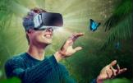
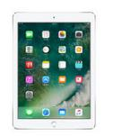
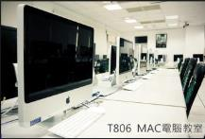
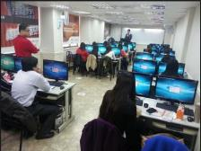
教學的演進
便利性
1990
2007
2017
2025

Slide 13
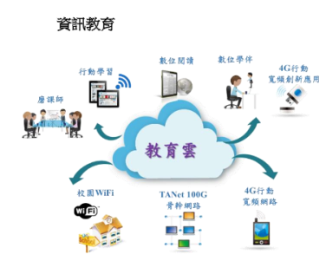
資訊教育現況與目的
資訊教育目標
均衡城鄉資訊環境基礎建設
樹立資訊教學典範
充實教學數位內容
提升教師網路資訊素養
資訊融入教學能力
Source:http://ws.moe.edu.tw/001/Upload/3/relfile/0/1158/be4a4419-6daa-487e-a993-8df0a9a73f2e.pdf

Slide 14
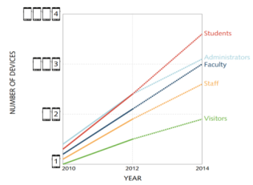
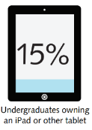
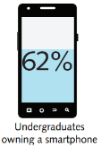
Higher Education Trend: BYOD
Average Number of Internet-Capable Devices Accessing Institutional Networks
Source: EDUCAUSE Center for Applied Research, The Consumerization of Technology and the Bring-Your-Own-Everything (BYOE) Era of Higher Education, March 2013
Notes:
One of the most prevalent issues for IT in higher education is the “bring your own device” or BYOD trend. As you can see from this chart published by EDUCAUSE, the trend not only affects students, but faculty and staff as well. From talking to CIOs at major higher ed institutions, on average, students are bringing 3 to 3 and a half connected devices to campus. In fact, one CIO I spoke with said that he didn’t look forward to the Christmas holiday break because when students returned to campus, they brought with them all of the new devices they received as gifts and expected IT to support them.

Slide 15
Key Challenges: Higher Ed BYOD
Device Technical Support:
High number of helpdesk calls
Difficulty printing from mobile devices
Incompatible Applications and Updates:
Inconsistent user experience
Need to install new applications and updates on devices
Ensuring Security:
Controlling access to sensitive information
Supporting Student Workstyles:
Limited resources to support extended computer lab hours
Computing Power:
Mobile devices and older computers have limited processing power
Notes:
So what does this mean for IT? First, they need to support these devices. The CIO I mentioned earlier had a large spike in helpdesk calls at the beginning of the school year as well as after the holiday break. Questions such as how do I connect my device to the network or how can I print from my device are common.
Another challenge for IT is being able to deliver the applications students need onto their devices. Depending on what device they’re using, they can have an inconsistent user experience.
Furthermore, once a device is connected to the network, IT has to ensure that students, faculty, and staff only have access to the content that they’re authorized for.
In addition, IT must support student workstyles. They want to use their own device but if there’s an application that is only available in a computer lab, IT has to provide support for that computer lab.
And finally, some devices don’t have the processing power to support today’s applications. For example, in Mechanical Engineering, a student might try to access a 3D graphics computer aided design application using a 5-year old laptop and not have a good user experience.

Slide 16
Key Challenges: Higher Ed BYOD
Device Technical Support:
High number of helpdesk calls
Difficulty printing from mobile devices
Incompatible Applications and Updates:
Inconsistent user experience
Need to install new applications and updates on devices
Ensuring Security:
Controlling access to sensitive information
Supporting Student Workstyles:
Limited resources to support extended computer lab hours
Computing Power:
Mobile devices and older computers have limited processing power
Notes:
So what does this mean for IT? First, they need to support these devices. The CIO I mentioned earlier had a large spike in helpdesk calls at the beginning of the school year as well as after the holiday break. Questions such as how do I connect my device to the network or how can I print from my device are common.
Another challenge for IT is being able to deliver the applications students need onto their devices. Depending on what device they’re using, they can have an inconsistent user experience.
Furthermore, once a device is connected to the network, IT has to ensure that students, faculty, and staff only have access to the content that they’re authorized for.
In addition, IT must support student workstyles. They want to use their own device but if there’s an application that is only available in a computer lab, IT has to provide support for that computer lab.
And finally, some devices don’t have the processing power to support today’s applications. For example, in Mechanical Engineering, a student might try to access a 3D graphics computer aided design application using a 5-year old laptop and not have a good user experience.

Slide 17
What if You Could:
Support access to apps and data from any device?
Offer a virtual 24 hour computer lab accessible at anytime?
Deliver the same user experience no matter if it's a 5-year old computer or the latest tablet?
Add or update applications during the school year and not have to wait until the next break?
Notes:
So what if you could solve these challenges?
What if you could enable access from any device?
What if you could keep your computer lab open 24 hours a day?
What if you could deliver the same user experience no matter what device is being used?
And what if teachers were free to add or update applications to their curriculum during the school year?

Slide 18
傳統個人PC維護管理遇到的挑戰

Slide 19
企業採用桌面虛擬化的主要驅動力
終端服務與保護的品質提升
架構上最佳化的終端資料洩漏保護與安全管理機制
用戶應用程式使用經驗的提升
行動化設備與各式終端設備的支援
內外部稽核法規的符合 終端軟硬體資產的掌握
IT人力專注於策略性專案及整體服務品質提升，而非瑣碎重複性工作
可被量化的成本節省
伺服器及終端設備延長年限使用
IT Help Desk與支援人力因虛擬化、桌面及應用程式標準化帶來的問題支援需求減少
用戶Downtime的大量減少 企業災備Downtime的降低
精簡終端設備帶來的電力減省
大量IT人力節省於傳統PC及應用程式的安裝配置作業 (Install/Move/Add/Change)

Slide 20
QCT VDI 系列解決方案及應用場景
VDI 工作負載的種類
應用場景
視覺設計
特殊效計
動畫
3D設計應用
QxVDI VMware Edition-3D
重度
圖像設計
醫學圖像
中羽量級繪圖應用
特殊影像計算需求
QxVDI | QxStack VMware Edition-HC
研究室(Lab)
大型辦公室
高效能運算應用(HPC)
High Density & Computing
高密度運算
QxVDI VMware Edition-OA
輕度工作量
電腦教室遠端辦公室| 分公司(ROBO)
電話服務處(Call Center)
辦公應用(OA System)
1. ROBO= Regional office and Branch office
2. OA System =Office Applications System

Slide 21
建置VDI的挑戰
什麼因素讓單位對於採用VDI猶豫不決
過度集中
IOPS 瓶頸
每一個使用者的成本過高

Slide 22
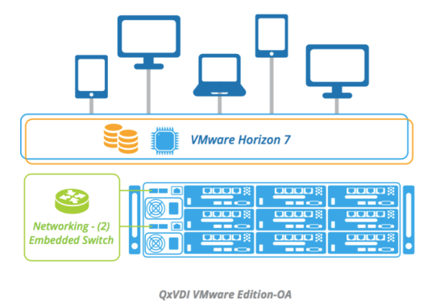
QxVDI VMware Edition-OA
Support up to 180 VDI users

Slide 23
全新高度整合 VDI 一體機| 簡化管理 超融和架構取代傳統架構
傳統(6U*)
QxVDI VMware Edition-OA
自行建置
自動部屬
Switch
Embedded Switch
Embedded Switch
Server
9 Nodes
Server
Server Node
Server Node
…
Server
Share Storage
VSAN
HDD
HDD
最高可承載180個使用者
檢疫彈性擴充
60分鐘內部署完成隨插即用
單一視窗，簡易管理
IT需針對多種類型的設備及多家廠商做管理, 增加維護營運的複雜度
* Base on 1P server and 100 VDI concurrent users

Slide 24
多節點實體隔離, 高可用性 | 分散風險
傳統架構
V.S.
QxVDI VMware Edition-OA
3 節點, 每一節點 33 個使用者
9 節點, 每一節點11 個使用者
3 x 33
9 x 11
+ 50%使用者
/每一個節點
+ 10%使用者/每一個節點

Slide 25
優化存儲環境 | 強化體驗
QxVDI VMware Edition-OA預先測試驗證及優化，將使用者分散至多個伺服器節點當中，使用本機磁碟，透過儲存虛擬化軟體組成叢集(Cluster)來當作分享空間，可有效提升每個用戶的IOPS並減少延遲(Latency)
VSAN技術 – 提高3至5倍IOPS
IOPS on 4K random write
傳統存儲
QxVDI VMware Edition-OA

Slide 26
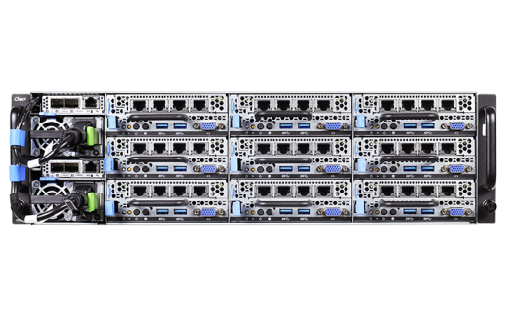
硬體架構及規格
(2) Embedded Switch Uplink
Infra Management
Virtual Desktop Distributed Storage
3U 9-Node, Per Node
CPU: (1) Intel® Xeon® processor
E3-1240 v5
Storage: (1) 200GB 2.5” SSD
(3) 1.2TB 2.5” HDD
Memory: (4) 16GB DDR4
NIC: (4) 1GbE

Slide 27
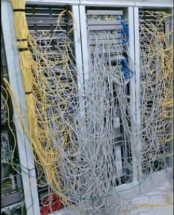
QxVDI VMware Edition-OA 內建交換器
聚合所有節點的流量
內建 2 組 L2 交換器。
2 @ two 10GbE SFP+ ports for uplink
大大簡化了佈線，切換的複雜性 (26:2)
降低傳統TOR Switch 管理所產生之
人力支出與資本資出
2* 10G SFP+ port via built-in switch

Slide 28
QxVDI | QxStack VMware Edition-HC
2U 4-Node 超融合架構
高效能桌面虛擬化解決方案

Slide 29
QCT VDI 系列解決方案及應用場景
VDI 工作負載的種類
應用場景
視覺設計
特殊效計
動畫
3D設計應用
重度
影像設計
QxVDI VMware Edition-3D
醫學圖像
中羽量級繪圖應用
特殊影像計算需求
QxVDI | QxStack VMware Edition-HC
研究室(Lab)
大型辦公室
高效能運算應用(HPC)
High Density & Computing
高密度運算
電腦教室遠端辦公室| 分公司(ROBO)
電話服務處(Call Center)
辦公應用(OA System)
QxVDIVMware Edition-OA
輕度工作量
1. ROBO= Regional office and Branch office
2. OA System =Office Applications System

Slide 30
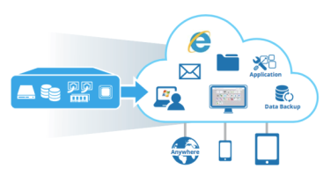
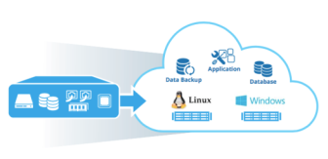
超融合式VDI 以及 SaaS 解決方案 | 簡易管理
QxVDI | QxStack VMware Edition-HC 為一高密度超融合式架構同時提供虛擬桌面(​​VDI)以及基礎設施及服務(IaaS)等工作負載，提供使用者快速建置以及簡易管理等效益。
QxVDI VMware Edition-HC
QxStack VMware Edition-HC
Notes:
3-> 5

Slide 31
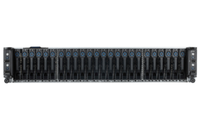
預先驗證以及測試 | 高可靠性
QCT 整合QuantaPlex T41S-2U伺服器以及企業級VMware軟體, 並預先驗證及測試其效能, QCT確保此解決方案為最佳配置且能運用於不同的工作負載。
Horizon
vSphere
vCenter
Virtual SAN
QCT QuantaPlex T41S-2U
Notes:
3-> 5

Slide 32
模組化架構| 無縫擴充 (Scale to Fit)
QxVDI |QxStack VMware Edition-HC為一模組化的超融合式架構, 每一個節點皆將運算與存儲打成一個資源池。當資源不足需要擴增時, 能隨著需求的增減無縫擴充。
最高可承載 1200 VDI users
最高可乘載 800 VM
最高可承載 600 VDI users
最高可乘載 400 VM
最高可承載 300 VDI users
最高可乘載 200 VM

Slide 33
預載虛擬化系統 | 快速布屬
透過預載QCT Auto Deployment Manager 與VMware Horizo​​n軟體, QxVDI | QxStack VMware Edition-HC 提供簡易快速布屬建置虛擬桌面(​​VDI)以及基礎設施與服務(IaaS)等不同工作負載應用，能在60分鐘將環境建置起來，替用戶減少建置時的複雜度以及人力上支出的成本。
5 mins
35 mins
60 mins
Deploy VSAN / VDI
Deploy 4X ESXi
Deploy VCSA

Slide 34
QxVDI | QxStack VMware Edition-HC 規格
QxVDI | QxStack VMware Edition-HC 規格
 | QxVDI VMware Edition-HC | QxStack VMware Edition-HC
HW Per node | CPU: (2) Intel® Xeon® Processor E5-2600 v4 family | CPU: (2) Intel® Xeon® Processor E5-2600 v4 family
 | RAM: (16) 16GB DDR 4 | RAM: (16) 16GB | 32GB DDR 4
 | HDD: (5) 1.2TB | HDD: (5) 1.2TB | 2TB
 | SSD: (1) 400GB | SSD: (1) 400GB | 800GB
 | SATADOM: (1) 32GB | SATADOM: (1) 32GB
 | NIC: (2) 10G SFP+ | RJ45 | NIC: (2) 10G SFP+ | RJ45
SW | 1. VMware Horizon 7 (200 VDI users/ per appliance- 2vCPU 4GB RAM) (300 VDI users/ per appliance- 2vCPU 2GB RAM) | 1. VMware vSphere Enterprise Plus+ vCenter Standard+ Virtual SAN Standard (100 VM/ per appliance- 4vCPU 8GB RAM) (200 VM/ per appliance- 4vCPU 8GB RAM)
 | 2. QCT Auto Deployment Manager | 2. QCT Auto Deployment Manager

Slide 35
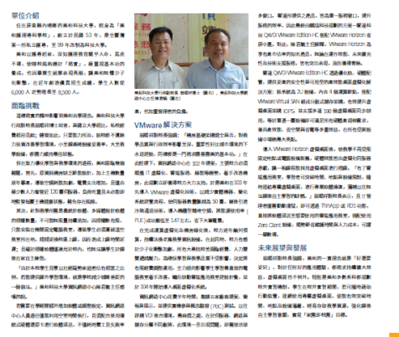
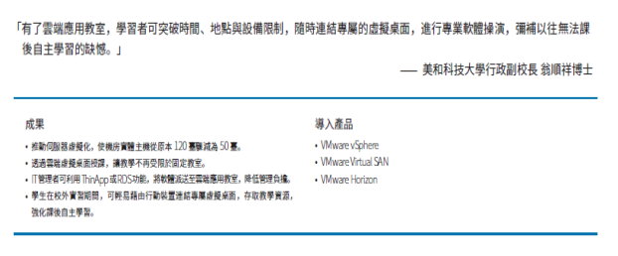
成功案例-美和科大

Slide 36
QxVDI VMware Edition-3D

Slide 37
QCT VDI 系列解決方案及應用場景
VDI 工作負載的種類
應用場景
視覺設計
特殊效計
動畫
3D設計應用
重度
圖像設計
QxVDI VMware Edition-3D
醫學圖像
中羽量級繪圖應用
特殊影像計算需求
QxVDI | QxStack VMware Edition-HC
研究室(Lab)
大型辦公室
高效能運算應用(HPC)
High Density & Computing
高密度運算
QxVDIVMware Edition-OA
輕度工作量
電腦教室遠端辦公室| 分公司(ROBO)
電話服務處(Call Center)
辦公應用(OA System)
1. ROBO= Regional office and Branch office
2. OA System =Office Applications System

Slide 38
3D相關應用程式之應用
nVIDIA
使用VMware Horizon 7，可以實現3D設計應用程式VDI環境具有良好的用戶體驗
Must have
3D ENGINEERING & DESIGN APPS
PLM & VOLUME DESIGN
Nice to have
OFFICE PRODUCTIVITY
MEDICAL RECORDS

Slide 39
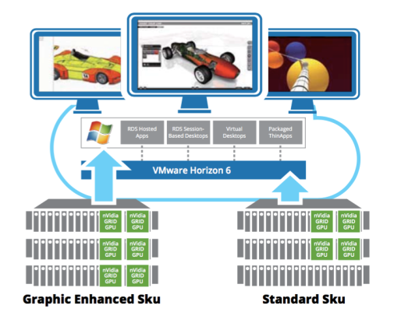
QxVDI VMware Edition-3D 高繪圖效能的超融合架構解決方案
7

Slide 40
QxVDI VMware Edition- 3D Solution Spec
Compute Node
Storage Node
QxVDI 3D Specification
 | Graphic Enhanced | Standard
HW per node | 3 Compute Servers | 2 Compute servers + 1 Storage server
 | CPU: (2) Intel® Xeon® Processor E5-2667 v3/v4 | Compute CPU: (2) Intel® Xeon® Processor E5-2667 v3/v4 Storage CPU: (2) Intel® Xeon® Processor E5-2620 v3/v4
 | RAM: (16) 16GB DDR4 | RAM: (16) 16GB DDR4
 | HDD: (3) 2TB | HDD: (3) 2TB
 | SSD: (1) 800GB | SSD: (1) 800GB
 | NIC: (2) 10G RJ45 | NIC: (2) 10G RJ45
 | Power: (2) 1600W | Power: (2) 1600W (Compute Node ) (2) 700 W (Storage Node)
 | GPU card: (6) nVidia GRID Card - M60 | GPU card: (4) nVidia GRID Card- M60
SW | VMware Horizon 7 | VMware Horizon 7

Slide 41
QuantaGrid D51PH-1ULH
1U Hybrid Scale-out High Computing Storage Server
Worldwide 1st Intel® Xeon® E5 v4 1U x12HDD H/S Storage Server
靈活的混合儲存平台
擴充式的建構環境
支援熱抽換
OpenStack , Swift & Ceph
Object Storage
Scale-out SDS
Enterprise Computing

Slide 42
雲達科技桌面虛擬化解決方案
效益與特色
高度整合一體機，簡化管理
最佳化儲存環境，強化體驗
多節點實體隔離，分散風險
模組化完美設計，彈性擴充
預載虛擬化系統，開箱即用
熱抽換故障節點，維修容易

Slide 43
ANY Applications
ANY Devices
教學軟體平台
ERP/Workflow簽核系統
CAD/CAM繪圖平臺
財務系統
兩岸三地應用服務
其他各式應用服務
精簡型電腦
一般電腦/筆電
訓練教室設備
行動裝置：手機/平板
One Cloud
透過虛擬桌面存取
QCT
QxVDI
透過瀏覽器存取
Socialcast
透過打包APP存取
365
Source: VMware
Notes:
[Sanjay] Let me define what VMware means by any app, any device…
Heterogeneity and choice define our approach.
Any App: Desktop (physical and remoted), Web and Mobile (Cloud-Native)
Any Device: Any operating system (iOS, MSFT/Windows 10, Android) – and any end point: phones, tablets, desktops, laptops across every manufacturer

Slide 44
謝謝指教

