Slide 1
Open Networking and SDN
PoWen, Tsai
Jan 2017

Slide 2

Who am I
PoWen Tsai
  3 years Open Networking business experience in Edgecore
  Support Open Networking Business
      Pre-sales / Solution Planning
      Support NOS porting
      Post-sales technical support / RMA

Slide 3

Mega Scale Operators (Facebook) DRIVING Industry Change
Open Networking
DISSAGREGATION
AUTOMATION
STANDARD DESIGNS
VIRTUALIZATION
FLEXIBILITY
Open Hardware
Software Control

Slide 4

Open Compute Project (OCP)

Slide 5



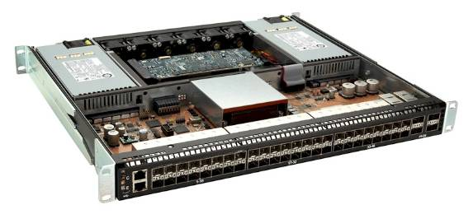
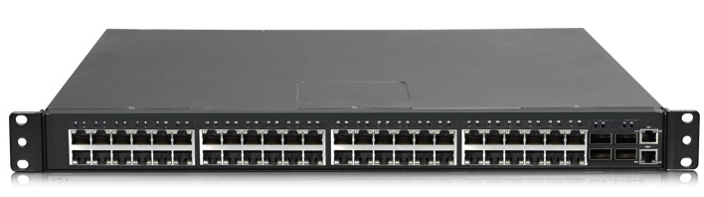
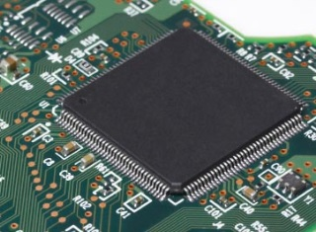
What’s inside a switch?
Control/Management Software
Network OS
Hardware Driver
Mechanical Box
Silicon

Slide 6
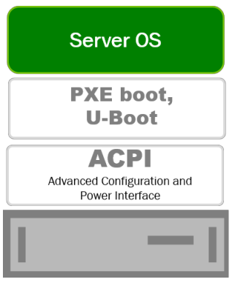
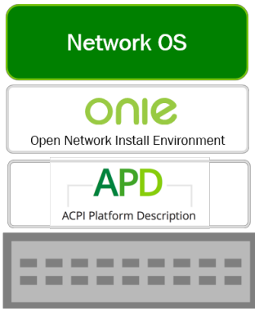
Managing Switch as in Server way
Customer Choice
Any OS on
Any Platform
Server
Switch

Slide 7


How to provision Bare Metal Switch like Server
Similar approach to installing OS on server
  BIOS + PXE → U-Boot + ONIE (Open Network Install Environment)
  Supported hardware (HCL) preloaded with ONIE
  ONIE available on GitHub
    http://onie.github.io/onie/
app
app
app
app
app
app
operating system
operating system
BIOS and PXE
U-Boot and ONIE
bare metal server
bare metal switch
Notes:
Just like BIOS and PXE allows you to install an OS on a server using a remote image, the combination of U-Boot and ONIE allows that for bare metal switches.
We require ONIE preloaded on HCL because U-Boot is different across vendor devices, and U-Boot itself is not very user friendly.
We created ONIE and gave it to the Open Compute Project (OCP); it facilitates easy network OS installation of not just Cumulus Linux (Big Switch’s Switch Light OS is an example). Now you have your choice of installing whatever OS you want, not just what comes with the switch (e.g. Cisco IOS– OEM example, or FASTPATH– Broadcom’s OS).
Think of ONIE as PXE on steroids. ONIE is a small BusyBox Linux distribution, with a bunch of fetch and execution Bash scripts. It leverages modern ways of discovering networks using what was built into Linux—e.g., IPv6 neighbor discovery, DHCPv6, DHCPv4.
U-Boot is very good at probing the bus. U-Boot takes about 1MB. It has boot flash that’s dedicated to booting the hardware, separate from the Operating System flash. ONIE is a way to build on top of this. Takes about 3.5 MB.
ONIE is extremely well documented and flexible, and embraced by the open source community. (Source is on GitHub since summer 2013).

Slide 8

Switch, Component Ecosystem and OCP Bare Metal
Mgmt
Software
Single
Vendor
Closed
Product
“Black Box”
Single
Vendor
Closed
Product
SDN Applications
Open Source
Networking Stack
/NOS /
Control Plane Management Plane
Network OS
Drivers
ODM Box
Vendor
Box /
Mechanical
ODM Chip
ODM Box
Silicon
Legacy Networking
(Past)
Traditional Networking
(Today)
ODM Chip
Bare Metal
(Tomorrow)

Slide 9



Open Networking Software Ecosystem with Edgecore - Commercial NOS options
Cumulus Networks Cumulus Linux
  Linux NOS at web-scale with configuration, provisioning & monitoring tools
Big Switch Networks SwitchLight
  Big Monitoring Fabric and Big Cloud Fabric via centralized controller
Pica8 PicOS
  Hybrid Networking: OpenFlow 1.3/1.4 agent, with native L2 and L3 features
IP Infusion OcNOS
  Full function L2/L3 with MPLS/VPLS, Carrier Ethernet. OAM and telecom features

Slide 10





Open Networking Software Ecosystem with Edgecore
Open Source Software options
OpenSwitch
  Full function, open-source NOS
  Introduced October 2015 by HP with Accton as charter member; now under Linux Foundation
SnapRoute FlexSwitch
  L2 and L3 protocol suite, with comprehensive configuration APIs, automation and orchestration
  OCP Accepted
Open Network Linux
  OCP reference OS for switches
  Forwarding Agents: OF-DPA & Indigo OF Agent, SAI, OpenNSL, FBOSS Agent, Quagga Routing
Open Network Foundation Atrium SDN Distribution (CORD use case)
  OpenFlow physical (ONL with OF-DPA) and virtual switches
  ONOS open-source OpenFlow controller, with BGP application based on Quagga
Open Compute Project
  ONIE: Universal NOS Loader
  Switch Abstraction Interface (SAI): standard HAL for silicon from multiple vendors
  Open Optical Monitoring API
Software for Open Networking in the Cloud (SONiC)
  Network OS components, including full function L3 routing
  Contributed by Microsoft and co-contributors to OCP
SONiC

Slide 11
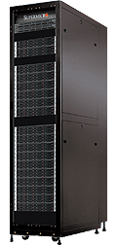
CORD Architecture
Residential
Mobile
Enterprise
XOS (Orchestrator)
vOLT
Control
Multicast
Control
Overlay
Control
Underlay Control
vRouter
Control
ONOS Controller Cluster
CORD-Fabric
Open Source
SDN-based
CLOS Networking
6712-32X
6712-32X
6712-32X
6712-32X
Underlay
6712-32X
6712-32X
6712-32X
6712-32X
6712-32X
6712-32X
Metro
Router
6712-32X
6712-32X
6712-32X
6712-32X
6712-32X
6712-32X
Overlay
OVS
OVS
OVS
OVS
OVS
R,E,M-Access
vSG
VNF
VNF
VNF
VNF
vSG
VNF
VNF
VNF
VNF
vSG
VNF
VNF
VNF
VNF

Slide 12

Freedom
Control
Innovation
Open Networking
from

